Slide 1
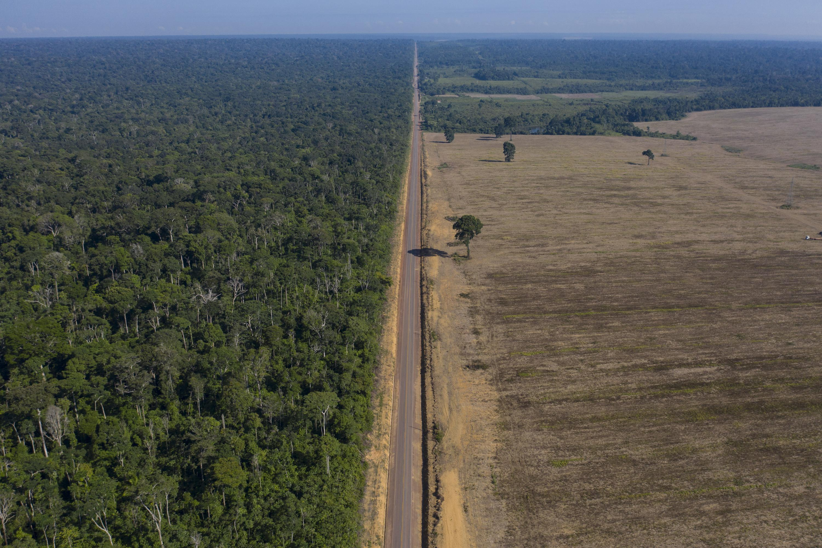

A Globally Relevant Data-driven Assessment of Carbon Leakage from Forestry
Dr. Adam Daigneault
University of Maine
School of Forest Resources
2026 Forest & Agriculture Modeling Forum
April 15, 2026

Slide 2




What is Leakage?
Carbon Project Boundary
Project to reduce harvesting increases carbon
Someone else responds by increasing harvests
Carbon elsewhere declines
In economics, leakage is a classic spillover, where an economic or policy driver in one market or location creates an unintended consequence in another market or location because of market interactions (e.g., shifts in supply and/or demand for inputs or outputs).

Slide 3

What is Leakage?
Carbon Project Boundary
Someone else responds by increasing harvests
Project to reduce harvesting increases carbon
Someone else responds by increasing forests
Total Forest Carbon Change
+
+
=
Leakage

Slide 4
What is Leakage?
Boundary
Carbon Project Boundary
Someone else responds by increasing harvests
Project to reduce harvesting increases carbon
Someone else responds by increasing forests
Three key points about leakage:
An economic phenomenon.
Can have both negative and positive effect.
The boundary set for the problem matters.
Total Forest Carbon Change
+
+
=
Leakage

Slide 5
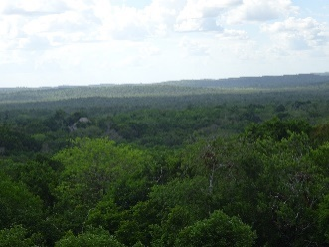
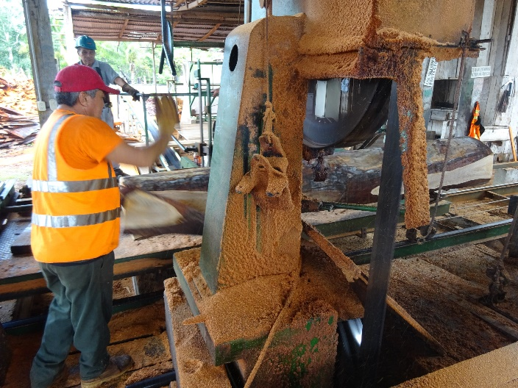
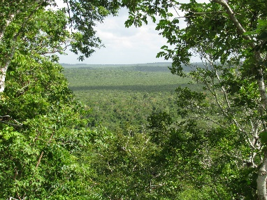
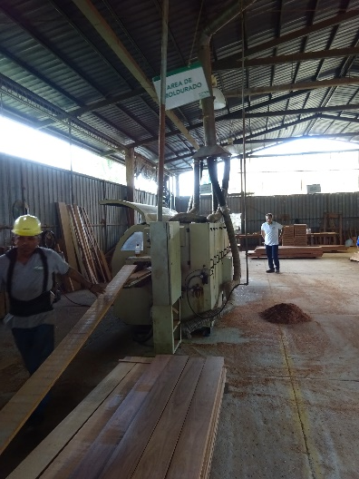

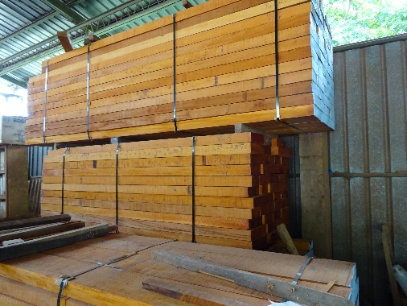
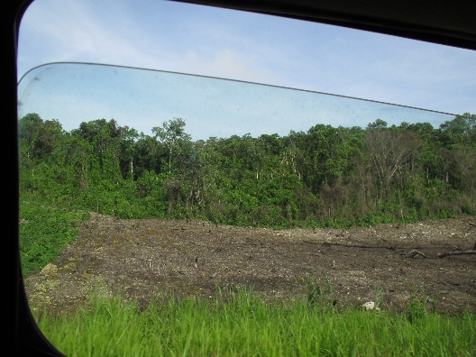
How does leakage happen?
Direct displacement
Market displacement

Slide 6
Some points on leakage in “no harvest” case
Leakage can only happen if at some point, the tree harvested would not have been harvested that period.
  Otherwise, loggers, traders, and mill owners are just trading trees that would have been harvested anyways.
No tree is free: If a tree taken off the market leads to an actual increase in harvest elsewhere → prices went up.
Leakage often implies taking a tree from a future harvest.
A price increase leads to new investments as well.

Slide 7
To evaluate leakage, we should…
Account for space ➔ including more forests is better.
Account for costs ➔ no forest is free to harvest, especially one that was not intended to be harvested.
  Marginal opportunity costs
  Marginal harvesting costs
  Marginal access costs
  Marginal transportation costs
Account for time
  Moving forests across time is costly
  Some leakage happens further in the future because prices have increased.
  Some leakage, or reduction in leakage, happens because people invest in forests.

Slide 8
Range of leakage estimates (Pan et al., 2020)
Mean Carbon Leakage
References
Notes:
Mean leakage rate = 40%.

Slide 9

How to Estimate Global and Regional Leakage: Global Timber Model
Comprehensive Coverage: 200+ forest types across 16 regions.
Diverse Forest Attributes: Each forest type is defined by yield curve, age class distribution, management and harvest costs, land rental, etc.
Planning Foresight: Forward looking “agents”
Long Run Perspective: Modeled 200+ year horizon

Slide 10
GTM IFM / CSF Leakage Scenarios
2 ‘project type’ Improved Forest Management / Climate Smart Forestry scenarios run across various forest biomes:
Extended rotation (i.e., deferred harvests). Increase in rotation length, implemented via changing the optimum harvest age of harvest for a given forest type (e.g., US Southern Pine) by 10 years.
Forest set-asides (i.e., permanent conservation). Decrease the total area of forest available for management and harvest via reducing the ‘accessible’ forest acreage
Implementation rates: 2-50% of eligible forest type forest area
Enrollment from 2020-2100+
Measure over 20 to 80-year timeframes

Slide 11
No Forest Carbon Policy – Global Baseline
Year | Forest Area (Mha) | Annual Forest C Flux (MtC/yr) | Annual Timber Harvest (Mm3/yr) | Roundwood Price ($/m3)
Annual Change | -1.2 | -8.4 | 11 | 0.45
Annual Change (%) | -0.03% | 1.70% | 0.40% | 0.40%

Slide 12
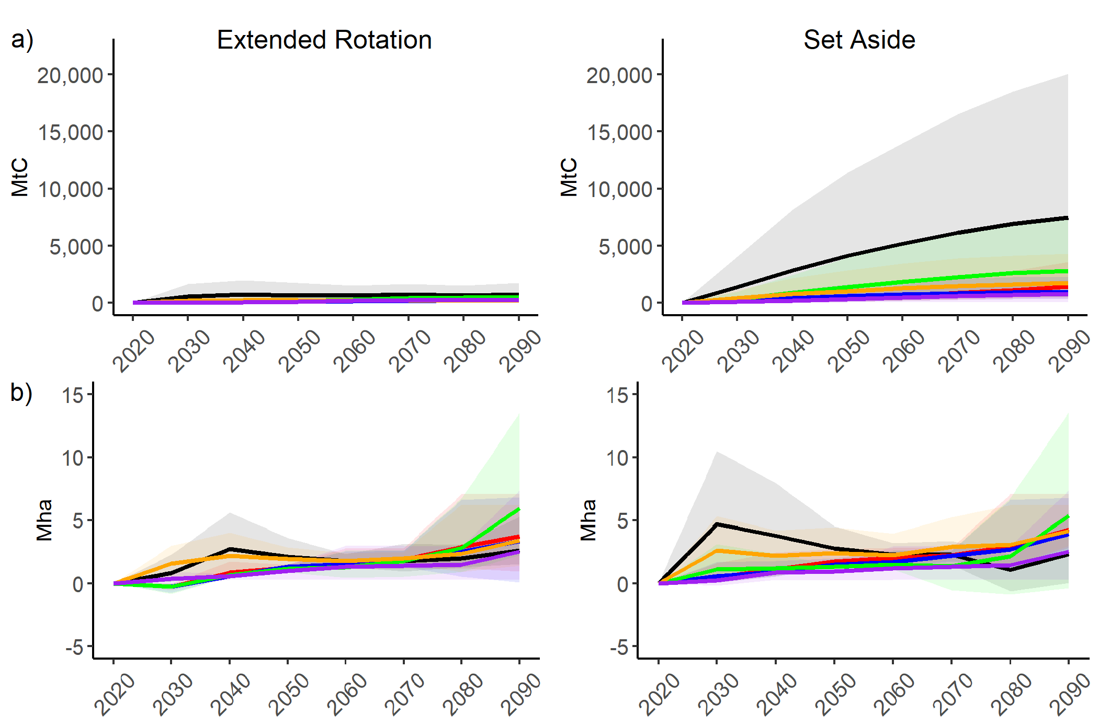


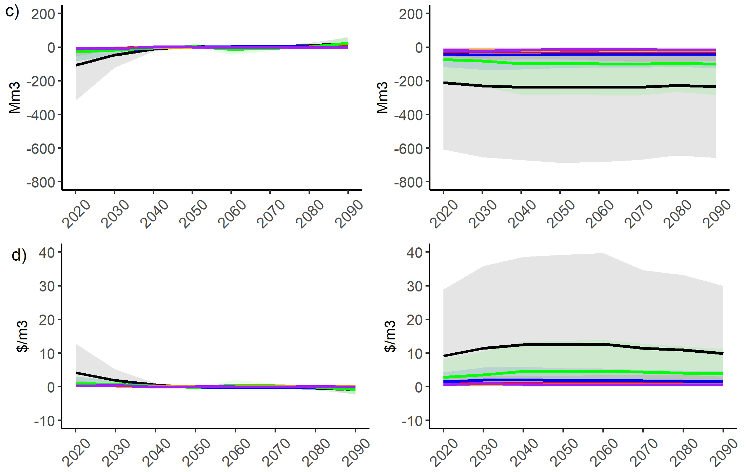
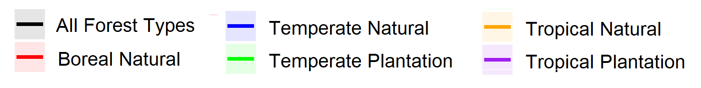
Forest Carbon Policy Scenario Impacts:
Change from Baseline
Carbon Stocks
Timber Harvest
Forest Area
Roundwood Price

Slide 13
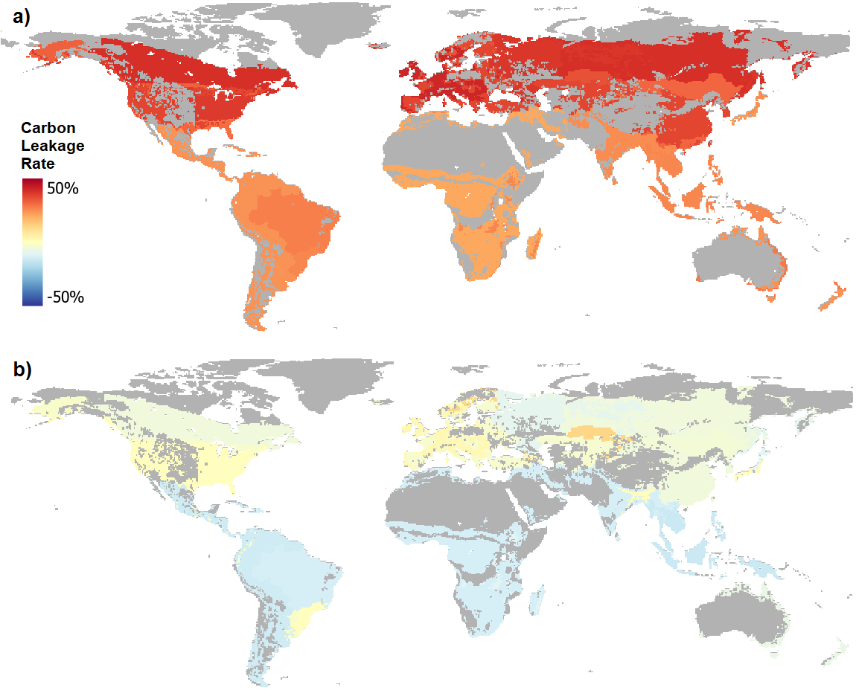
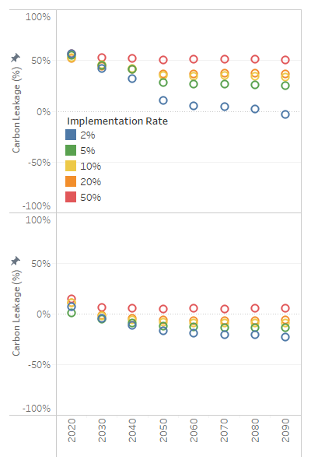
Global Carbon Leakage
Mean = 37%
Min = -4%
Max = 56%
Mean estimated carbon leakage rate for “all forests” scenario by forest type for 10% implementation rate
Mean = -5%
Min = -23%
Max = 15%
Notes:
For the case where all forest types across the globe can enroll in the carbon project:
Extended rotation - forest carbon leakage averages +50% for the first couple of decades after the program commences. Long-term estimates diverge depending on the implementation rate, with more enrollment resulting in larger carbon leakage rates (+32% to +50%). Lower implementation rates are estimated to result in long run carbon leakage of about -5% to +25%. The 20-year leakage rates when all forests are eligible for set aside projects ranges from -11% to +15%, with more leakage occurring with higher implementation rates.
Set aside leakage declines slightly over time and is only positive (+7%) 50-years after enrollment for the 50% implementation rate scenario.
Carbon leakage increases with enrollment area. For example, 2% enrollment results in a -20% leakage rate in 2080, while 20% enrollment yields -7%. Investing in forest set aside projects at the global scale will likely result in negative leakage or overall greater carbon stocks than the baseline (i.e., a positive spillover effect). One reason behind this finding is the dynamic adjustment of forest managers in response to current and anticipated shocks. That is, even if some forests enrolled as a set aside in 2020 are not economically mature and thus could not be harvested until later in the century, because all enrollment occurs in 2020, the early signal gives other landowners time to adjust their management and harvest schedule to meet both current and future timber demands.

Slide 14
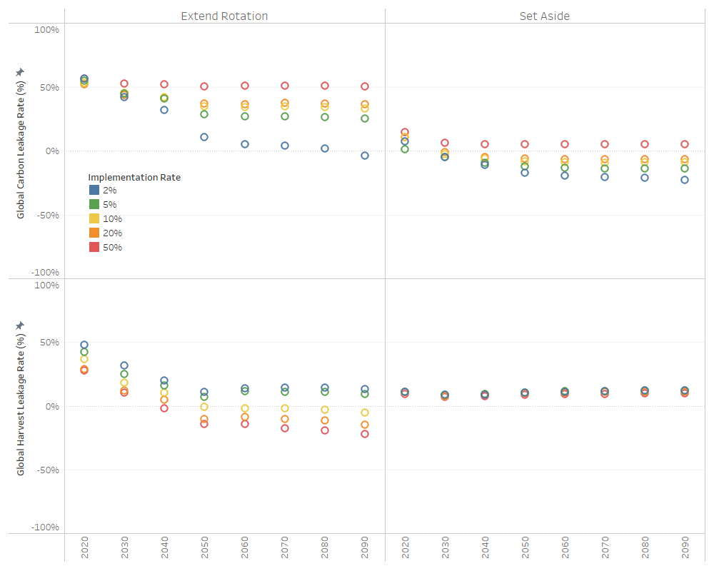
Global Carbon vs. Harvest Leakage
Leakage Estimates Summary Stats
(All implementation rates)
Scenario | Metric | Carbon Leakage | Harvest Leakage
Extend Rotation | Mean | 37% | 7%
 | Min | -4% | -22%
 | Max | 56% | 48%
Set Aside | Mean | -5% | 10%
 | Min | -23% | 7%
 | Max | 15% | 12%
Carbon Leakage
Carbon v. Harvest Leakage Correlation
Harvest Leakage
Scenario | 2% | 5% | 10% | 20% | 50%
Extend Rot. | 0.92 | 0.94 | 0.99 | 0.99 | 0.94
Set Aside | -0.45 | -0.50 | -0.37 | 0.06 | 0.06
Notes:
Extended rotation harvest leakage estimates for the ‘all forest’ scenarios are +30 to +50% for the early decades, declining to -10% to +10% when estimates in the second half of the century after the sector adjusts to the new harvest schedules.
For set aside projects, harvest leakage estimates are consistent across implementation rates and time, averaging about +10%. The relatively low and constant rates are attributable to the immediate but persistent shock because of eliminating harvests from some accessible forestland that incentivizes immediate shifts to productive forests that can efficiently meet timber demand.

Slide 15
Set Aside Sensitivity Analysis
Carbon leakage sensitivity: -14% to +11% across parameter adjustments
Inelastic price elasticity: -14% → price effects encourages investment
Inaccessible forest access costs: -5% to +11% → high variation in specific forest carbon content
Lower forest yields: -10%
Higher forest yields: +6%
Lower land supply elasticity: -3%
Global mean leakage rate estimates from sensitivity analysis of key GTM parameters and assumptions for “All Forest Type, Set Asides, 10% Implementation Rate” scenario.

Slide 16
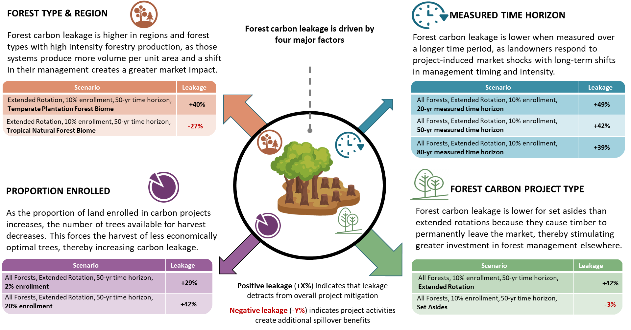

Slide 17
Discussion
GTM forward-looking optimization model, rational agents
  Early adjustments in anticipation of future conditions
Model responds to harvest reductions via mix of intensification (e.g., improved management) and extensification (i.e., afforestation)
  Changes in areas already heavily forested w/existing infrastructure
What is the ‘right’ leakage policy scenario to model?
  Forests across the globe have potential to enroll → ‘all forests’
  Start with lower implementation but then ramp up over time?

Slide 18

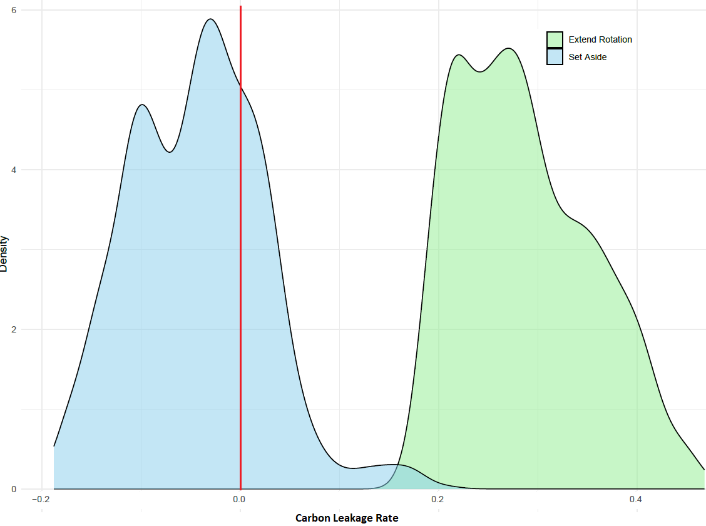
Pan et al (2020) Carbon Leakage Meta Analysis
GTM Leakage Study Estimates
Scenario | Metric | Global C Leakage
Extend Rotation | Mean | 37%
 | Min | -4%
 | Max | 56%
Set Aside | Mean | -5%
 | Min | -23%
 | Max | 15%
Extend Rotation
Set Aside
This Study (All Forest Scenario)
-20%
0%
20%
40%

Slide 19
Leakage Estimation Summary
Leakage rates highly variable across projects and implementation rates
  Many instances of ‘negative’ leakage → positive spillovers
  Higher implementation → larger market signal and response to harvest/price shocks
Leakage rates often decline over time-length of measurement
  Non-project forests can ‘mitigate’ leakage impacts, but takes time
Set asides have lower leakage rates than deferred harvests → higher price change drives more investment in management of non-project forests
  Mix of intensive and extensive actions
Carbon and harvest leakage rates are not the same
  We should not combine for project leakage deduction

Slide 20
What the ‘Right’ Rate for Global Carbon Leakage?
‘Current’ forest carbon project implementation and coverage:
Extended rotation: +15% to +35%
Set asides: -5% to +5%
Optimistic about global forest carbon market growth and coverage:
Extended rotation: +35% to +40%
Set asides: -5% to 0%

Slide 21
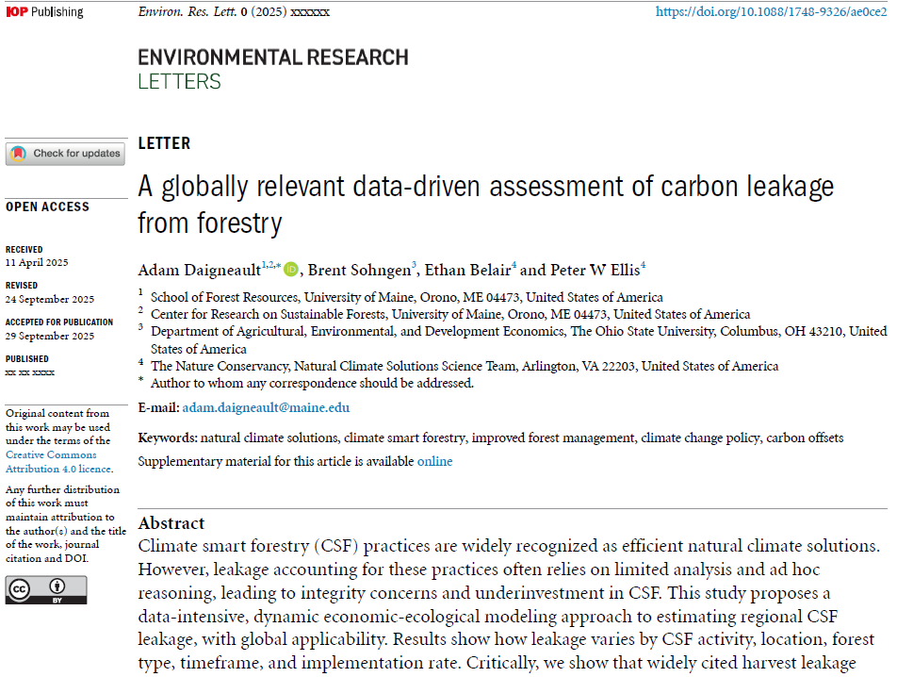




Want to learn more?
Daigneault, A., Sohngen, B., Belair, E., Ellis, P. (2025). “A globally relevant data-driven assessment of carbon leakage from forestry.” Environmental Research Letters.
Journal Article: https://iopscience.iop.org/article/10.1088/1748-9326/ae0ce2
Data & Model: https://github.com/AdamDaigneault/GTM_Leakage

Slide 22

Contact Details
Dr. Adam Daigneault
E.L. Giddings Assoc. Prof. of Forest Policy & Economics and Director
University of Maine
School of Forest Resources
adam.daigneault@maine.edu

