Slide 1
Modeling the Global Potential and Costs of Forest Carbon Sequestration Using Dynamic Economic Analysis
Alice Favero
April 15, 2026
Forum
Notes:
Good afternoon everyone. It’s a pleasure to be here at the Forum.
Today I’ll present a set of studies using the Global Timber Model (GTM) to assess forest-based mitigation potential and its associated costs, both at the global scale and with a specific focus on the United States.”

Slide 2
Context
Forests are central to mitigation pathways
  Preserving and enhancing forest carbon is essential for limiting warming to 1.5°C
  IPCC (2022) estimates AFOLU mitigation potential at 8–14 Gt CO₂/yr through 2050
FAO 2025 evidence confirms forests as net carbon sinks
  Global forests removed 3.6 Gt CO₂/yr (2021–2025)
  Deforestation emissions (2.8 Gt CO₂/yr), forests remained a net sink of −0.8 Gt CO₂/yr
Forests are embedded in national climate targets (UNDP, 2025)
  97% of NDCs include LULUCF
  75% include LULUCF in economy-wide targets, 68% explicit LULUCF targets
Notes:
First, let’s contextualize the role of forest carbon sequestration from both a research and a policy perspective.
Forests are central to global mitigation pathways with Both the IPCC and other global studies rely heavily on natural carbon sequestration from forests to meet temperature targets.
For example, the IPCC estimates mitigation potential in the AFOLU sector at 8 to 14 gigatons of CO₂ per year through 2050.
In terms of the current status, forests remain a net carbon sink. According to the FAO, global forests removed about 3.6 gigatons of CO₂ per year between 2021 and 2025. Despite emissions from deforestation of roughly 2.8 gigatons of CO₂ per year, forests still acted as a net sink of about 0.8 gigatons of CO₂ annually. This is, of course, far below the 8 to 14 gigatons needed.
Finally, from a policy standpoint, countries have clearly recognized the role of forests in climate mitigation. Forests are included in national climate commitments: 97 percent of NDCs include the LULUCF sector, 75 percent include LULUCF in economy-wide targets, and 68 percent specify explicit LULUCF targets.

Slide 3

Motivation
Strengthen net-zero planning by providing country-level data on forest mitigation potential and costs
Equip countries with actionable insights on forest-based carbon removal options
Clarify costs and opportunities to support domestic climate strategies (e.g., NDCs)
Bridge the gap between ambition and implementation with robust, evidence-based information
Notes:
In this context, This work originated from two different needs. The first was to provide country-level information on forest mitigation opportunities to support other studies and models developing comprehensive net-zero pathway assessments. These assessments examined mitigation options across all sectors.
The second need was to inform countries themselves about the costs and natural carbon removal options from forests available in the short and long term, helping them better understand the opportunities available for their NDCs.

Slide 4
Key Results
1. Mitigation vs Targets
Investment scenarios: Low / Medium / High
Benchmarks:
  2030 regional NDCs
  2050 U.S. carbon flux
  → Gap to targets
2. $ vs Mitigation
Investment ($) → Abatement (tCO₂)
Increasing costs for additional mitigation
→ Diminishing returns
3. Cost-Effectiveness
Marginal Abatement Cost Curves (MACCs)
Forest sector, country-level (2050)
→ Low vs high-cost opportunities
Notes:
“Now that I’ve outlined the motivation, let me walk you through what I’ll cover today. I’ll be presenting a set of key results from multiple studies using the GTM framework, with a focus on two main themes.
First, I’ll compare expected mitigation outcomes under different levels of investment against policy-relevant targets. Specifically, I’ll look at how these investments align with 2030 regional NDCs, as well as the US longer-term strategy. This helps us understand not just what’s possible, but how far different investment pathways can take us toward those benchmarks.
Second, I’ll examine the relationship between the dollar value of investments and the mitigation potential they generate. To make this more concrete, I’ll present marginal abatement cost curves for forest-based mitigation at the country level in 2050. These curves highlight the cost-effectiveness of different opportunities and show how mitigation supply evolves as costs increase.
Together, these results aim to provide a clearer picture of both the scale and efficiency of forest-based climate mitigation under different investment scenarios.”---

Slide 5
Methodology : Economic Model GTM
Global Timber Model (GTM): Partial equilibrium model of the global forestry sector
Integrated framework: Economic behavior, land-use competition, and biophysical forest dynamics
Forward-looking optimization: Maximizes the NPV of global forestry sector welfare
Global scope: 16 regions, >200 forest types; 150-year horizon in 10-year steps
  Regions connected through global timber markets
Endogenous Decisions: Optimal harvest timing, land-use allocation, and forest management levels
  3 Management Types: natural, naturally regenerated, and high-intensity (plantation)
Policy analysis: Evaluates forest and climate policies and demand changes
  Carbon accounting: Tracks carbon in biomass, soils, harvested wood products, and slash
Notes:
These results are all based on runs from Global Timber Model, or GTM, which is a well-recognized partial equilibrium model of the global forestry sector.
GTM integrates economic behavior, land-use competition, and biophysical forest dynamics to project future forest outcomes under changing socio-economic conditions, climate dynamics, and policy scenarios.
GTM is a forward-looking intertemporal optimization model. It maximizes the net present value of total welfare in the forestry sector, defined as the sum of consumer and producer surplus, by endogenously choosing optimal harvesting ages, land-use allocation, and forest investment decisions over time.
Spatially, the model covers 16 global regions and over 200 forest types. Some countries are modelled individually like the US, Brazil, Canada while others are modelled like region such as central America, SouthEast Asia,
Temporally, it spans 150 years, solved in 10-year intervals starting in 2025, with all periods solved simultaneously to reflect forward-looking landowner behavior.
Forests within and across 16 global macro-regions are linked through integrated timber markets. This means that timber prices, forest management choices, land conversion decisions, are all jointly determined across regions. The model operates under an idealized framework with perfect competition and well-defined property rights.
One of the main strengths of GTM is that it allows for a system-wide assessment of the forestry sector. It captures multiple ecosystem services and goods, including timber supply and carbon sequestration, within a single consistent framework.
As I said, GTM is well suited for policy analysis. It can evaluate the impacts of specific forest or climate policies, as well as changes in demand, across both time and space. Because the model is forward-looking, future demand expectations affect today’s investment decisions, and actions taken in one region influence land use and investment outcomes in all other regions through global markets.
Finally, GTM includes a detailed carbon accounting framework, tracking carbon across four pools: biomass, soils, harvested wood products, and slash, which allows us to consistently evaluate the climate implications of forest management and land-use change.

Slide 6
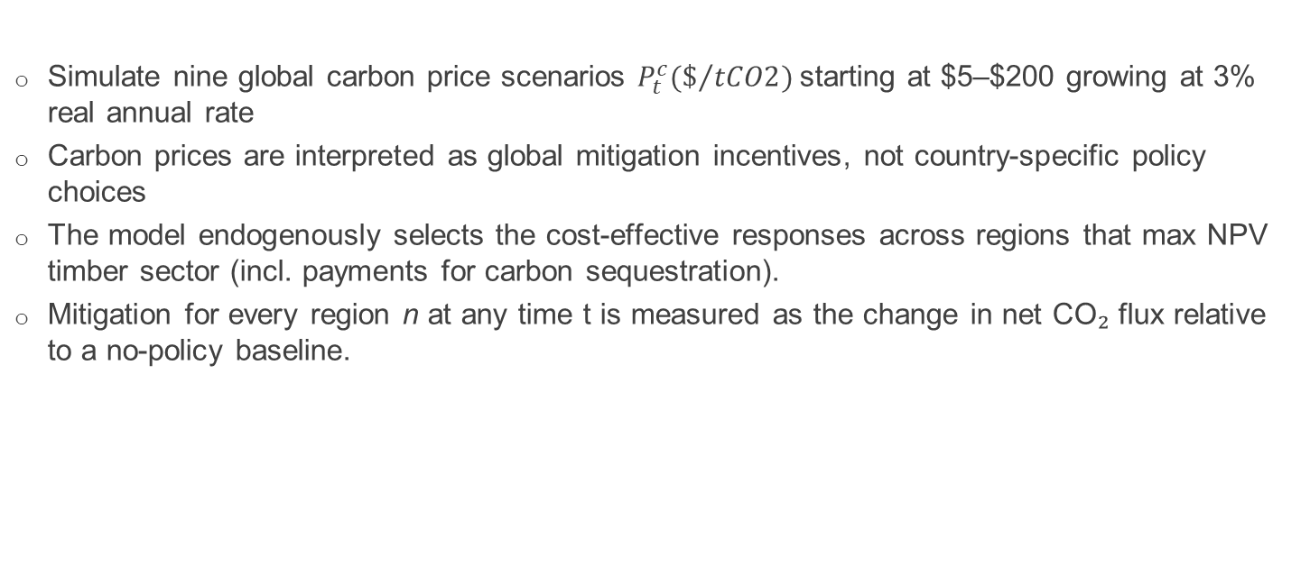
Scenarios
Simulate nine global carbon price scenarios $P_{t}^{c}(\$/{tCO2})$starting at $5–$200 growing at 3% real annual rate
Carbon prices are interpreted as global mitigation incentives, not country-specific policy choices
The model endogenously selects the cost-effective responses across regions that max NPV timber sector (incl. payments for carbon sequestration).
Mitigation for every region n at any time t is measured as the change in net CO₂ flux relative to a no-policy baseline.
Notes:
In this set of simulations, we evaluate nine global carbon price incentive scenarios. The carbon price PtcP_t^cPtc​ starts at values ranging from five to two hundred dollars per ton of CO₂ and increases at an annual rate of three percent.
Rather than modeling country-specific policy choices, we interpret the carbon price as a global incentive that can be translated into expected investment signals. The model responds endogenously by selecting the most cost-effective mitigation options across regions and activities, rather than imposing predefined actions at the country level.
Carbon incentives enter the model in two main forms. First, as rental payments for carbon stored in standing forests, which affect forest management and land-use decisions over time. Second, as payments for carbon embodied in long-lived harvested wood products, reflecting the value of delayed carbon release.
Mitigation outcomes are measured as the change in net CO₂ flux relative to a no-policy baseline. This allows us to isolate the mitigation response that is directly attributable to carbon pricing incentives.

Slide 7
Mitigation Activities
Reduced/Avoided Deforestation
Carbon rentals on carbon stock in forests incentivize avoiding deforestation or harvesting
Preserves carbon in existing forests
Afforestation and Reforestation
Conversion of non-forest land to forest
Increases aboveground carbon stocks over time also increases soil carbon
Changes in Forest management
Adjustments in harvest intensity and rotation length
Increases carbon stored per hectare
Changes in Harvested Wood Products
Carbon payments incentivize longer-lived wood products
Shifts production toward more durable product categories
Notes:
This slide explains how the Global Timber Model responds to carbon payments and how we measure forest-based carbon mitigation. When a carbon price is introduced, GTM adjusts both forest management practices and land-use decisions, including whether land stays in forest or is converted to other uses. These responses vary by country and are shaped not only by local trade-offs between timber production and carbon mitigation, but also by interactions through the global timber market.
We measure mitigation as the change in carbon flux relative to a baseline across four carbon pools: aboveground biomass, soil, harvested wood products, and slash. From these pools, we identify four main mitigation pathways.
First, carbon payments reduce deforestation by incentivizing the preservation of existing forests. Avoided deforestation prevents emissions that would have occurred under the baseline and also allows forests to continue sequestering carbon as they grow.
Second, afforestation and reforestation increase carbon stocks by establishing new forests on non-forest or previously cleared land. These forests accumulate carbon over time in both aboveground biomass and soils.
Third, changes in forest management—such as longer rotations or lower harvest intensity—raise carbon stored per hectare. We capture this effect as the remaining increase in aboveground carbon after accounting for deforestation and forest expansion, including natural yield gains like carbon fertilization.
Fourth, because carbon payments also apply to harvested wood products, the model can shift production toward longer-lived and more durable wood products, increasing carbon storage outside the forest.
Finally, because the policy is global, actions in one country can affect outcomes elsewhere through market responses and leakage. This means some regions may see carbon declines even under a global policy, highlighting the importance of assessing net global impacts across all carbon pools.

Slide 8
Results

Slide 9
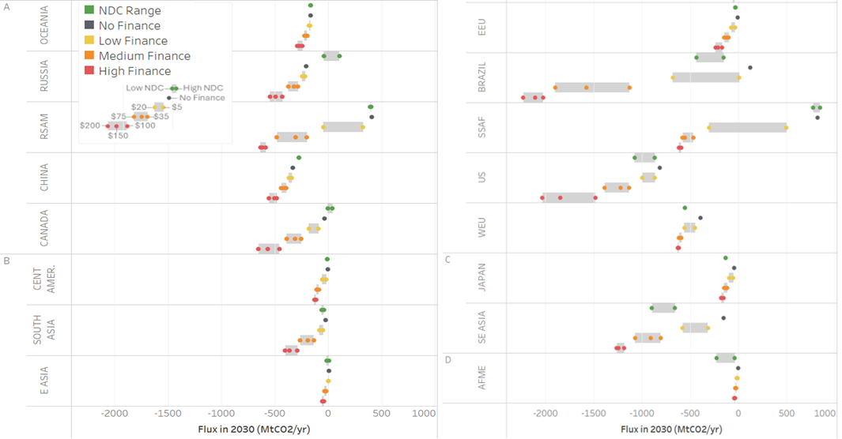
Regional net forest CO2 flux in 2030 under NDCs and under alternative finance scenarios
Group A = regions achieving their NDC target without price incentives (No Finance)
Group B = regions achieving their NDC target with low price incentives
Group C = regions achieving their NDC targets with medium price incentives
Group D = regions achieving their NDC targets with high prices incentives
Positive flux = Net Emissions from Forests
Negative flux = Net Sequestration from Forest
Austin, K. G. et al. Targeting climate finance for global forests. Nat. Commun. 16, 6443 (2025).
Notes:
“This slide presents the first set of results from a project led by Kemen Austin at TNC. In this work, we analyzed 16 GTM regions to estimate the level of investment required to meet their 2030 NDC targets.
A key step in this process was translating economy-wide NDCs into forest-specific targets, and then aggregating those to align with the GTM regional structure. This step is not trivial—and it highlights that, sometimes, policies can be just as challenging to interpret as model results.
We then grouped regions based on the level of carbon payments needed to achieve their forest-based NDC targets. Regions in Group A can meet their targets without additional price incentives under their future expected business as usual scenario. Group B requires relatively low carbon prices, Group C requires moderate incentives, and Group D requires high carbon prices to close the gap. This classification helps us quickly see where forest-based mitigation is more readily achievable and where stronger financial incentives are likely needed.”

Slide 10
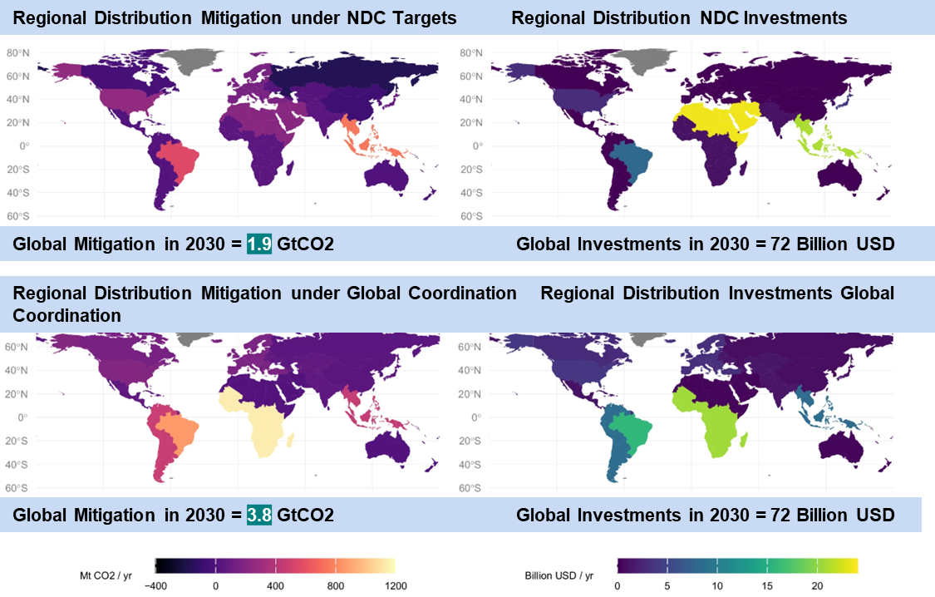
Costs and mitigation outcomes of meeting regional forest based NDCs, compared to a Global Coordination scenario, in 2030
Austin, K. G. et al. Targeting climate finance for global forests. Nat. Commun. 16, 6443 (2025).
Notes:
“Models are also very useful for identifying inefficiencies in policy targets.
Here, we do that by comparing mitigation under current policies—specifically NDCs—with an idealized scenario where investments are allocated based purely on cost-effectiveness. In this simplified framework, mitigation is implemented wherever it is least expensive, abstracting from national borders and policy constraints.
This comparison helps reveal the gap between where mitigation is currently happening and where it could occur if resources were allocated more efficiently.”
In this figure we show the the expected mitigation under the NDC targets (left) and distribution of investments (right)
We compared this to a scenario where we spend the same amount of money in aggregate (72 billion), but without requiring NDCs to be met
What happens in this simplified case – which reflects ~$22 / t CO2 – is that total mitigation from forests reaches 3.8 Gt CO₂, or twice the quantity of mitigation expected under the achievement of upper bound NDC commitments (1.9 Gt CO₂), at the same cost
This is the product of a geographic shift in mitigation, with large increases in low-cost mitigation in some regions, and slight decreases in very high-cost mitigation in other regions, relative to regional NDC targets
Canada, Russia, China, Central America, and Oceania (which remember, had very low ambition) begin to take advantage of low-cost abatement opportunities that are not reflected in the in the first generation of their NDCs.
Also more mitigation in SSA, Brazil, and RSAM
*** these are priorities for closing the gap between what has been pledged under NDCs and what is needed to reach emissions compatible with a 1.5 °C pathway***
But less in SE Asia, Japan, E Asia and North Africa and the Middle East

Slide 11
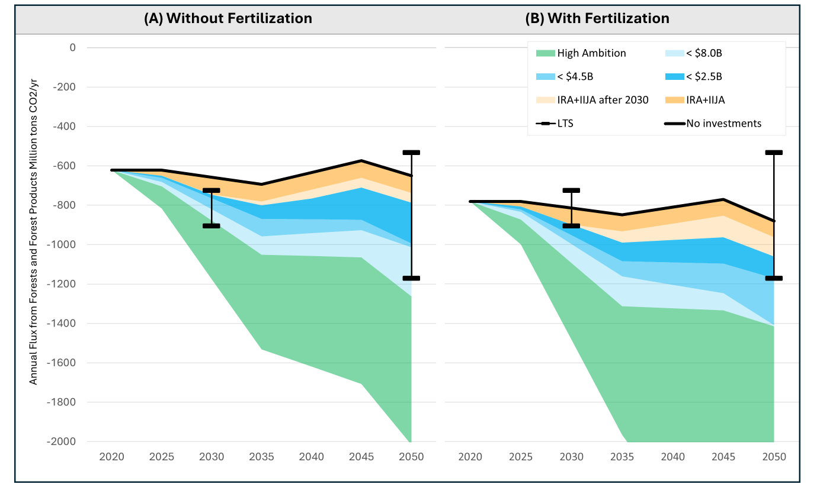
US net forest CO2 flux under alternative investment scenarios vs targets
Favero, A., Baker, J., Sohngen, B., Daigneault, A., Wade, C., Ohrel, S. & Ragnauth, S. (2025). Investing in US forests to mitigate climate change. Carbon Balance and Management 20 (1), 4.
Notes:
Now let me move to a different application, focusing specifically on the United States.
This figure shows the projected annual net CO₂ flux from forest ecosystems and harvested wood products from 2025 to 2050, across different levels of investment simulated in GTM. Results are presented in atmospheric terms: positive values indicate emissions, while negative values indicate net sequestration.
Starting with the baseline, the black line shows the trajectory without additional investments. The dark orange wedge represents the impact of investments under the Inflation Reduction Act and the Infrastructure Investment and Jobs Act through 2030. The light orange extends those same investment levels beyond 2030.
The blue wedges then show progressively higher levels of annual investment, ranging from above $640 million up to about $8 billion. Finally, the green wedge represents a high-ambition scenario, with investments above $8 billion, reaching up to around 2 gigatons of CO₂ sequestration by 2050.
For reference, the black bars indicate the range of net CO₂ flux consistent with the U.S. Long-Term Strategy targets for 2030 and 2050. These are derived assuming that forests continue to account for roughly 85 percent of the land-use carbon sink, consistent with historical estimates.
Overall, this figure illustrates how increasing investment levels translate into progressively larger forest carbon sinks, and how those outcomes compare to national long-term climate goals.”

Slide 12
Country-based MACCs in 2050
We generate 215 country-specific MACCs, covering 99% of global forest.
Results are highly skewed — a small number of countries deliver most mitigation.
We highlight 12 representative countries that together account for 65% of global mitigation.
Favero and Austin (2026). Charting our forest future: national supply curves for forest-based CO₂ mitigation | npj Climate Action
Notes:
Another way to use the results from the model is to compare the dollar value of investments and the mitigation potential they generate.
This slide presents country-specific MAC curves for 215 countries, covering 99% of global potential.
These curves show how mitigation supply evolves as costs increase presenting Diminishing returns
Also Results are highly skewed — a small number of countries deliver most mitigation.
We highlight 12 representative countries that together account for 65% of global mitigation.
Constraints are largely biophysical and economic rather than policy-driven.
Brazil dominates global forest mitigation potential.
Even low prices ($5–20) can reverse net emissions.
Indonesia and DRC show similar sensitivity — modest prices stop deforestation.
Avoided deforestation is crucial but bounded by baseline trends.
The U.S. and Europe dominate temperate mitigation.
Under high prices, the U.S. alone contributes nearly 3 GtCO₂ in 2050.
Management changes dominate at higher prices.
Boreal forests respond more slowly.

Slide 13
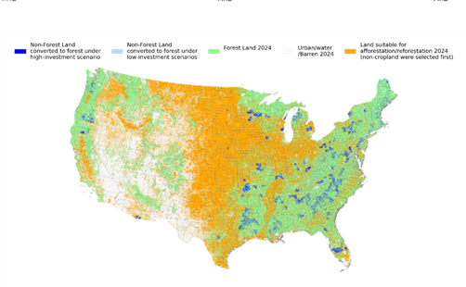
Geo-spatial results
Forests provide multiple benefits beyond carbon sequestration
  Ecosystem services, adaptation, and economic value
Need to target investments in:
  Low disturbance / low reversal risk areas
  maximize mitigation + climate resilience
New research direction: Integrating GTM with machine learning (EcoShift)
  High-resolution: 30 × 30 m
Why spatial detail matters:
  Identify synergies with other ecosystem services
  Assess exposure to natural disturbances
  Improve durability and resilience of investments
Changes in Forest Area in 2035 – $50/tCO2
Favero et al. 2026 (under review)
Notes:
Yesterday speakers discussed how no single model can answer all questions and also, highlighed the need for geospatial insights to support more informed land-based decisions. To address this, we have recently integrated GTM results with a machine learning model, Ecoshift.
This integration allows us to examine multiple dimensions, including the co-benefits of forest-based activities by identifying where they are implemented. It also enables us to assess how disturbances may reshape the landscape, helping direct investments toward areas where mitigation potential is likely to remain stable and where activities can enhance forest resilience.
For example, this figure shows where afforestation and reforestation activities are likely to occur under a $50 carbon pricing scenario. By overlapping these projections with data on species and communities, we can measure co-benefits ex post. Additionally, combining this with maps of future climate-related disturbances allows us to evaluate the long-term stability of these investments.

Slide 14

Key Takeaways & Limitations
No single model can answer all questions
  Each model has limitations and built-in assumptions
  Integrating multiple tools can help expand modeling capabilities
Translating policy targets into model inputs (and vice versa) is challenging
Robust findings across studies:
  Forest mitigation potential is large, cost-effective, and unevenly distributed globally
  Carbon pricing effects are heterogeneous: Responses differ across regions
Models represent a best-case economic potential: Perfect information, No transaction costs, Clear property rights, No free-riding,
Purpose of models: Not to judge reality, but to benchmark it against an idealized frontier, Measure the distance from efficiency, not the quality of real-world action
Notes:
“To conclude, no single model can answer all questions. Each model comes with its own limitations and built-in assumptions, and for that reason, integrating multiple tools is often necessary to expand our analytical capabilities.
At the same time, translating policy targets into model inputs—and interpreting model outputs back into policy terms—is itself a non-trivial and often challenging process.
Despite these challenges, there are robust findings that consistently emerge across studies. In particular, forest mitigation potential is large, cost-effective, and highly unevenly distributed across regions. We also see that carbon pricing effects are heterogeneous, with responses varying significantly across geographies.
It is important to emphasize that models represent a best-case economic potential, based on assumptions such as perfect information, no transaction costs, well-defined property rights, and no free-riding.
For this reason, the purpose of models is not to judge real-world outcomes, but rather to benchmark them against an idealized frontier. They help us measure the distance from economic efficiency, rather than evaluate the quality of real-world action.”

Slide 15

Thank you
Alice Favero| afavero@rti.org

Slide 16
Cited References
Charting our forest future: national supply curves for forest-based CO₂ mitigation | npj Climate Action
Austin, K. G. et al. Targeting climate finance for global forests. Nat. Commun. 16, 6443 (2025). https://doi.org/10.1038/s41467-025-61657-6
Bastin, J. F. et al. The global tree restoration potential. Science 365, 76–79 (2019).
Ling, P. Y. et al. Mapping global forest regeneration – an untapped potential to mitigate climate change and biodiversity loss. Environ. Res. Lett. 18, 054025 (2023).
ESSDD - New FAOSTAT forest emissions and removals estimates: 1990–2025
UNDP NDC Insights Series – Issue No. 8 (November 2025) – ITRC
Chapter 7: Agriculture, Forestry, and Other Land Uses (AFOLU)
Food and Agriculture Organization of the United Nations (FAO). Global Forest Resources Assessment FRA Platform. (FAO, 2021).
Food and Agriculture Organization of the United Nations (FAO). FAOSTAT. (FAO, Rome, 2025). https://www.fao.org/faostat/en/
Sohngen, B., & Mendelsohn, R. (2003). An optimal control model of forest carbon sequestration. American Journal of Agricultural Economics, 85(2), 448-457.

