Slide 1
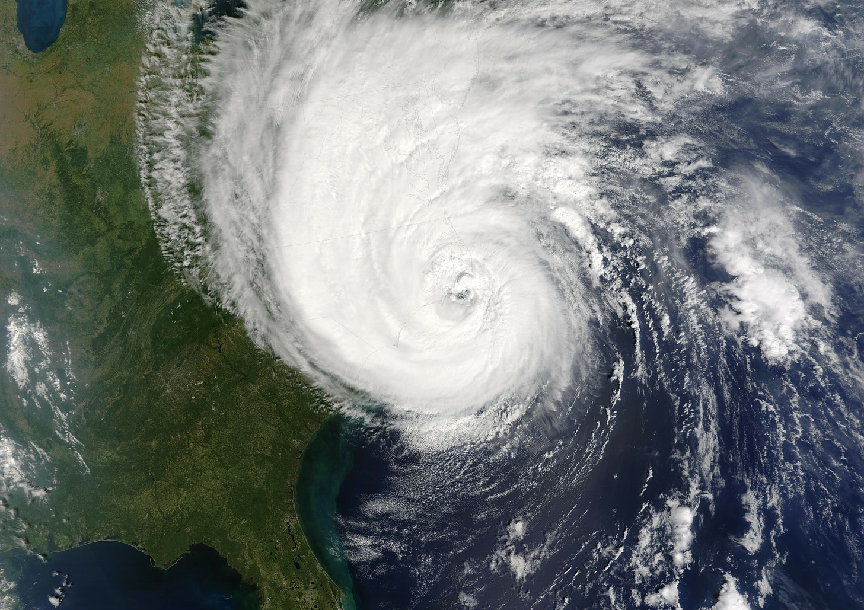


Measuring development in the LULUCF Sector
From fragmented modeling to global indicators influencing policy
14th of April 2026
Nicklas Forsell
Professor | MetaEarth Research Center
Advanced Institute of Science and Technology (KAIST)
Email: forsell@kaist.ac.kr

Slide 2
Evolution of EU LULLUCF modelling
From centralized modeling to decentralized accountability
Phase 1. AFOLU estimates for EU Member States (MS) developed by the European Commission
First EU-wide and MS specific AFOLU projections provided in the 2013 EU Reference Scenarios
Phase 2. Member States developing / improving domestic capacities
Numerous EU MS used domestic modelling tools to estimate Forest Reference Levels
Phase 3. Setting of EU wide LULUCF targets and MS specific contributions
Could set an EU-wide targets of increasing the LULUCF sink to -310 MtCO₂eq by 2030
Phase 4. Implementation of domestic policies to reduce emissions and enhance sink effects
Increased utilization of national tools to formulate and set national targets
Notes:
EC models → MS capacity → EU targets → National policies
From centralized modeling → decentralized accountability

Slide 3
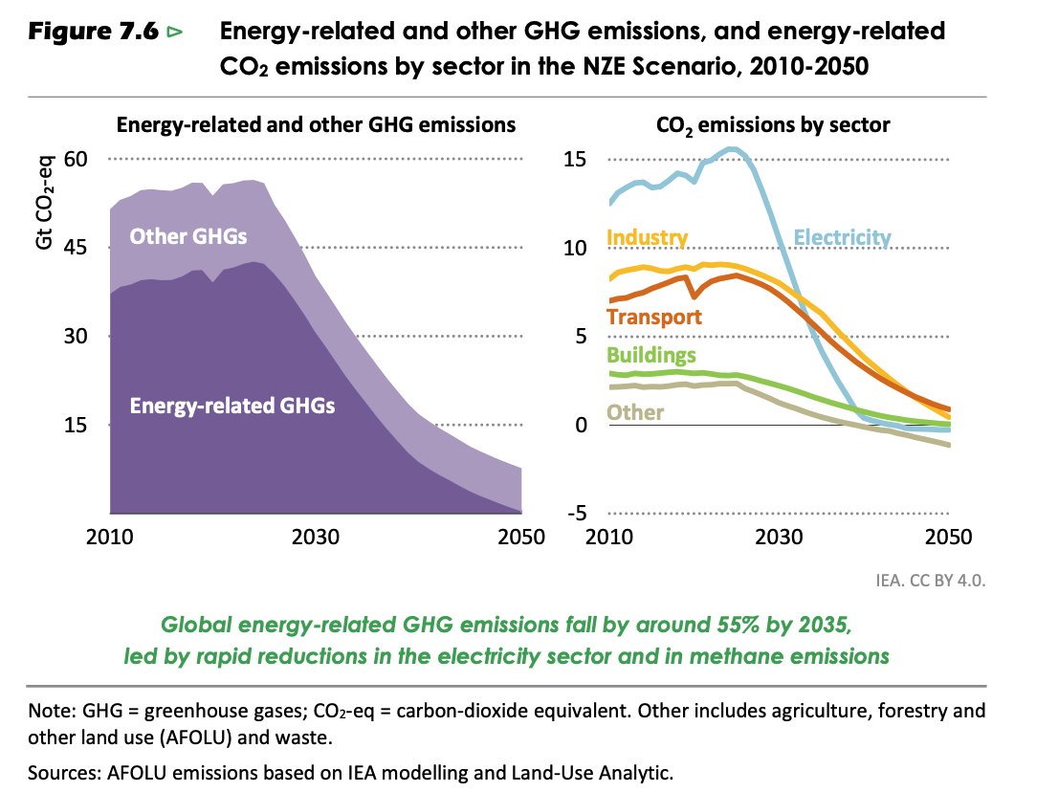
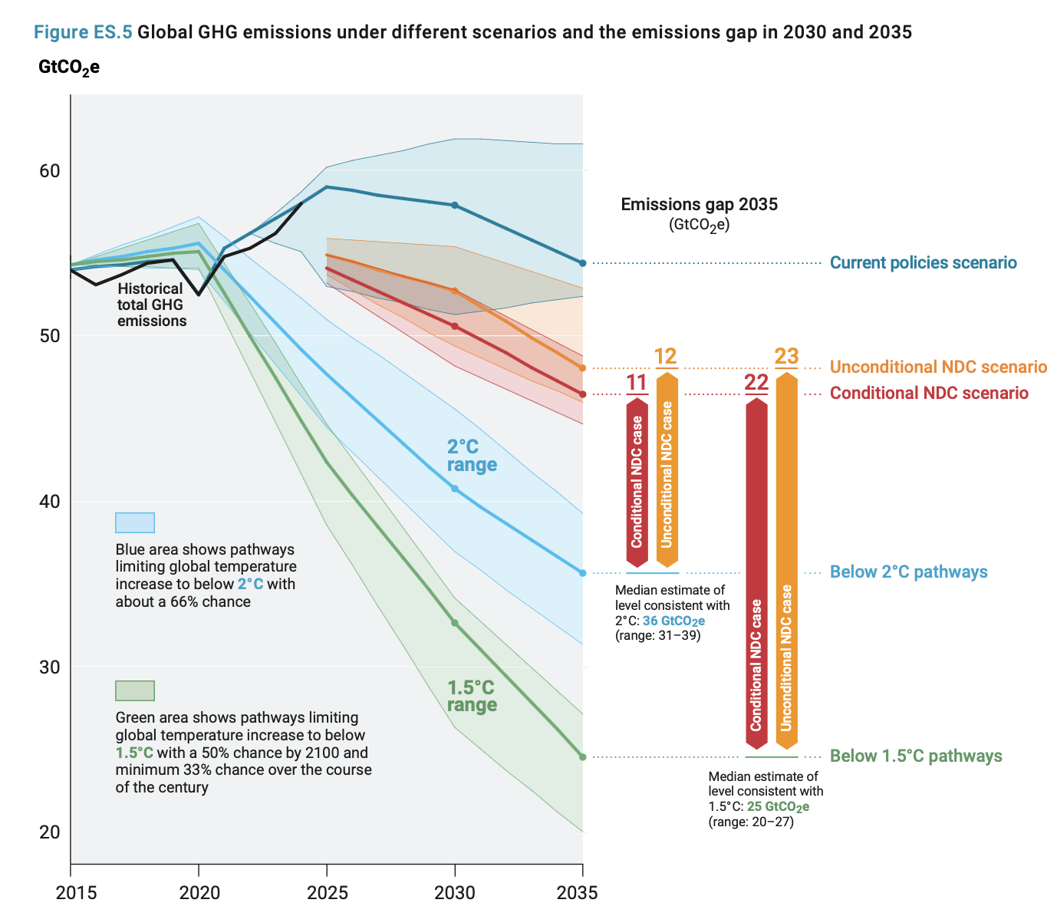
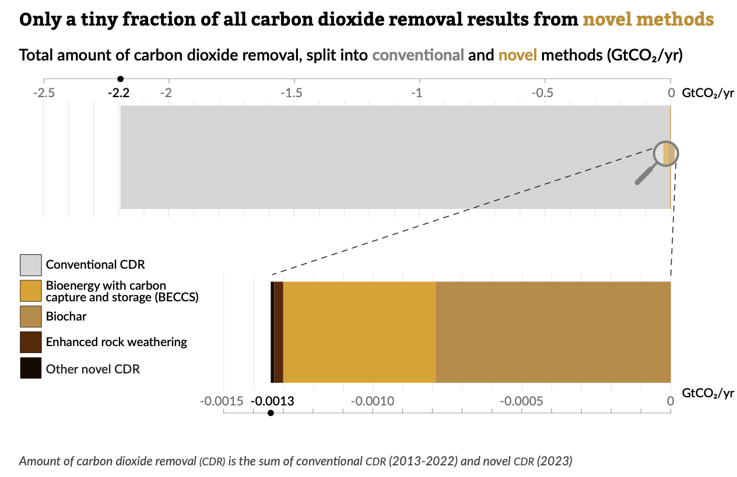
Integration of land-use sector into global assessments
The AFOLU sector and its contribution has moved from peripheral to mainstream
in global assessments
IEA World Energy Outlook (2025)
UNEP Gap report (2025)
State of CDR report (2025)
Notes:
Land-use is now a core component of global climate assessments

Slide 4
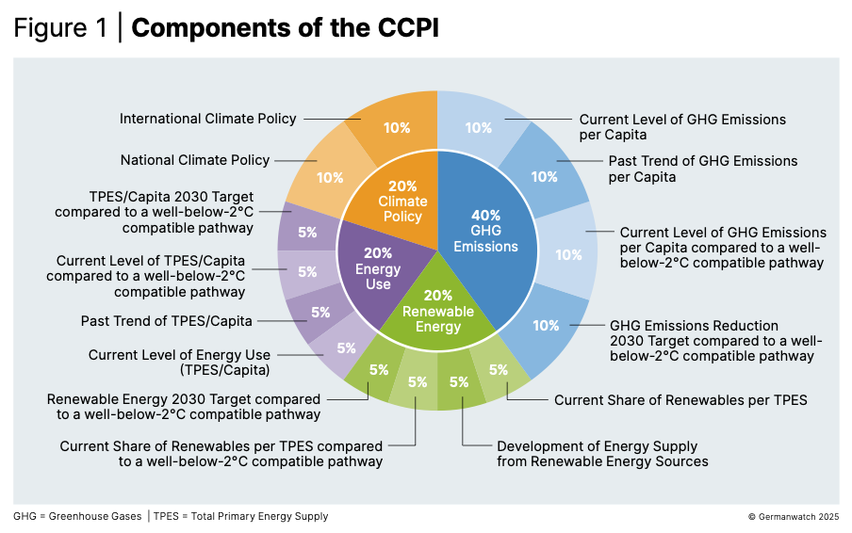
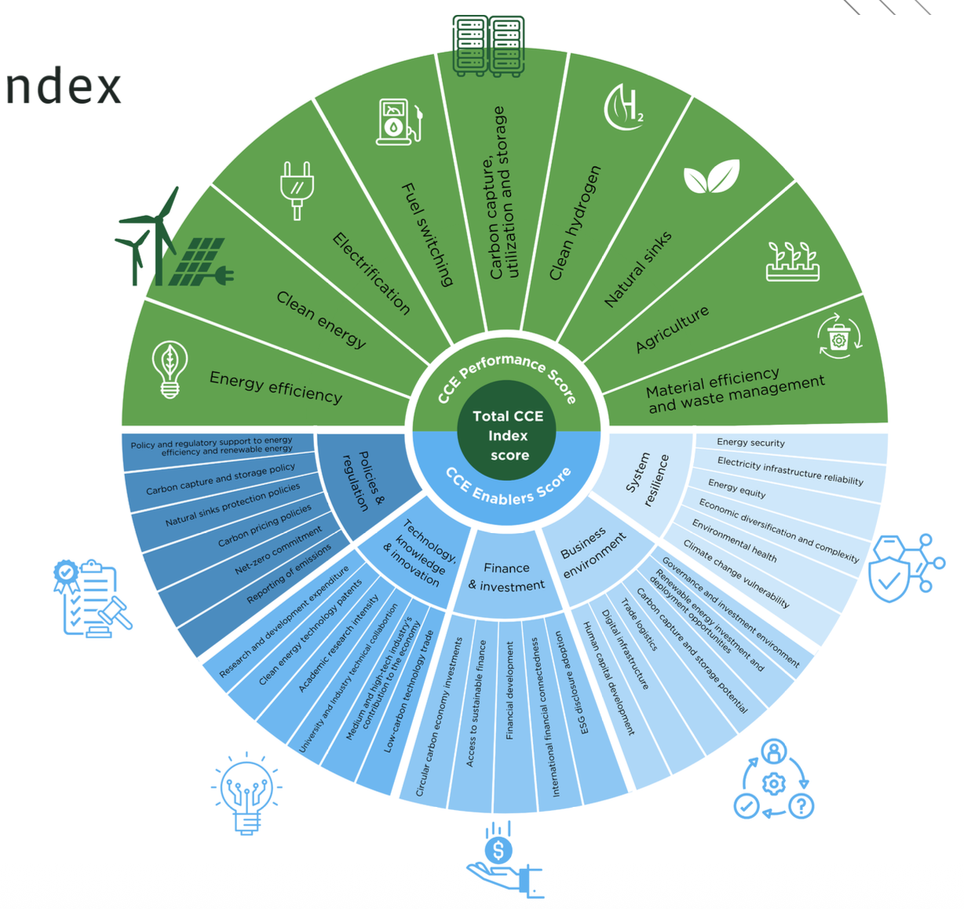
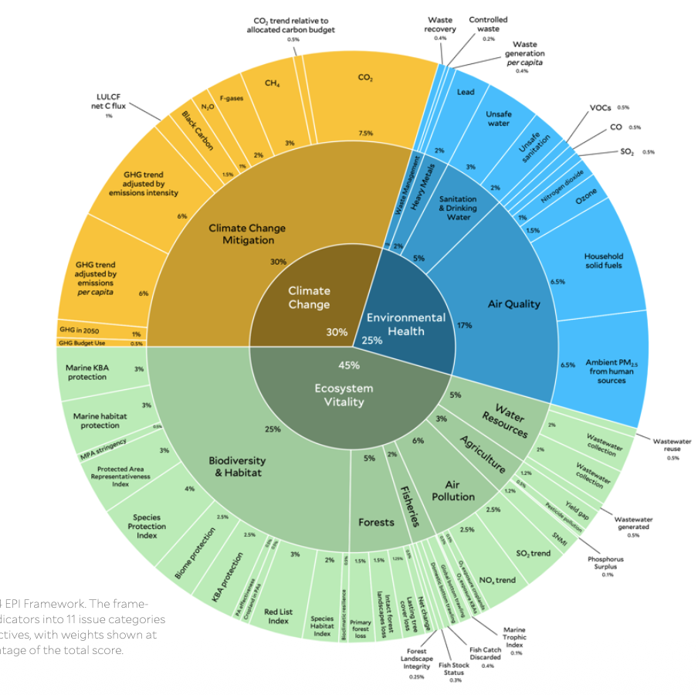
From modelling to benchmarking countries
The AFOLU sector and its contribution is also being integrated too major index providers
assessing the state of climate change mitigation
Climate Change
Performance Index (CCPI)
Circular Carbon
Economy Index (CCE)
Environmental Performance
Index (EPI)
Notes:
What gets measured, gets compared, drives policy pressure

Slide 5

Integration of land-use sector into global index
Developed a Forest Industry Lens (FIL) that measures the carbon circularity in the
forest sector of 30 countries across the world
2023 Scores for major countries
The Forest Industry Lens
and its four indicators
Development of scores
from 2019-2023

Slide 6
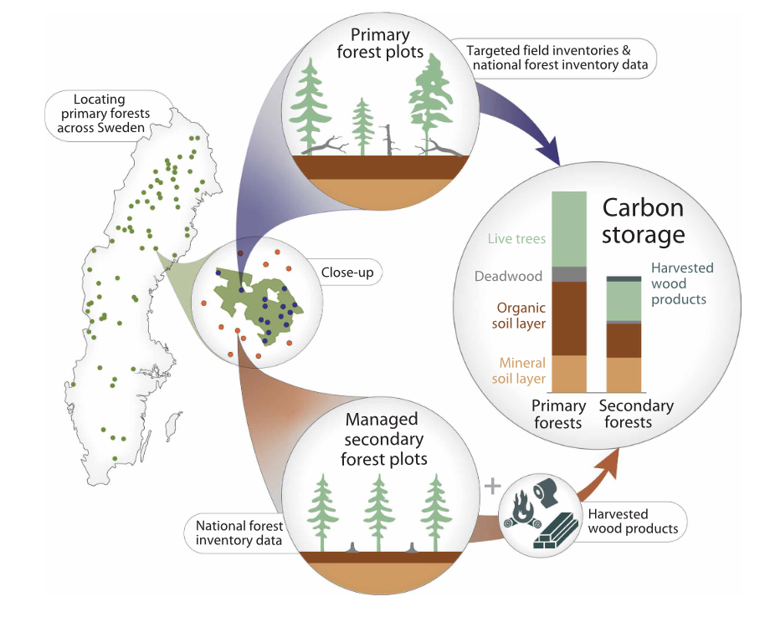
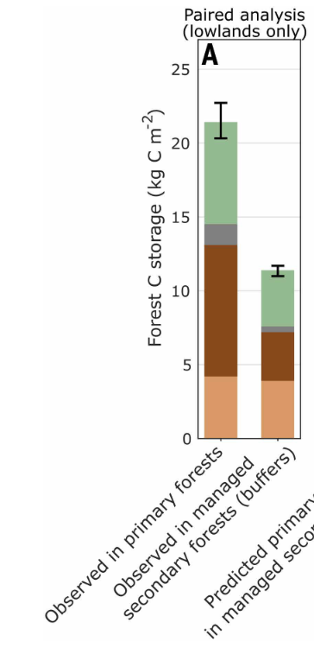
Even with better data, fundamental value conflicts remain
Key headline of the assessment: Sweden’s old-growth natural forests store 83% more
carbon than managed woodlands
Source: D. Pascual et al., Science (2026)

Slide 7
Conclusion
LULUCF has moved to the center of climate modeling and policy
Indicators and indices now shape decisions and accountability
Fundamental debates remain unresolved
Notes:
LULUCF is no longer just modeled—
it is measured, compared, and contested

Slide 8
Thank You
Nicklas Forsell
Professor | MetaEarth Research Center
Advanced Institute of Science and Technology (KAIST)
Email: forsell@kaist.ac.kr
Presentation supported by the National Research Foundation of Korea (NRF) grant
funded by the Korea Government (MSIT) (RS-2025-24536202), the Ministry of Science and ICT through the National Research Foundation of Korea (RS-2025-02312954)
Notes:
LULUCF is no longer just modeled—it is measured, compared, and contested

Slide 9

Thank You
Nicklas Forsell
Professor | MetaEarth Research Center
Advanced Institute of Science and Technology (KAIST)
Email: forsell@kaist.ac.kr
Presentation supported by the National Research Foundation of Korea (NRF) grant
funded by the Korea Government (MSIT) (RS-2025-24536202), the Ministry of Science and ICT through the National Research Foundation of Korea (RS-2025-02312954)
Notes:
LULUCF is no longer just modeled—it is measured, compared, and contested

