Slide 1
Assessing competing economic incentives for biomass energy and forest protection:
the case of Brazil
Presenter: Jason Funk | Senior Director, Forest Strategy
April 15, 2026
Team: Alice Favero, Starry Sprenkle-Hyppolite, Allie Goldstein
© Luana Luna

Slide 2
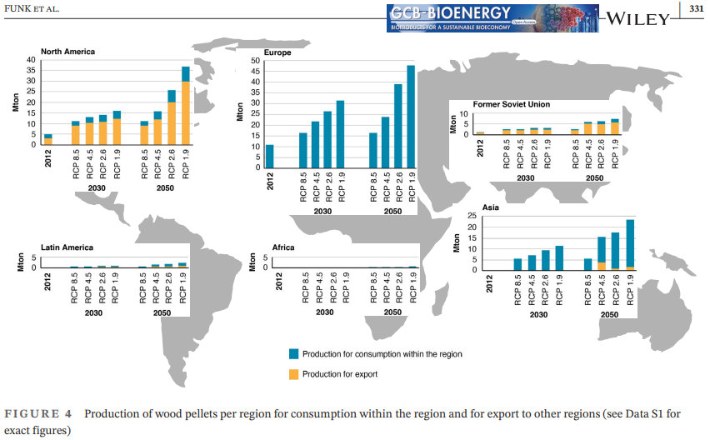

Slide 3
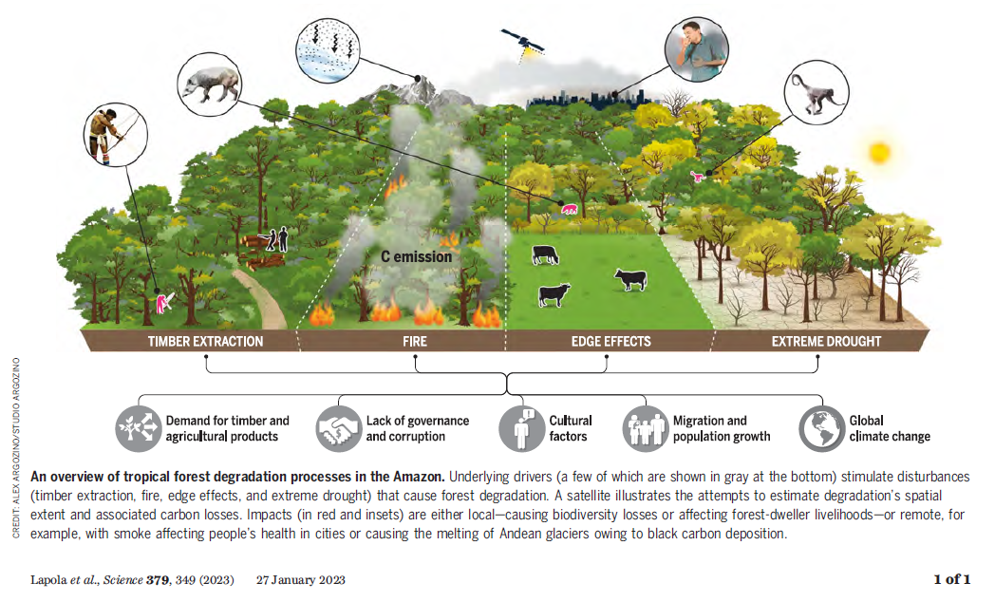

Slide 4
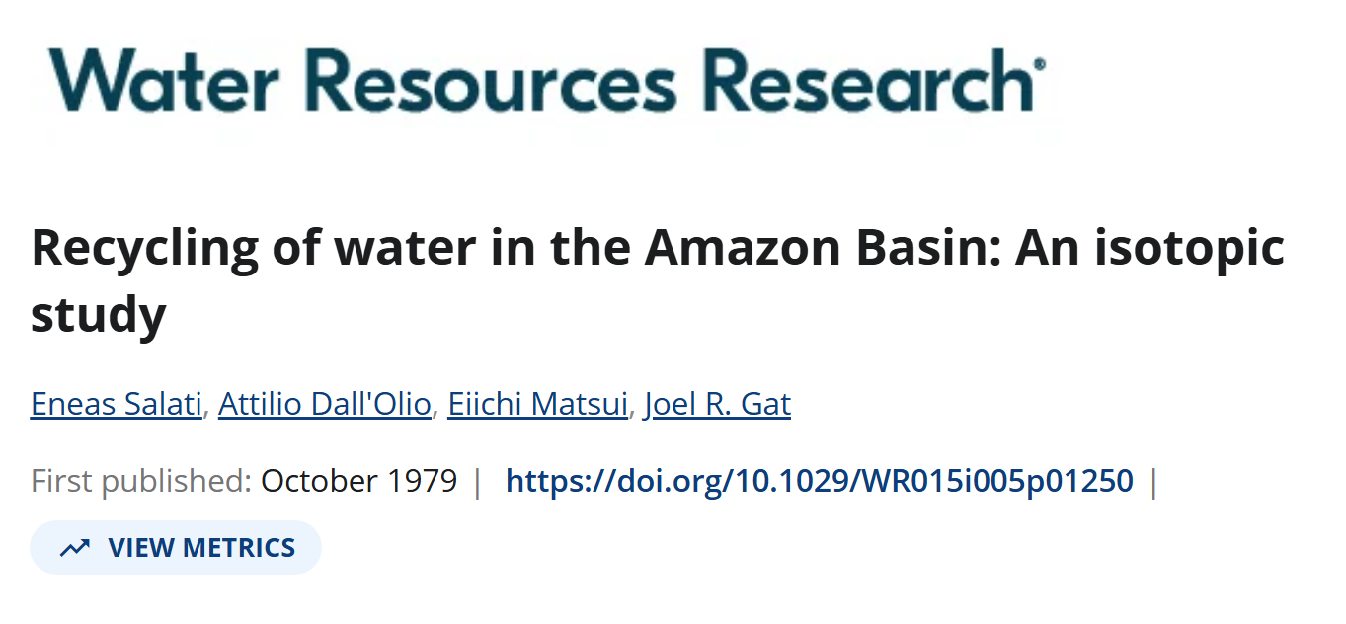
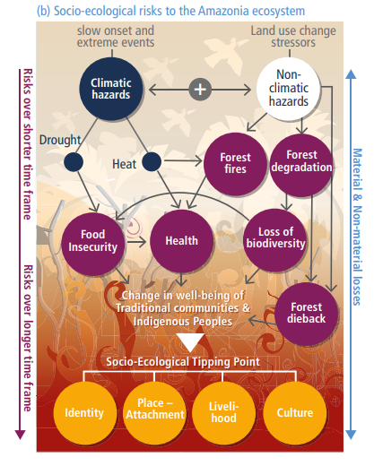
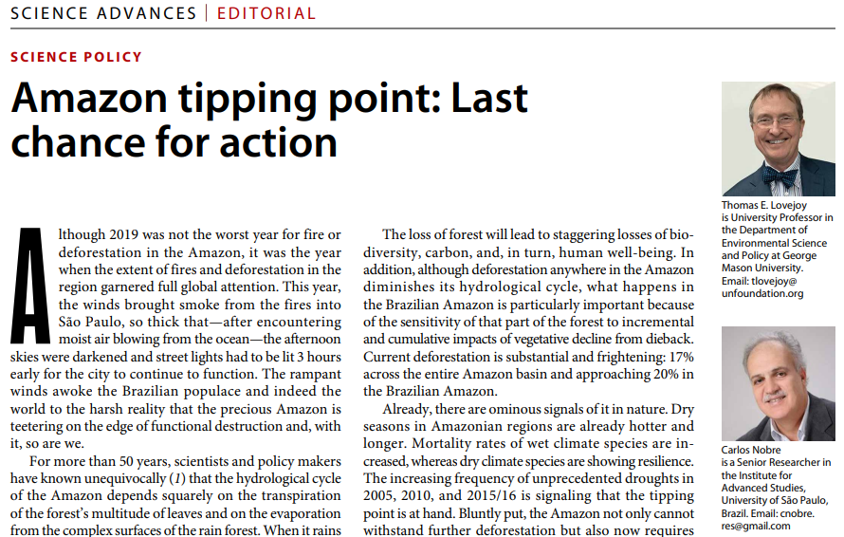
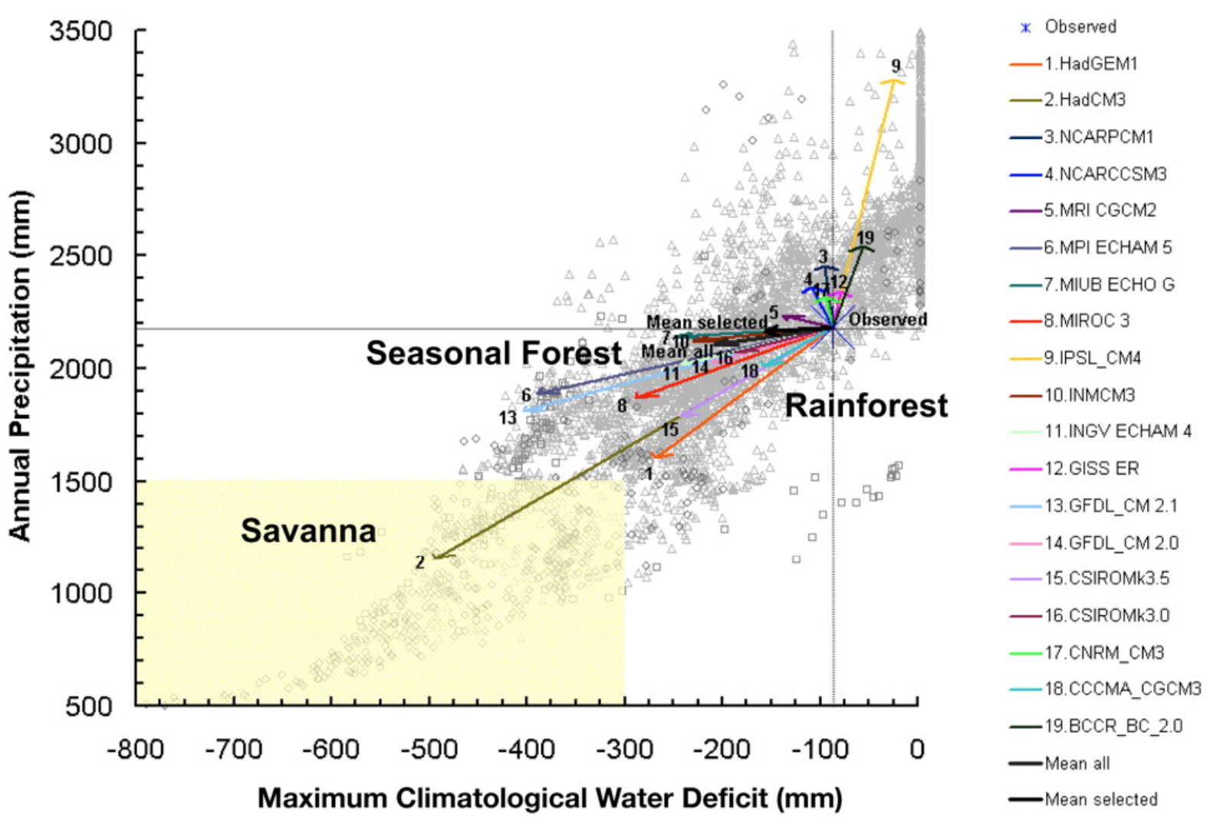
Amazon Tipping point
Salati et al. 1979
Lovejoy and Nobre 2019
Mahli et al. 2009
IPCC AR6 2022

Slide 5

Transition of focus and approach
2022 (GLOBIOM)
2025 (GTM)
Global-scale processes, only one region: Brazil
No direct climate impacts
Biomass energy demand and carbon prices as factors
More detail around forest management regimes
Benchmarked against potential future state
Global-scale processes, all regions
Varying RCP scenarios
Sole focus on biomass energy demand and supply
Little detail about forest management
Benchmarked against historical state

Slide 6
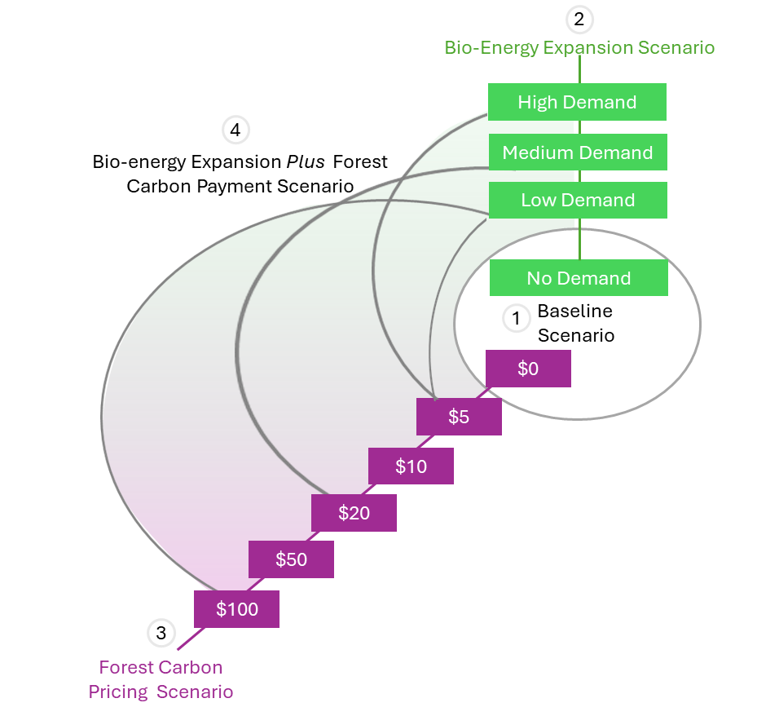
Scenario design
Which of these scenarios avoid the tipping point?
How do they change forest management regimes in Brazil?
How do prices interact to shape outcomes?

Slide 7
Forest management regimes
Plantation Forest: Forest predominantly composed of trees established through planting and/or deliberate seeding, usually of non-native tree species. Plantations are both softwood (Pinus) and hardwood (Eucalyptus).
Commercial Naturally Regenerating Forest: Naturally regenerating forest comprised of native species, managed for commercial timber production.
Non-commercial Natural Forest: Naturally regenerating forest comprised of native species, not harvested or managed for commercial timber production.

Slide 8
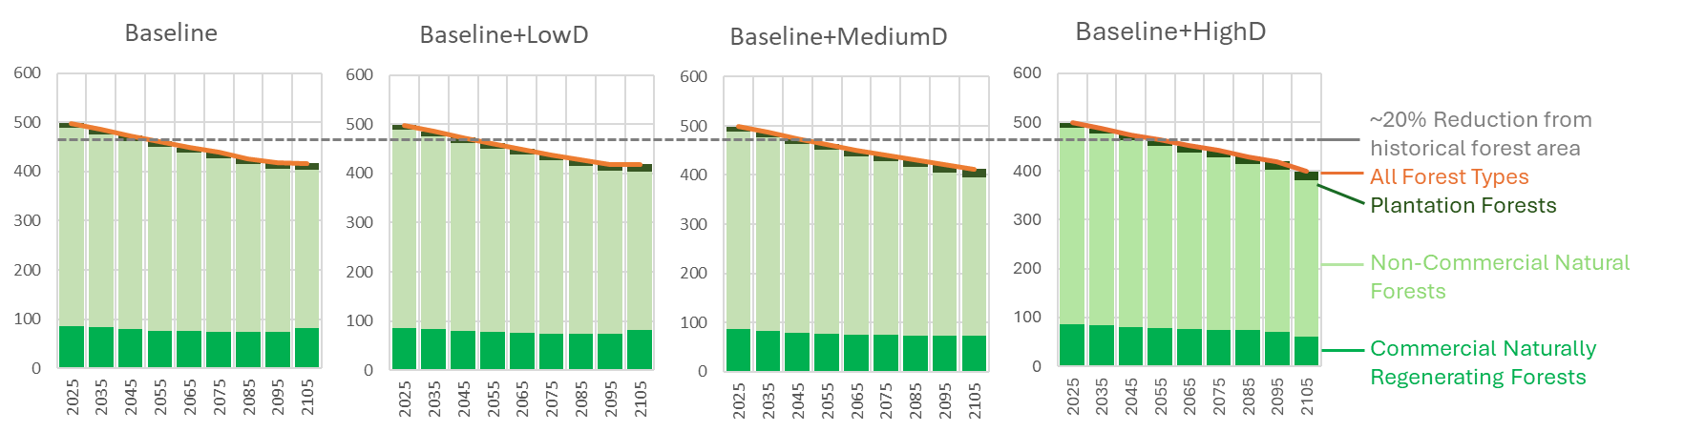
Results: biomass demand

Slide 9
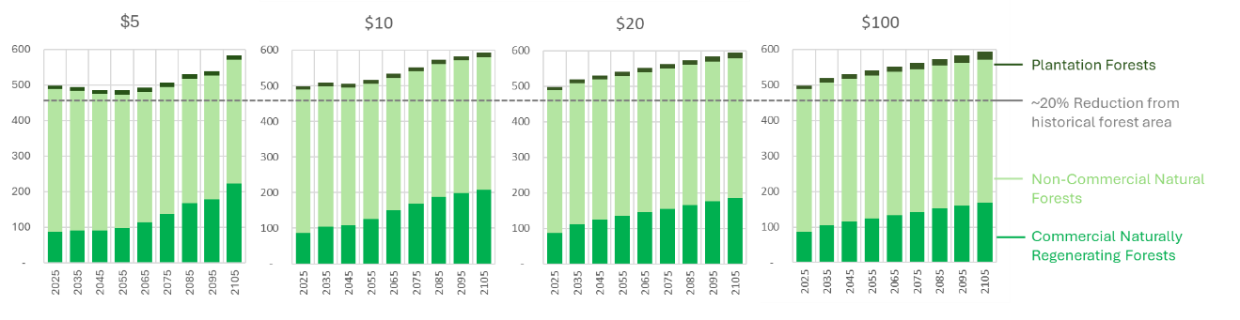
Results: carbon Pricing

Slide 10
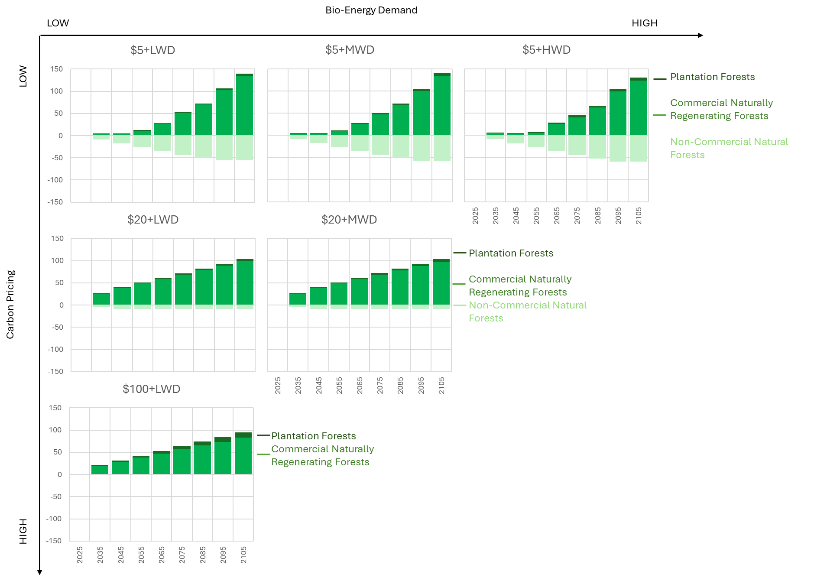
Results: biomass + Carbon Price

Slide 11
takeaways
Productive exchange across modeling environments, with selection based on strengths of each
Forward-looking aspect is tremendously useful for policy, as climate and economies move into uncharted territory
Global dynamics downscaled to national-level responses is new (?) and important
Biomass energy has the potential to change composition of forest management regimes, directly and indirectly
Incentives for biomass feedstock production not sufficient to avoid Amazon tipping point
Relatively modest carbon prices ARE sufficient to avoid tipping point
Combination of incentives – carbon price can be dominant, preserving ecological integrity of Amazon ecosystem even with biomass energy demand

Slide 12
Future directions
Application of methodology to different forest regions
Spatialization of results to investigate changes in distribution of different management regimes
Spatial and temporal intersection of natural disturbances (under different climate scenarios) for carbon, management, and economic outcomes
Analysis of spatially tailored, policy-supported instruments (i.e. carbon market, conservation program, PES system, etc.) that incorporate learnings

Slide 13

THANK YOU
jfunk@conservation.org
afavero@rti.org
© Conservation International/photo by Haroldo Palo Jr.
13

