Slide 1
Evaluating Forest Fuel Reduction Effectiveness Under Deterministic and Stochastic Wildfire Modeling
Greg Latta¹ and Others²
¹ Associate Professor and Director, Policy Analysis Group, University of Idaho
² Not named as this talk will be a bit all over the place (and that could be embarrassing)
Presented at: 12th Forestry & Agriculture Modeling Forum
Duke Farms, New Jersey
April 14, 2026

Slide 2
The plan
Success is stumbling from failure to failure with no loss of enthusiasm — Winston Churchill
A Little Background / Motivation
  Wildfire – forest fires in particular
A bit about the Model
  The Land Use and Resource Allocation Model (LURA)
A bit about the failure
  2 examples (one in detail and one very abbreviated)
The Pivot

Slide 3
Motivation: Why This Matters
Wildfire increasing in scale/severity
Forests are a major carbon sink at risk
Policy Push: scale up fuel treatments and wood utilization
Management is being justified as a climate¹ mitigation strategy
1. I’m not sure I can actually use this word (but I already said the other bad C word above)

Slide 4
The Problem
Management
  Immediate emissions (because it usually involves harvest/thinning)
  Future avoided wildfire emissions
So we have a temporal issue – and –
  Benefits depend on whether fire actually occurs at a managed site

Slide 5
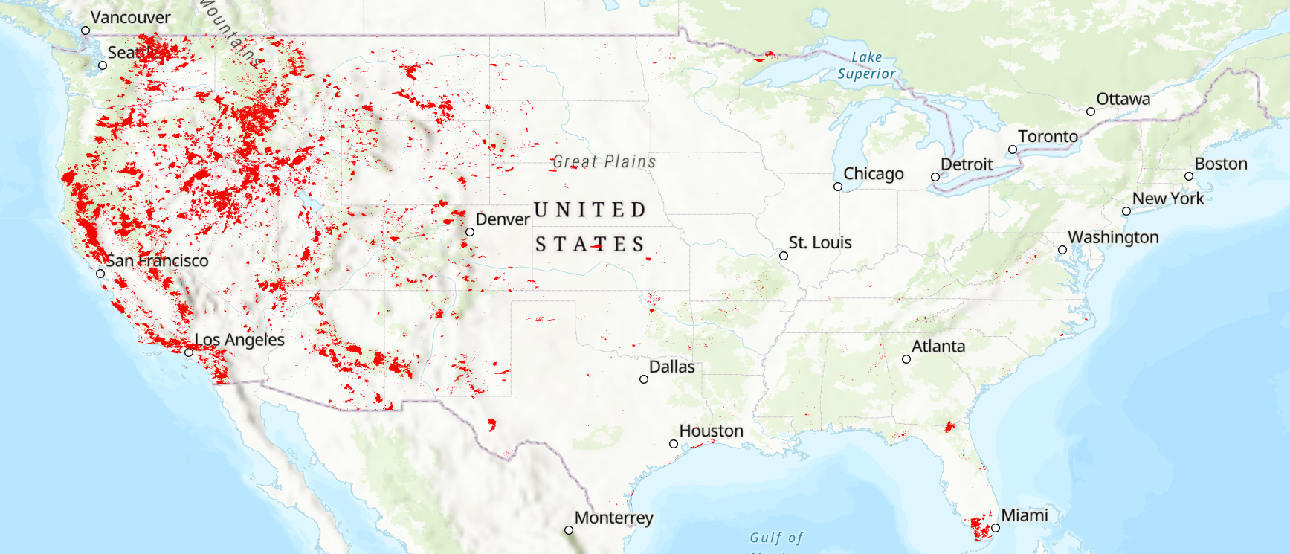
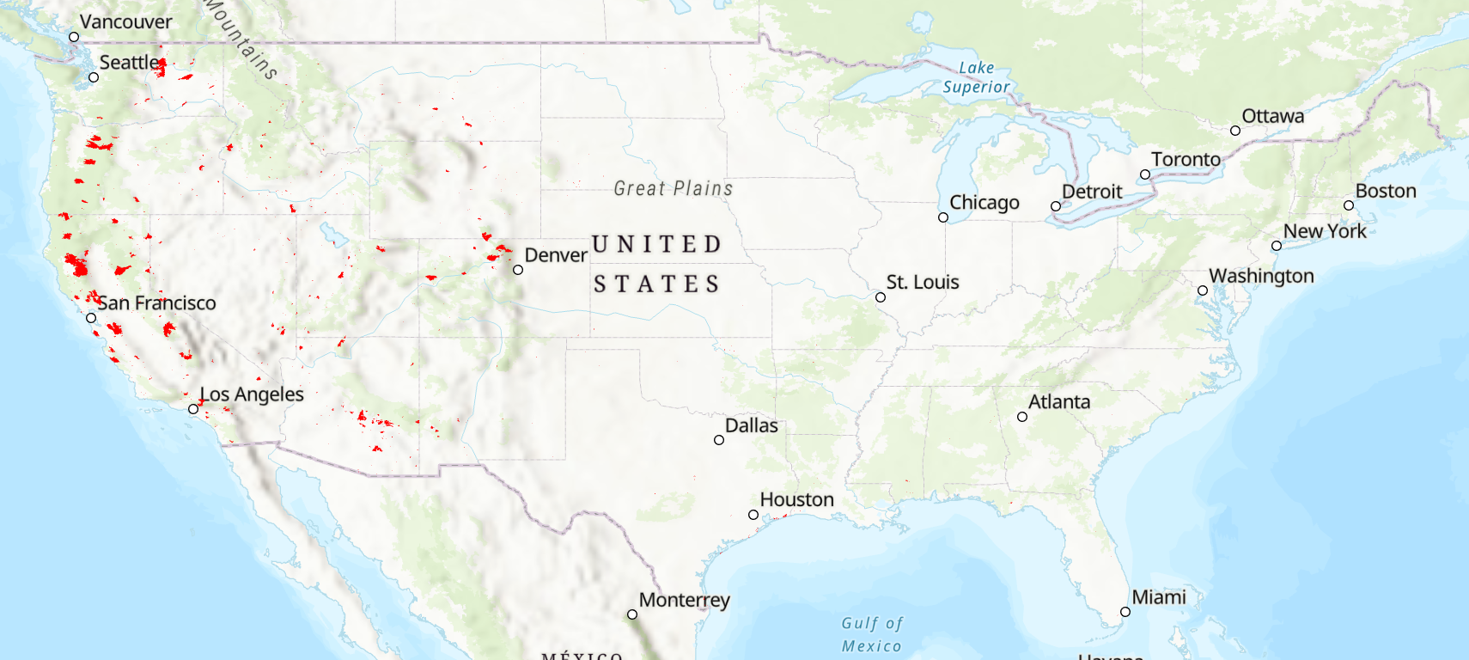
The typical modeling approach
Two primary approaches
Deterministic fire
  Expected burn probability applied every year
Stochastic fire
  Episodic, spatially random events
30 Years of Fire
1 Year of Fire

Slide 6
Why This Difference Matters?
There is a timing mismatch between costs (now) and benefits (uncertain future)
Two primary approaches
Deterministic fire
  Smooth, predictable benefits
Stochastic fire
  Benefits are uncertain, delayed, or absent
30 Years of Fire
1 Year of Fire

Slide 7
The motivation part
How does deterministic vs. stochastic wildfire modeling affect estimates of fuel treatment effectiveness for carbon?
Modeling Framework
  U.S. forest sector model – and by this I mean price endogenous spatial partial equilibrium model
    Detailed forest resource
    Detailed forest industry
    Link markets → harvest → fuels → fire → carbon

Slide 8
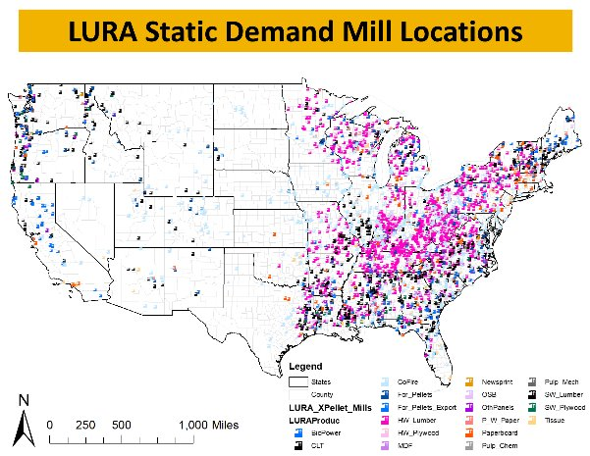
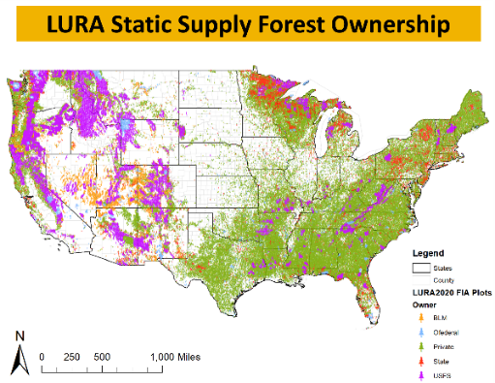

Land use and resource allocation (lURA) model
Market model with price sensitive demand and transportation networks (Latta et al., 2018)
  Static phase
    Balances supply with demand in a single year by Maximizing Net Social Surplus
  Dynamic phase
    Allocates new capacity and updates forest inventory between years
Latta, G. S., Baker, J. S., & Ohrel, S. (2018). A Land Use and Resource Allocation (LURA) modeling system for projecting localized forest CO2 effects of alternative macroeconomic futures. Forest Policy and Economics, 87, 35-48.

Slide 9
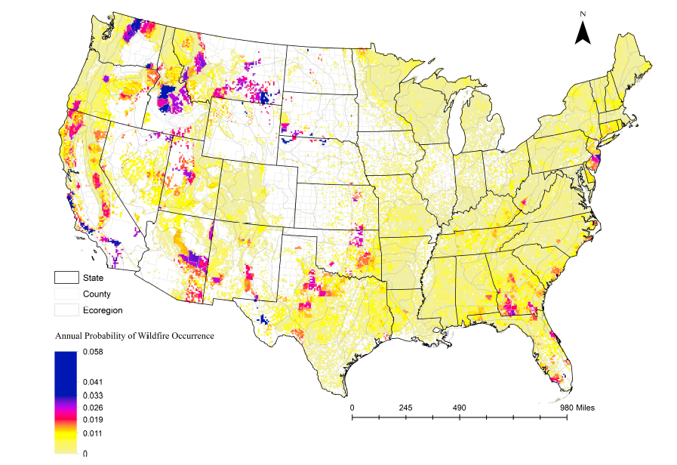
Getting fire in lura – Part 1 what burns
Spatial Autocorrelation Regression model where fire probability is function of climatic parameters
So we have a probability that a plot will burn in each year
Pokharel, R., G. Latta and S. Ohrel. 2023. Estimating Climate-Sensitive Wildfire Risk and Tree Mortality Models for Use in Broad-Scale U.S. Forest Carbon Projections. Forests. 14(302).

Slide 10
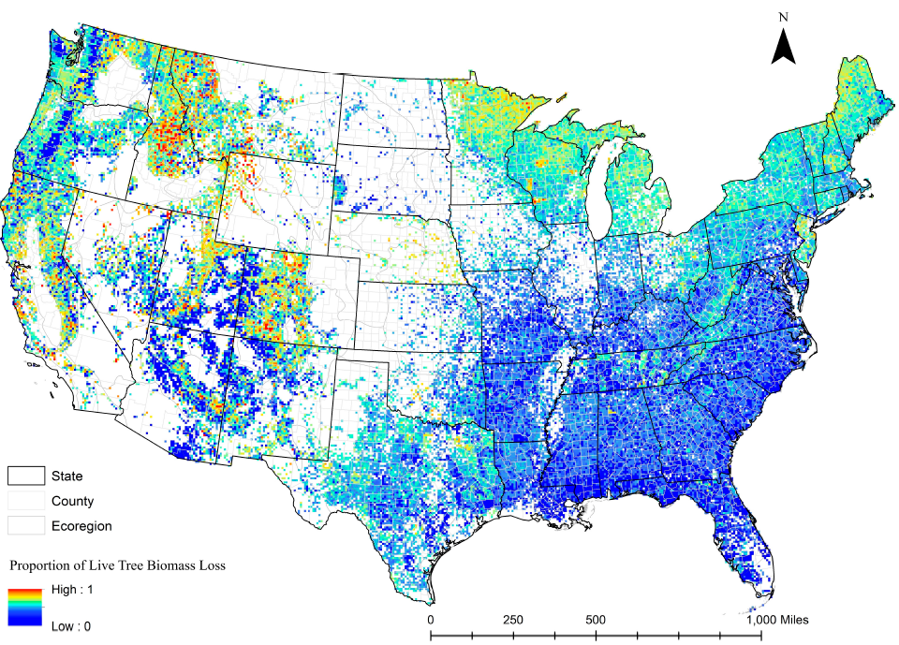
Getting fire in lura – Part 2 how bad
Spatial Autocorrelation Regression model where tree mortality is function of climatic parameters and current biomass
So we have a how many trees will succumb to fire each year in each year
Pokharel, R., G. Latta and S. Ohrel. 2023. Estimating Climate-Sensitive Wildfire Risk and Tree Mortality Models for Use in Broad-Scale U.S. Forest Carbon Projections. Forests. 14(302).

Slide 11
How fire works in lura
Fire is applied in the dynamic phase – so between years
And can be:
Deterministic
  Where the fire probability is applied to each plot in each year with the mortality based on the biomass level
Stochastic
  Where a random number between 0 and 1 is drawn and if it is smaller than the fire probability, the whole plot is burned in that year with the mortality based on the biomass level

Slide 12
Failure #1 – locating new facilities
So, being very proud – I started using the new fire module

Slide 13
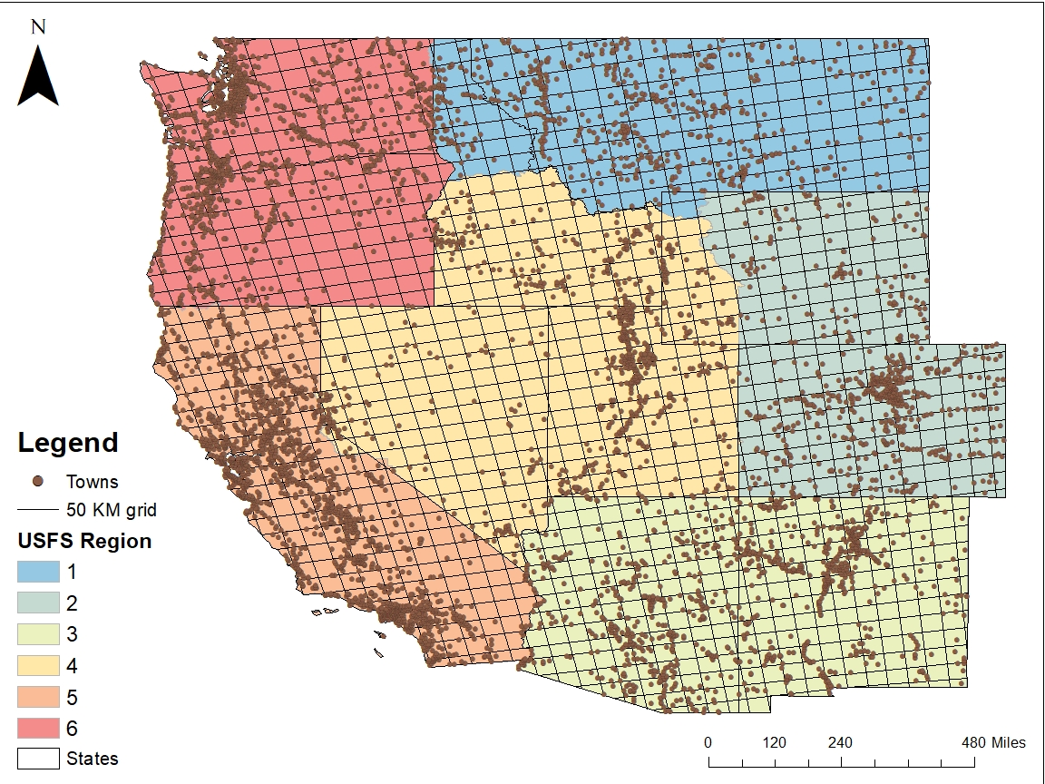
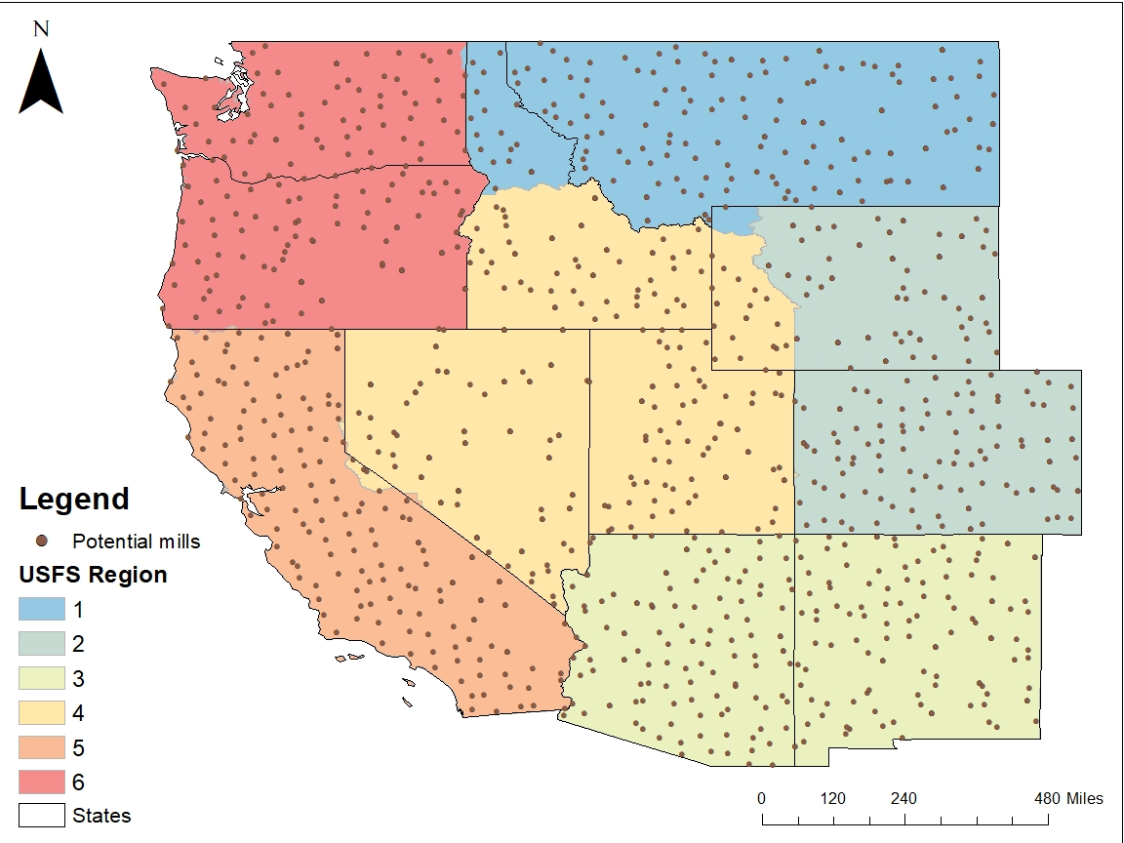
Potential mill LOCATIONS
Lay out 50 km grid
Choose closest town to midpoints
Eliminate areas without a town
Mill size = regional average
Region | Mill size (1000 M³)
1 | 120
2 | 50
3 | 50
4 | 30
5 | 120
6 | 140

Slide 14
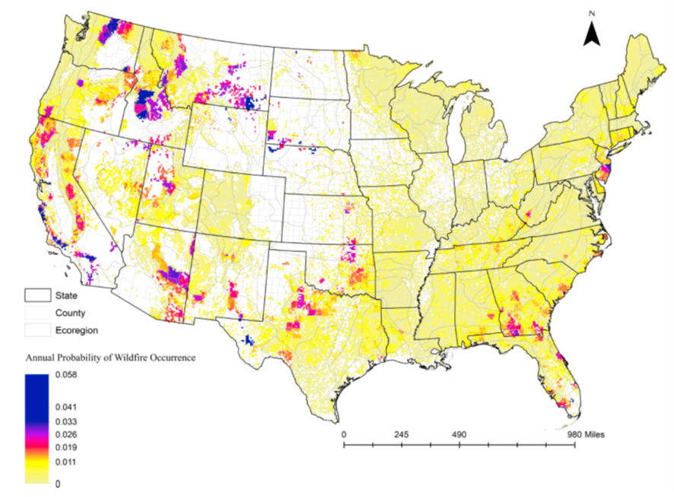
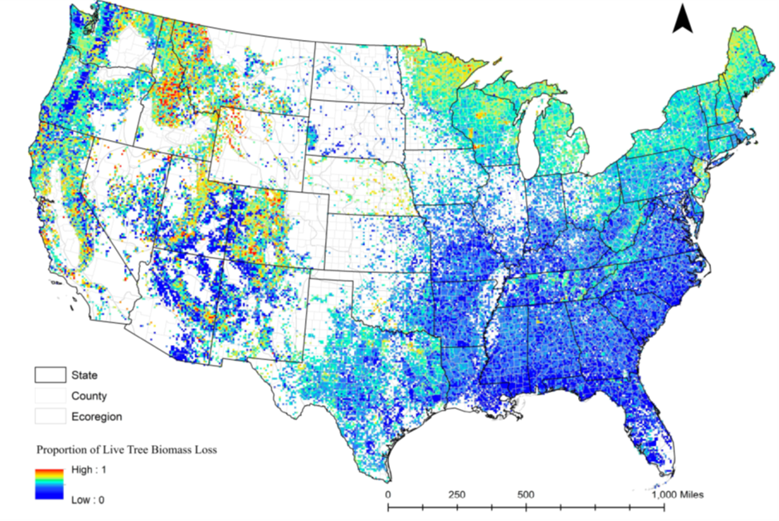
MODELING POTENTIAL FIRE EMISSIONS
Spatial autoregressive models (Pokharel et al., 2023)
Wildfire risk – annual probability of a wildfire occurring
Tree mortality – amount of biomass lost in the event of a fire
Fire mortality = wildfire risk * tree mortality
Potential supply for new mills
Pokharel, R., Latta, G., & Ohrel, S. B. (2023). Estimating climate-sensitive wildfire risk and tree mortality models for use in broad-scale US forest carbon projections. Forests, 14(2), 302.
Notes:
Values are leveraged from a fire model designed by Pokharel et al., so each mill is assigned a value based on the county-level and ecoregion it resides in

Slide 15
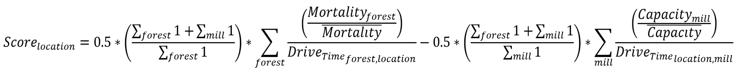
Algorithm TO PRIORITIZE SITING
Goal = add mills where fire mortality is highest, and competition is lowest
Fire mortality of each mill location (supply)
More forest plots than mills – scales two factors
Drive time from plot to mill – farther away = lower value
Competition of each mill – lower value = farther from other mills (demand)

Slide 16
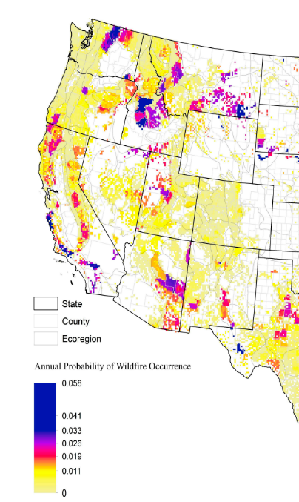
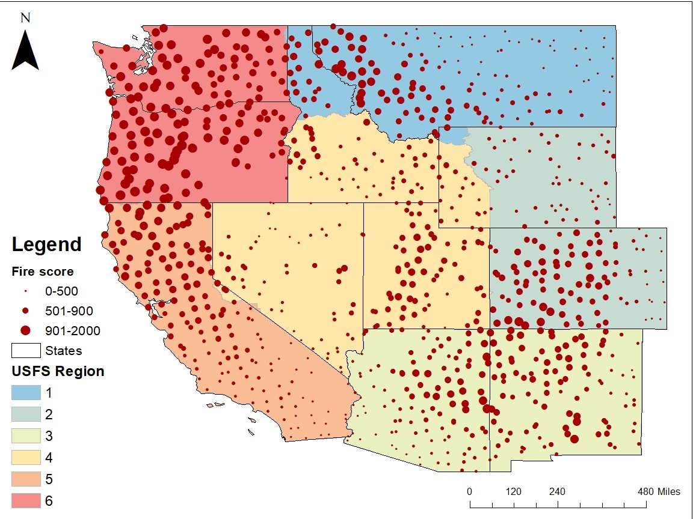
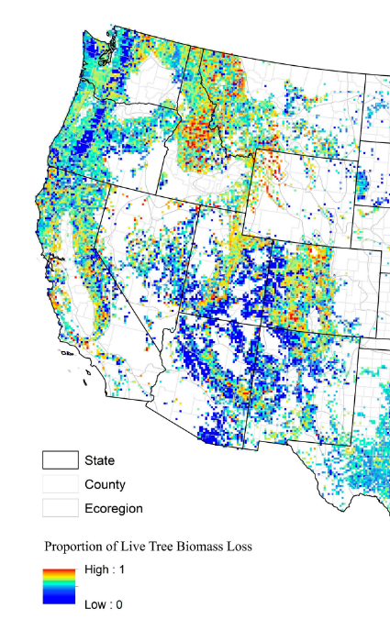
POTENTIAL FIRE EMISSIONS SCORING

Slide 17
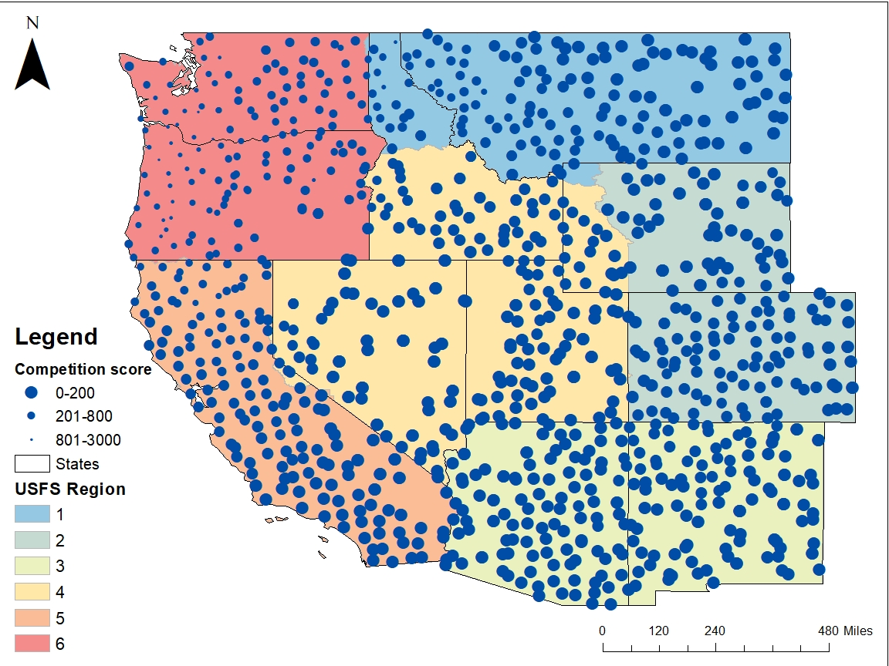
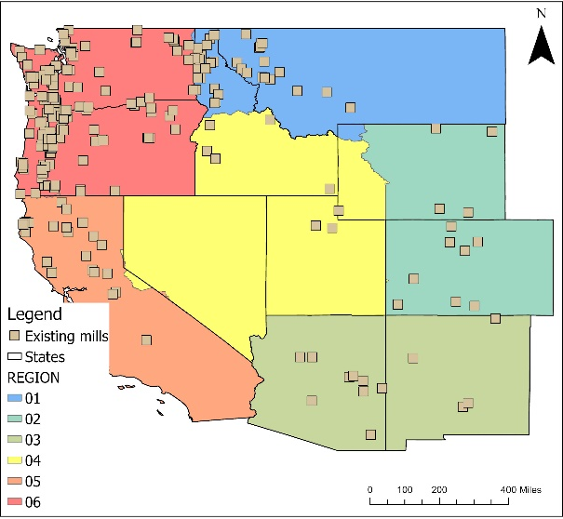
POTENTIAL COMPETITION SCORING

Slide 18
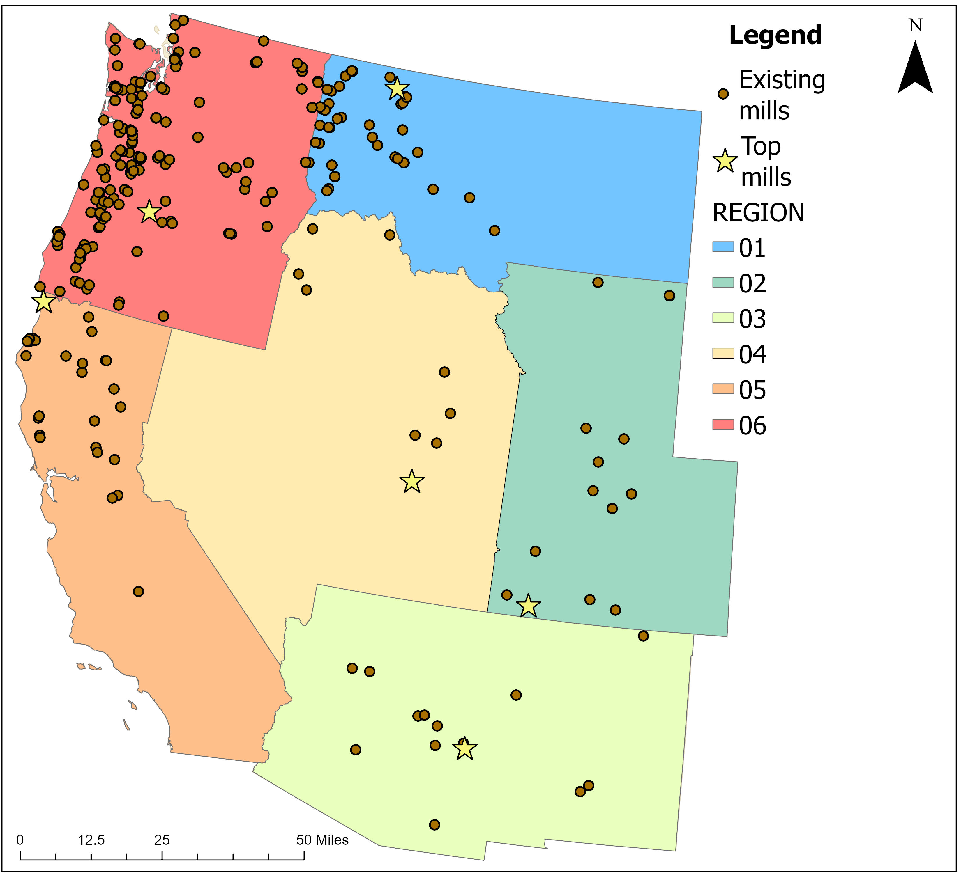
results
Notes:
When we decide to add one mill in each region, here are the top 6 across the Western United States

Slide 19
Land use and resource allocation (lURA) model
Market model with price sensitive demand and transportation networks (Latta et al., 2018)
  Static phase
    Balances supply with demand in a single year by Maximizing Net Social Surplus
  Dynamic phase
    Allocates new capacity and updates forest inventory between years
Latta, G. S., Baker, J. S., & Ohrel, S. (2018). A Land Use and Resource Allocation (LURA) modeling system for projecting localized forest CO2 effects of alternative macroeconomic futures. Forest Policy and Economics, 87, 35-48.

Slide 20
Scenarios
Model runs from 2020-2038 with mills added in 2023
Two sensitivities:
  Scale – how many facilities are added?
    1 or 3 per region
  Scope – who participates?
    Everyone or only federal forests (USFS)
Today's focus: One mill added in each region, all owners participating

Slide 21
results

Slide 22
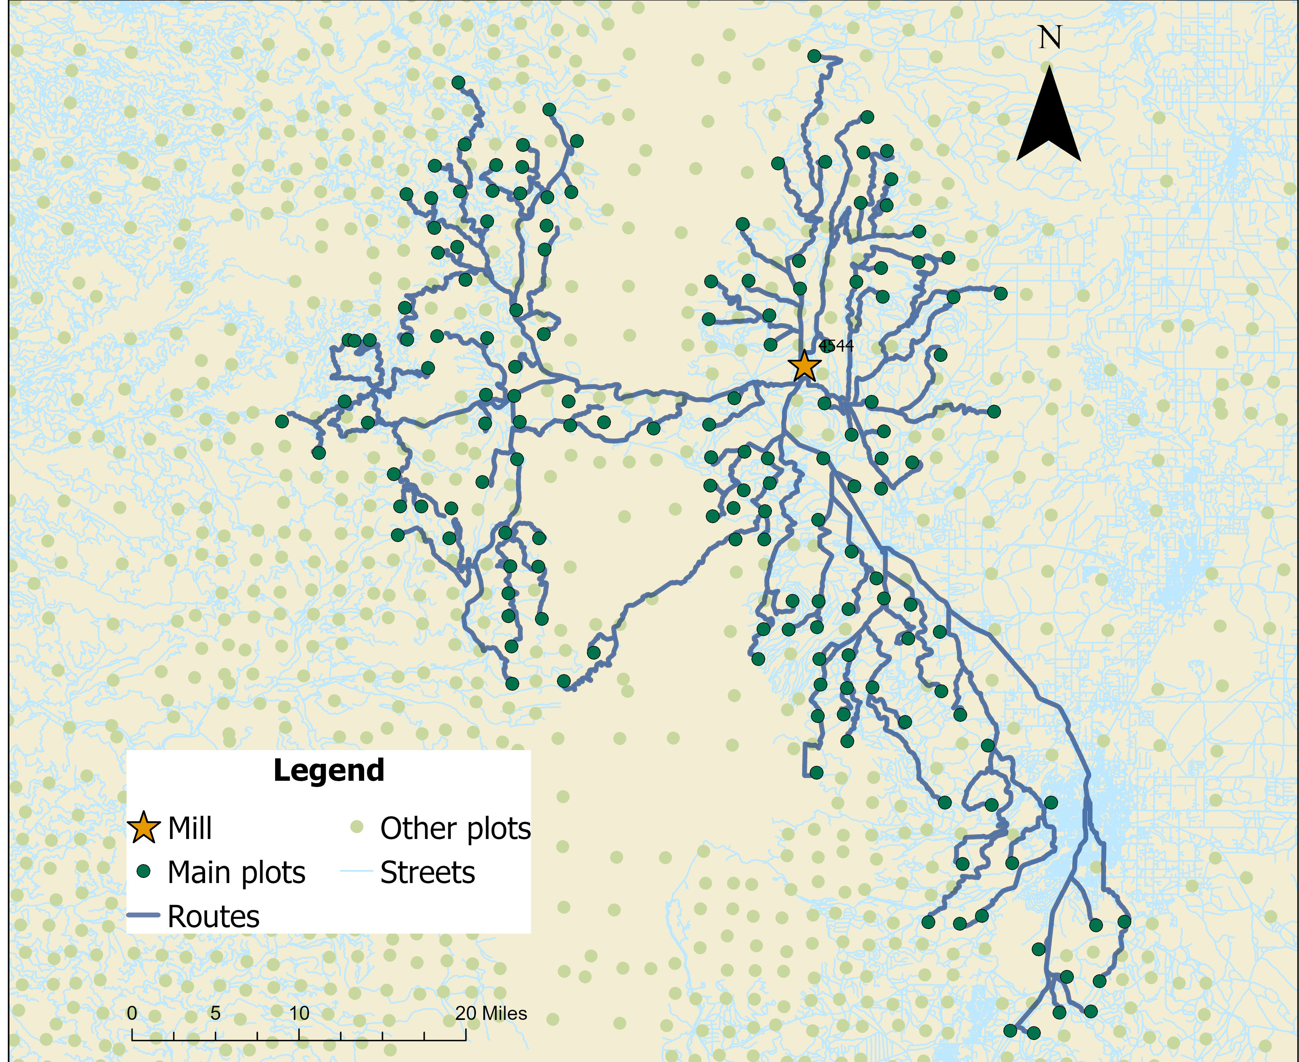
Supply shed
Plots receiving treatment
Plots NOT receiving treatment
Haul routes
Notes:
Doesn’t form a circle, determining the supply shed is a function of the geography

Slide 23
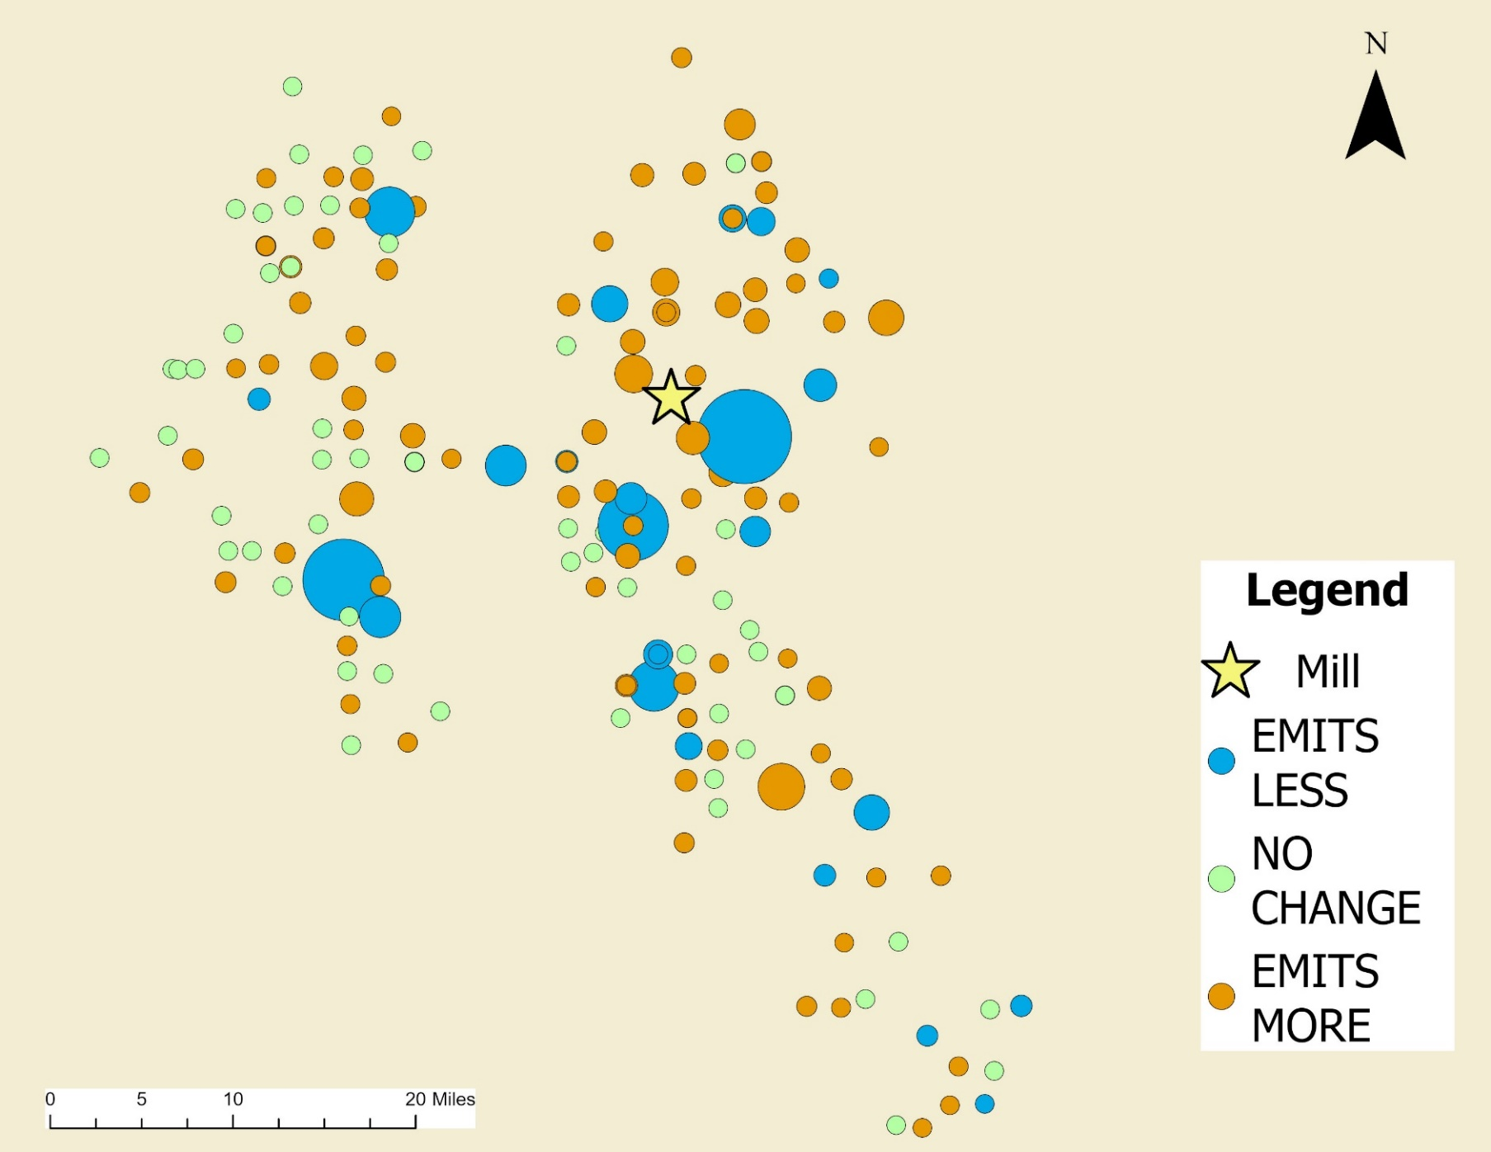
Results – fire emissions
~6.38 → ~5.51 MMT CO₂
↓13.7%
Notes:
Overall those plots emitted 900k metric tons or 13.7% less of CO2.

Slide 24
Summary stats – annual average 2023-2038
SCENARIO | FIRE EMISSIONS | TOTAL EMISSIONS | FIRE % CHANGE | TOTAL % CHANGE
MMT CO₂
0 mills (base) | 16.67 | -216.49
1 mill, all | 15.88 | -206.22 | -3.92 | 3.98
1 mill, USFS | 16.01 | -209.76 | -3.30 | 2.61
3 mills, all | 15.53 | -195.94 | -5.70 | 7.97
3 mills, USFS | 15.87 | -205.80 | -3.98 | 4.14
Fire emissions ↓ ~4% while
total emissions ↑ 4%
Looks good at the national level, but all over the place at the mill level

Slide 25
Failure #2 – harvesting to reduce emissions
The idea here was to increase forest production in California
Scenarios
Baseline (current capacity)
2× capacity (double Californian forest products manufacturing)
3× capacity
10× capacity
Time horizon: 15 years
As California had substantial fire emissions, we were expecting to see overall forest emissions go down (we use the high-risk stuff and leave low risk stuff on the landscape in other states)
Problem is, I used the stochastic fire setup in LURA
And had to redo the analysis with the deterministic fire setup

Slide 26
Head scratching
The results got me thinking
First off – the model is relatively slow to run
  So we are not going to do a Monte Carlo thing
The deterministic fire approach is the way to go for developing policy/management actions
The stochastic fire approach is the way to go for tempering expectation regarding policy/management outcomes
  I do worry though about its use – but -
Take-home points
  Fire representation fundamentally changes estimated outcomes
  Fuel treatments reduce risk, not guaranteed emissions
  Stochastic modeling is critical for realistic policy evaluation

Slide 27
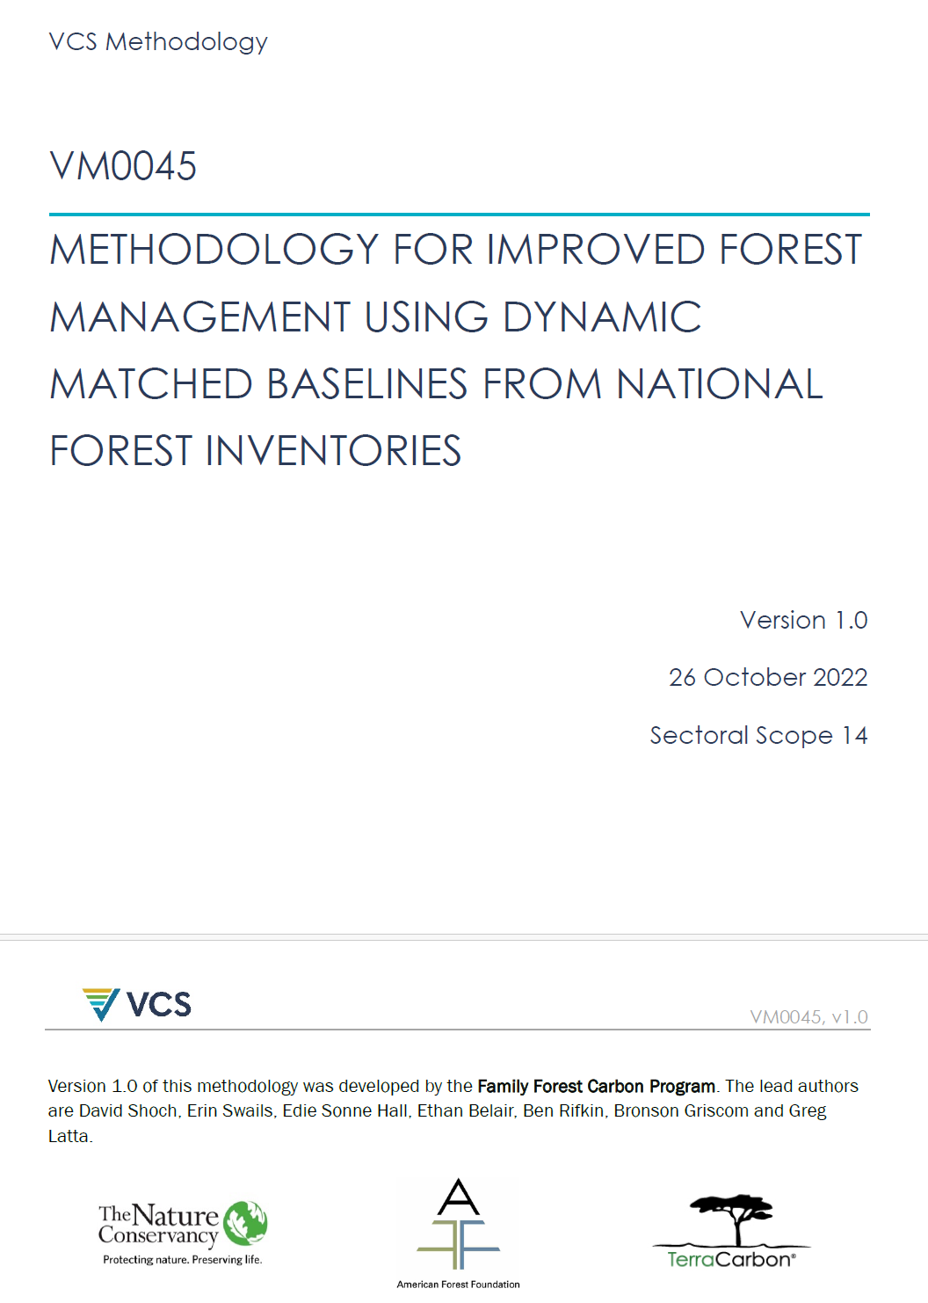
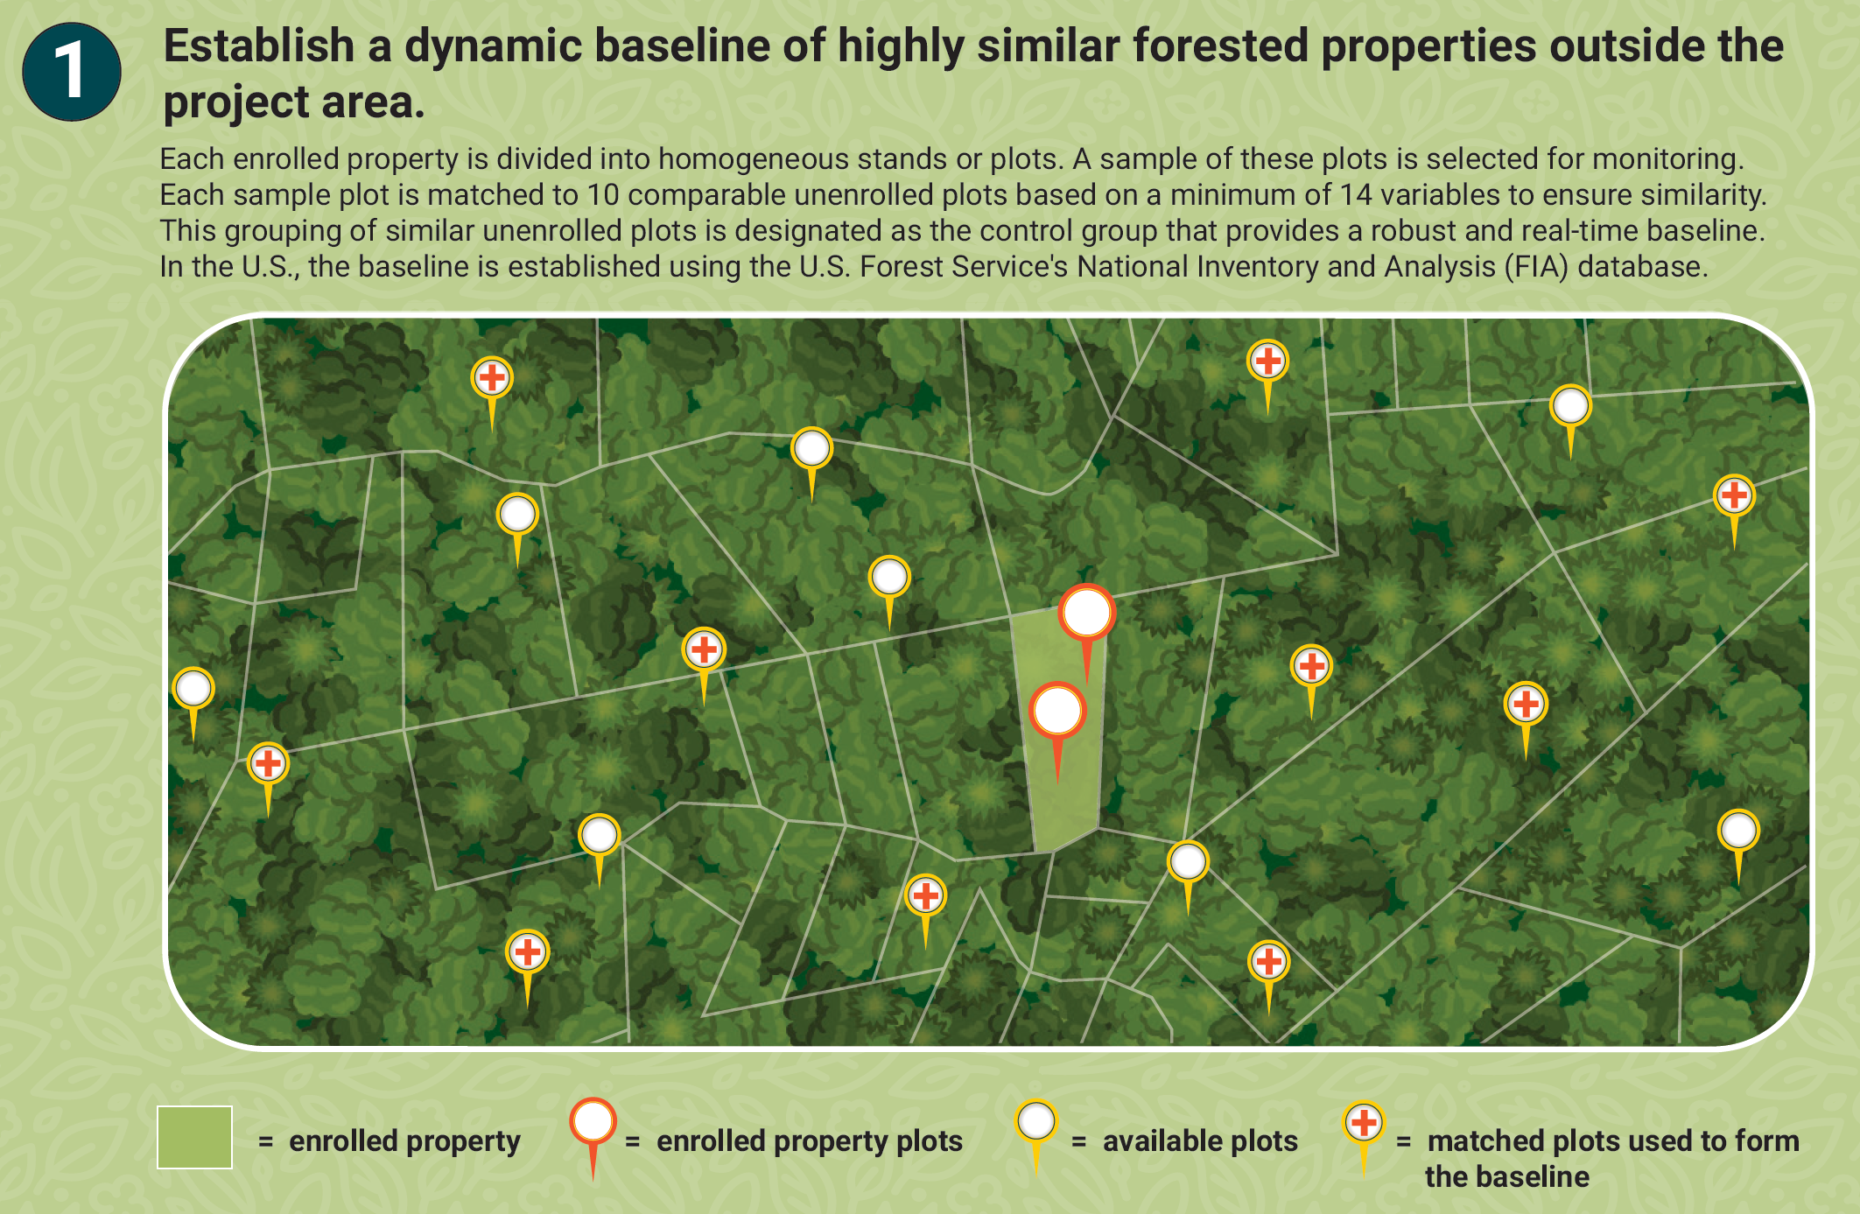
The pivot
What about forest carbon offset programs?
What else is random / stochastic?
  Non-industrial private forest landowners
VM0045
  You compare your property
  To how many others?
    10

Slide 28

Greg Latta
Director, Policy Analysis Group
glatta@uidaho.edu
e-newsletter and reports
http://www.uidaho.edu/cnr/pag

