Slide 1
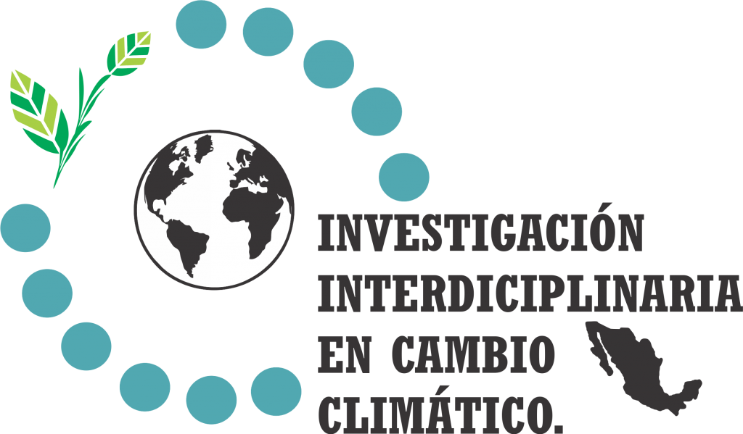

Impacts of climate change and extremes on agricultural yields in Mexico
Guillermo Murray-Tortarolo
Instituto de Investigaciones en Ecosistemas y Sustentabilidad
UNAM

Slide 2
A team effort
Guillermo Murray-Tortarolo^{1,*}, Fabiola Murguía Flores^{1,2}, Natalia Flores^{1,2}, Rafael Bernal^{1,2}, Quetzalli Flores^{1,2}, Diego R. Pérez-Salicrup¹, Fermín Pascual¹, Montserrat Serrano-Medrano, Daniela Rosales-Tapia, Arhat Tejeda Aguilar.

Slide 3
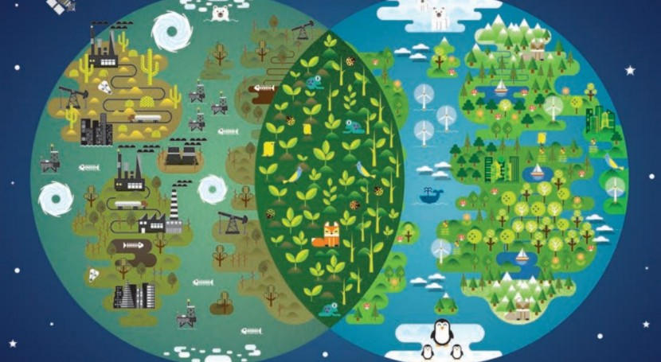
Current CC risk: life and food production

Slide 4
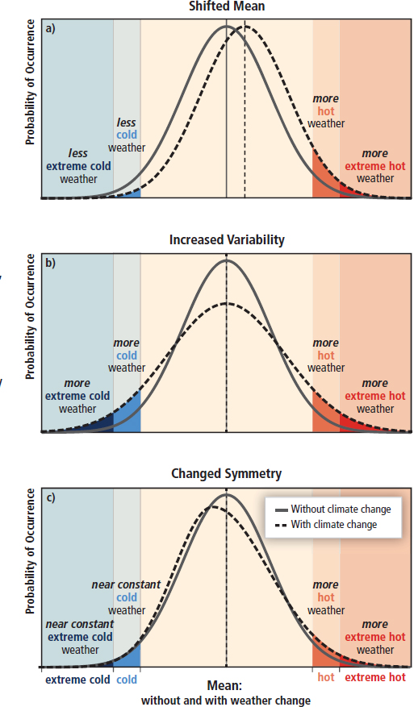
Three types of change
TRENDS
Extreme Events
Seasonality

Slide 5
Changing climate across Mexico

Slide 6
Long-term trends

Slide 7
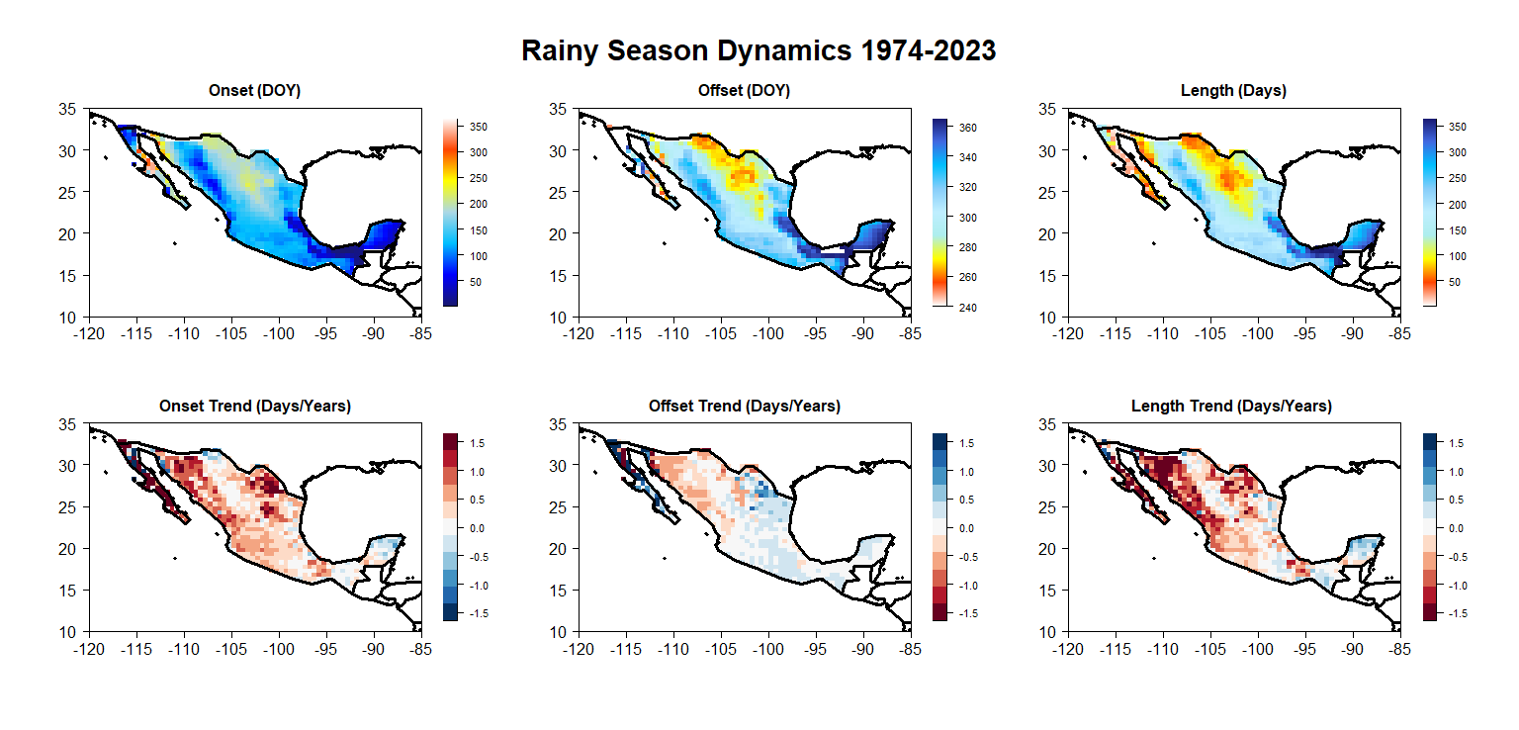
Rainfall Seasonality
Cristina Pérez. In progress

Slide 8
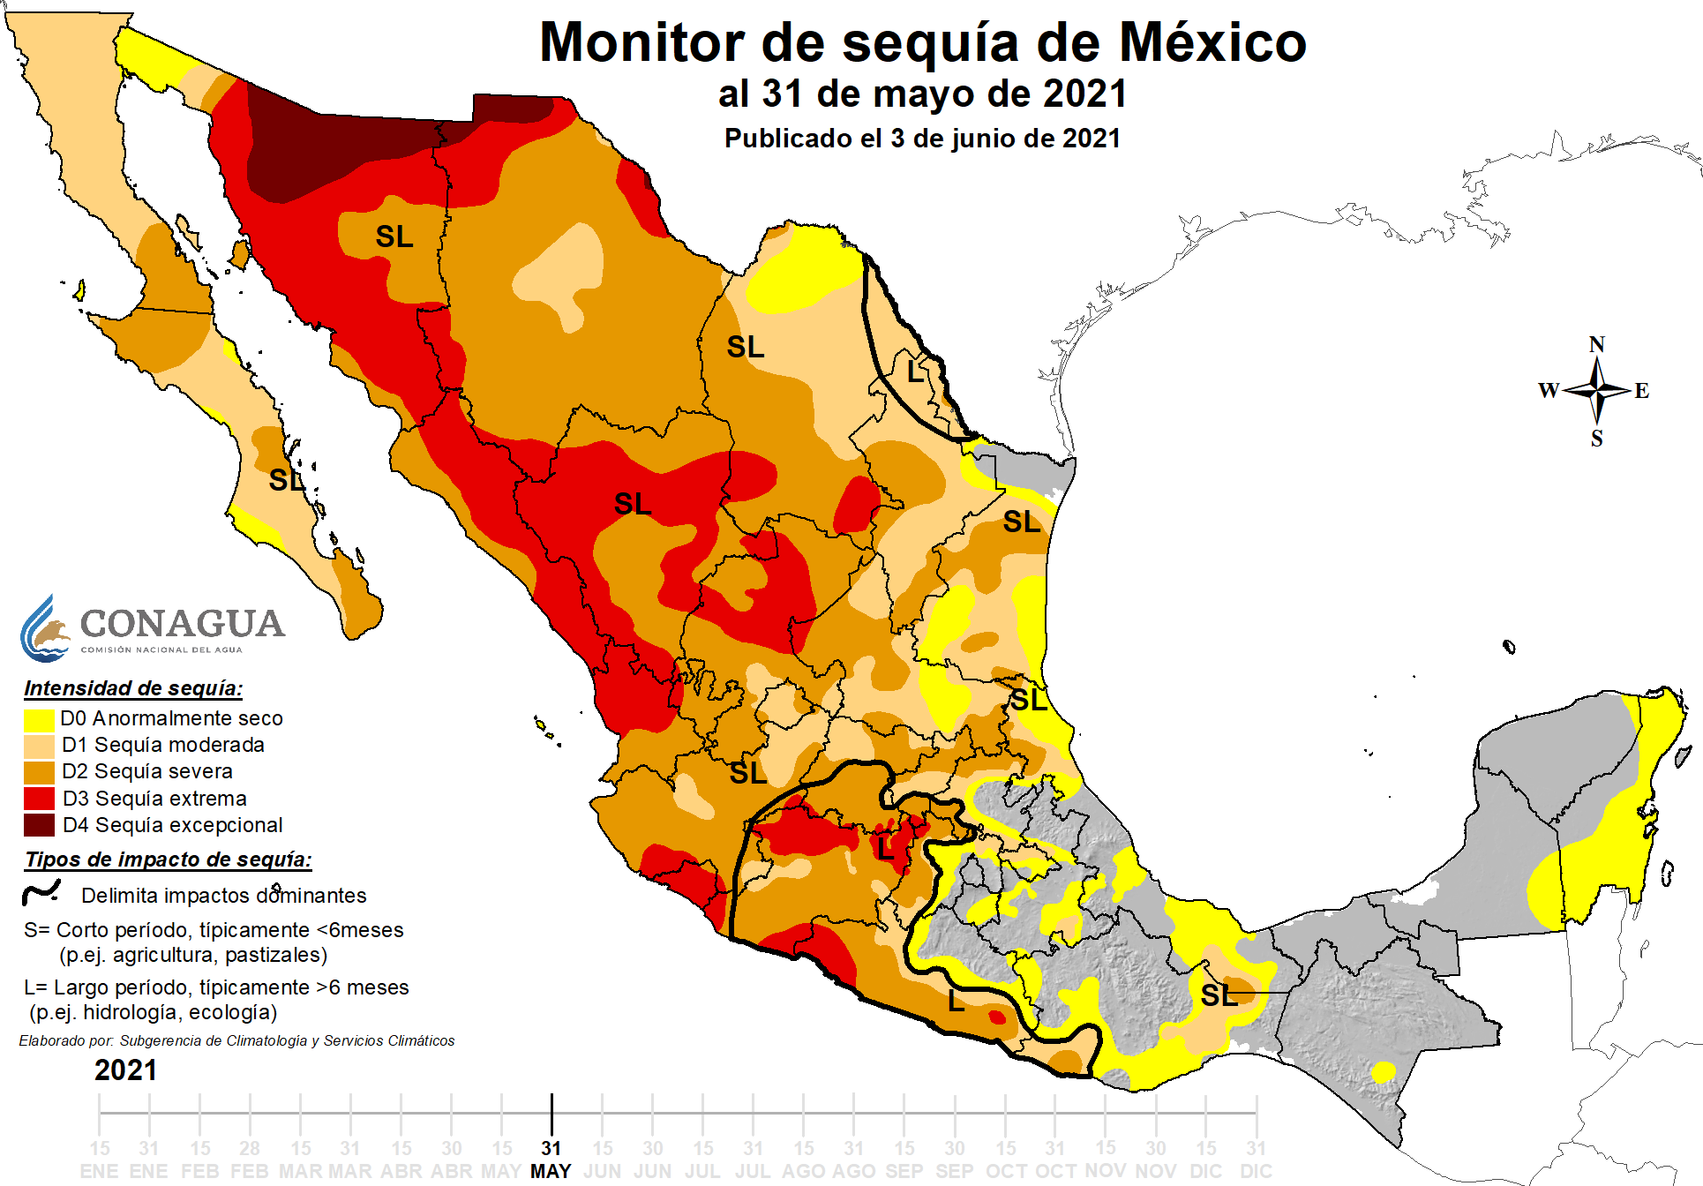
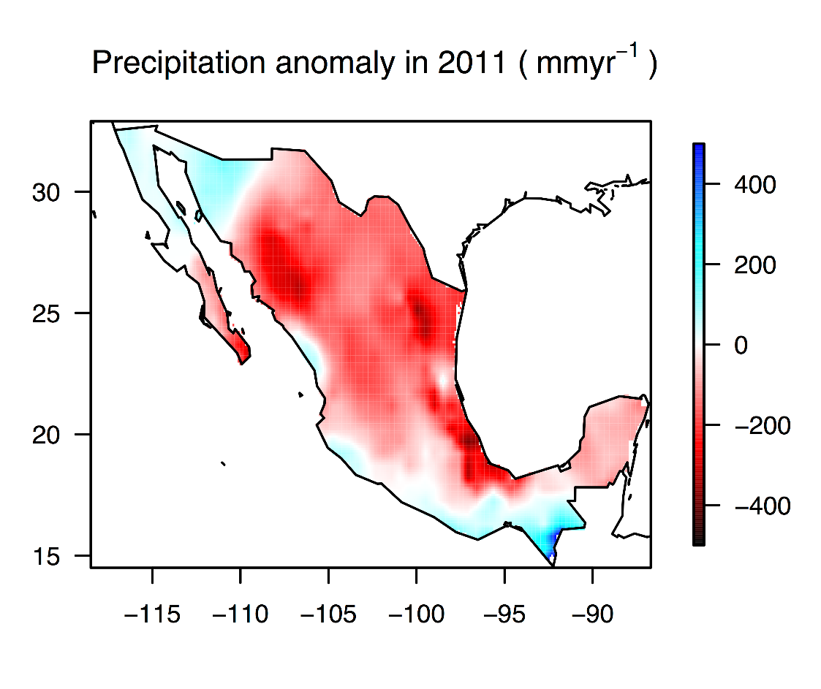
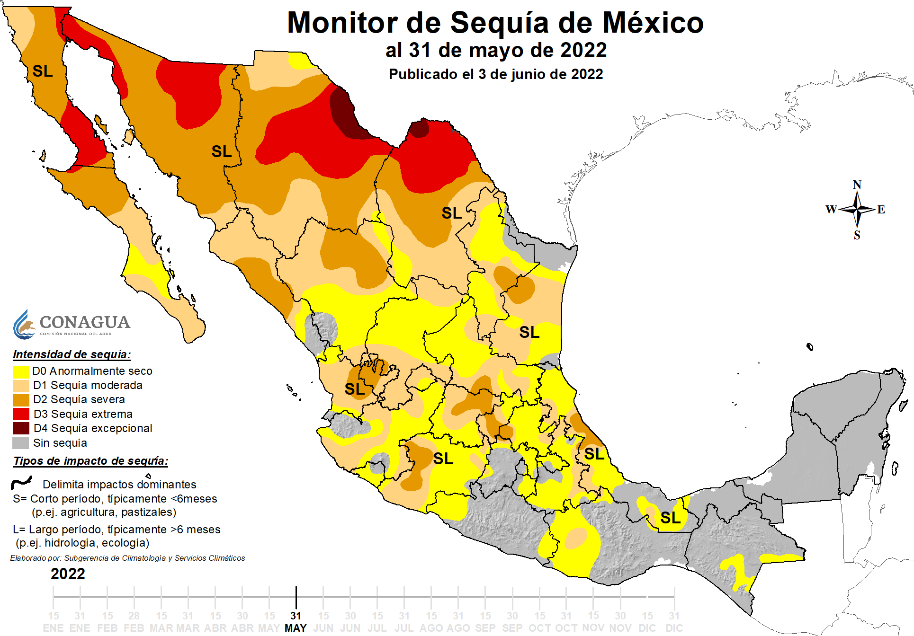
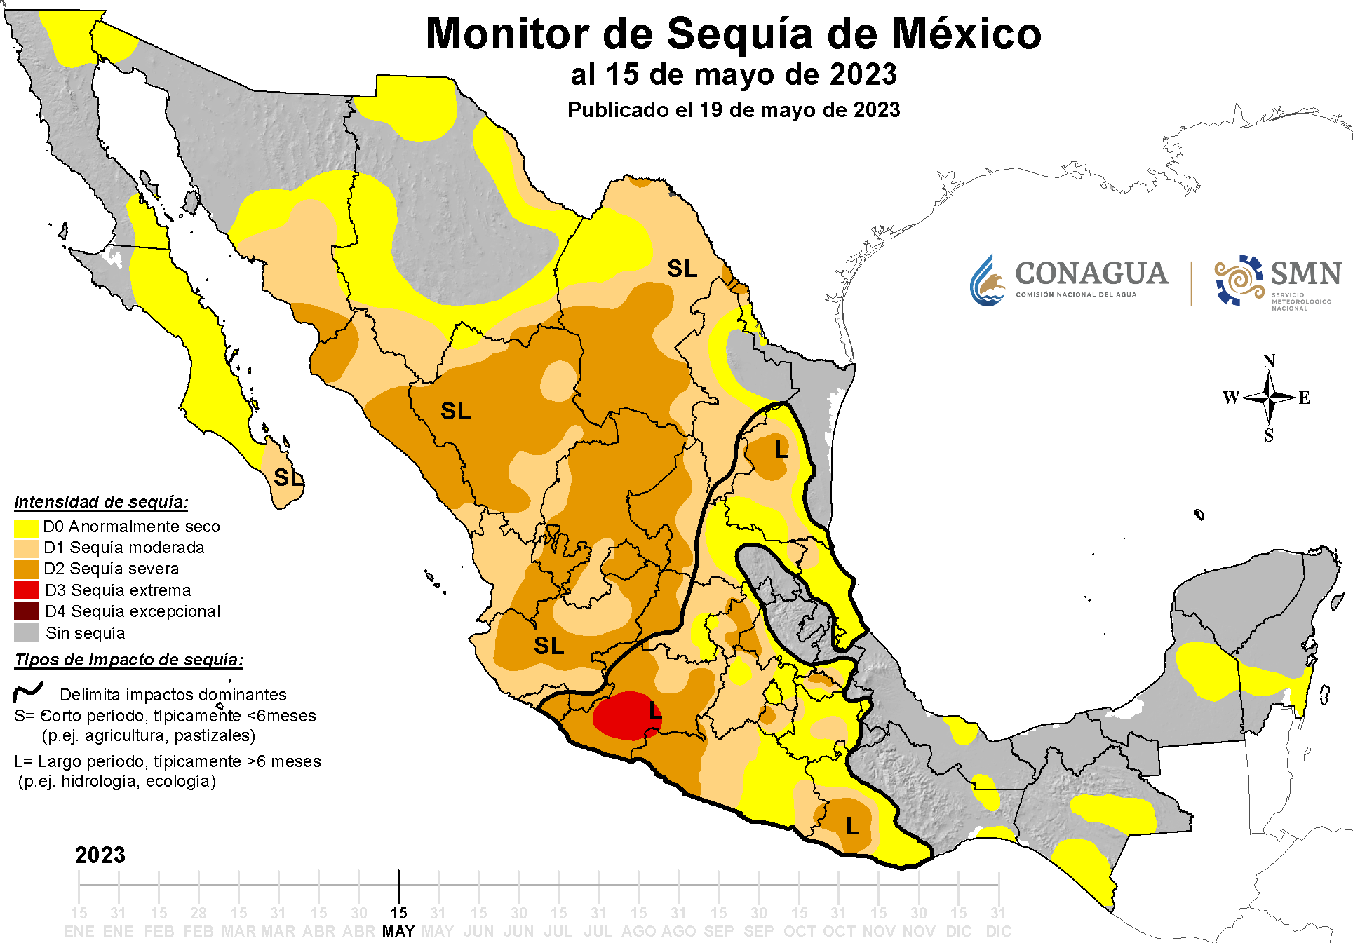
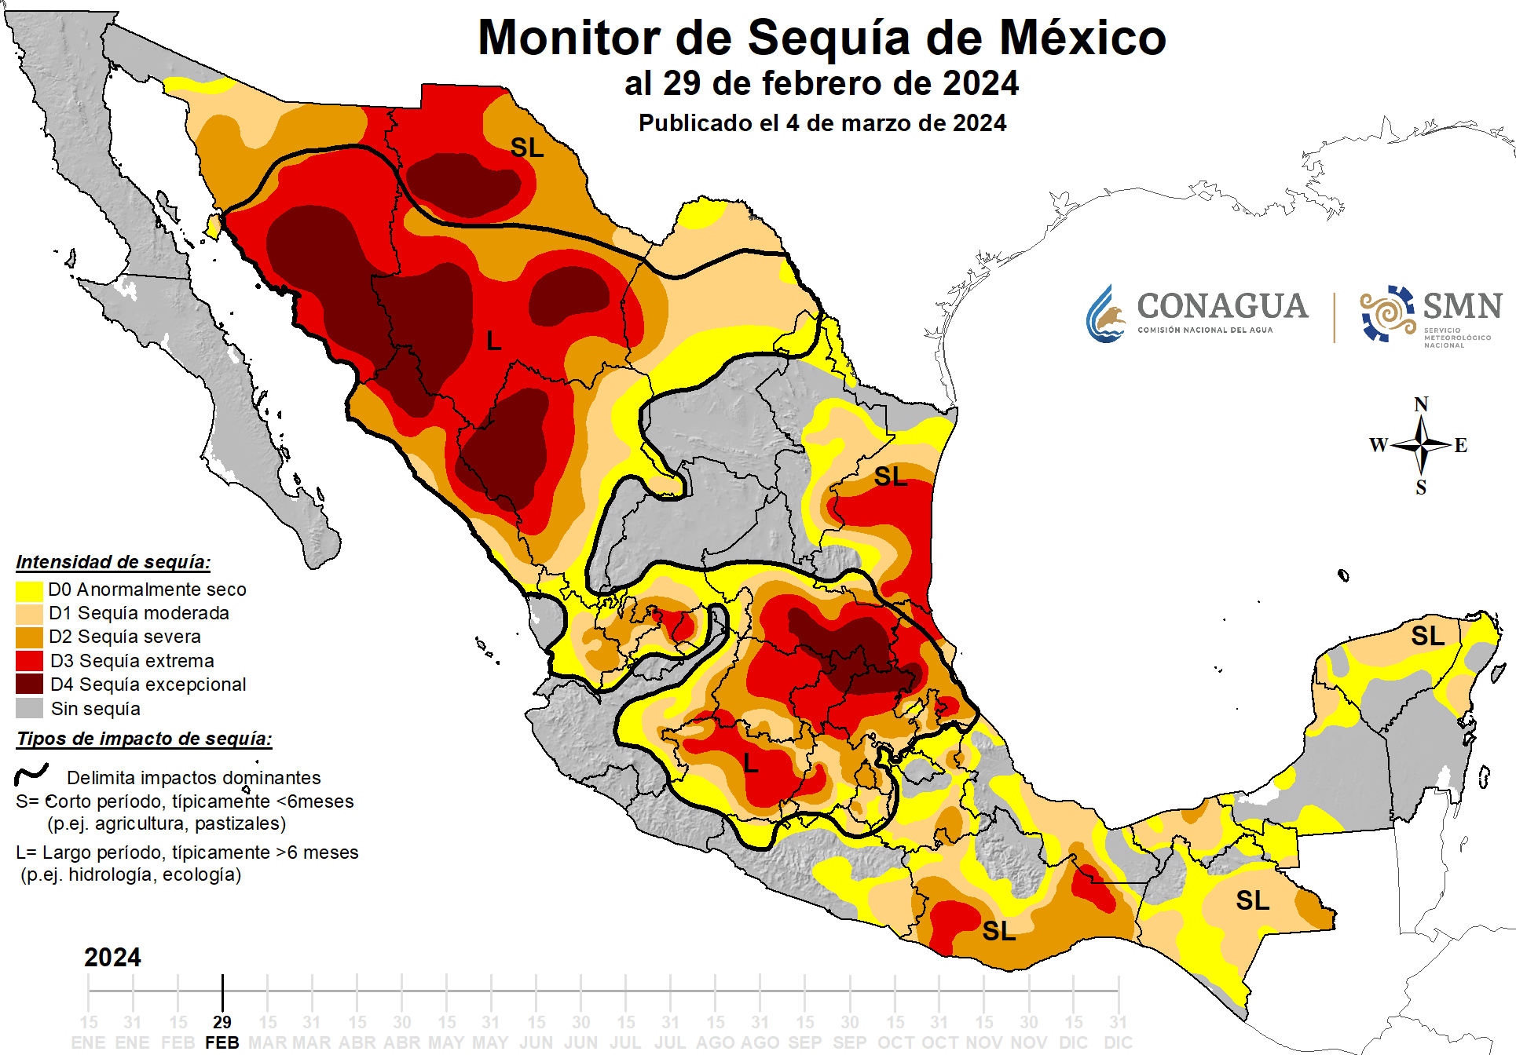
Extremes (drought)
https://smn.conagua.gob.mx/es/climatologia/monitor-de-sequia/monitor-de-sequia-en-mexico

Slide 9
Impacts on food production

Slide 10
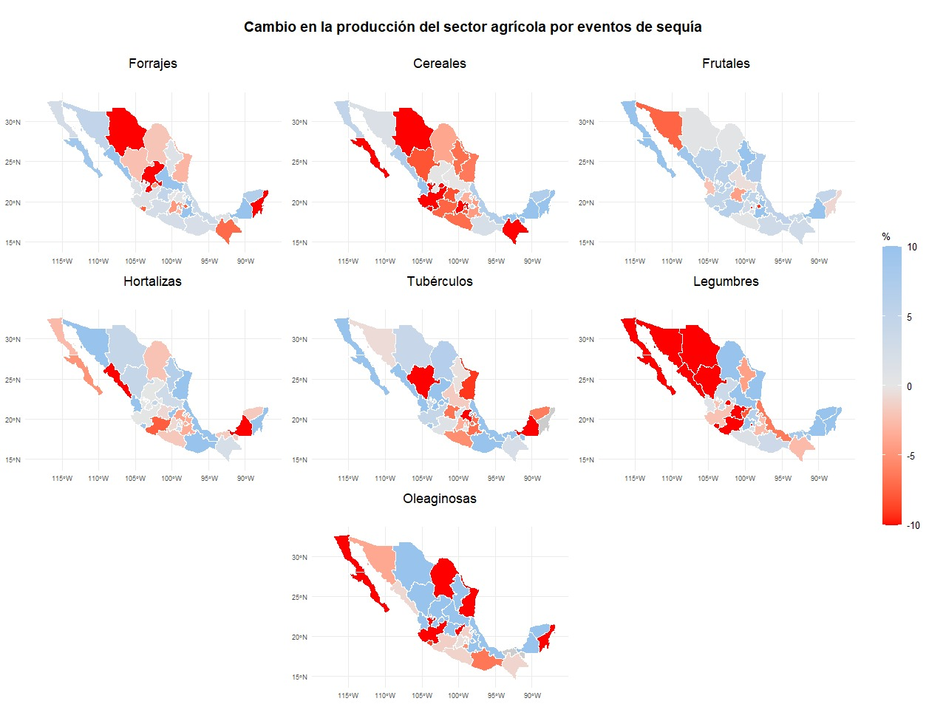
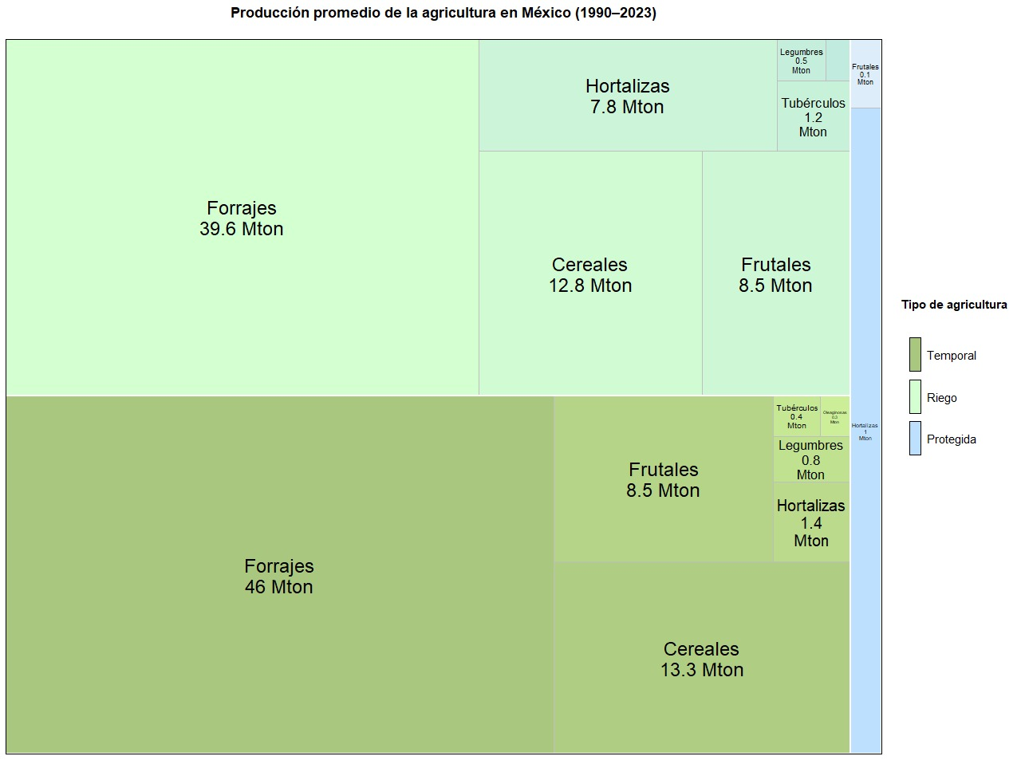
Agriculture in Mexico

Slide 11
Rainfed maize (future scenarios)
RCP | Mean Precipitation Change (mm) | Mean Maize Yield Change (ton/ha) | Mean Production Change (mill ton and %)
2.6 | 9.9 ± 15.8 | 0.02 ± 0.15 | +0.05 (0.05%)
4.5 | -15.4 ± 21.4 | -0.04 ± 0.17 | -0.33 (-3.8%)
6.0 | -50.3 ± 26.0 | -0.13 ± 0.11 | -0.89 (-8.4%)
8.5 | -97.5 ± 83.9 | -0.26 ± 0.21 | -1.10 (-10.5%)

Slide 12
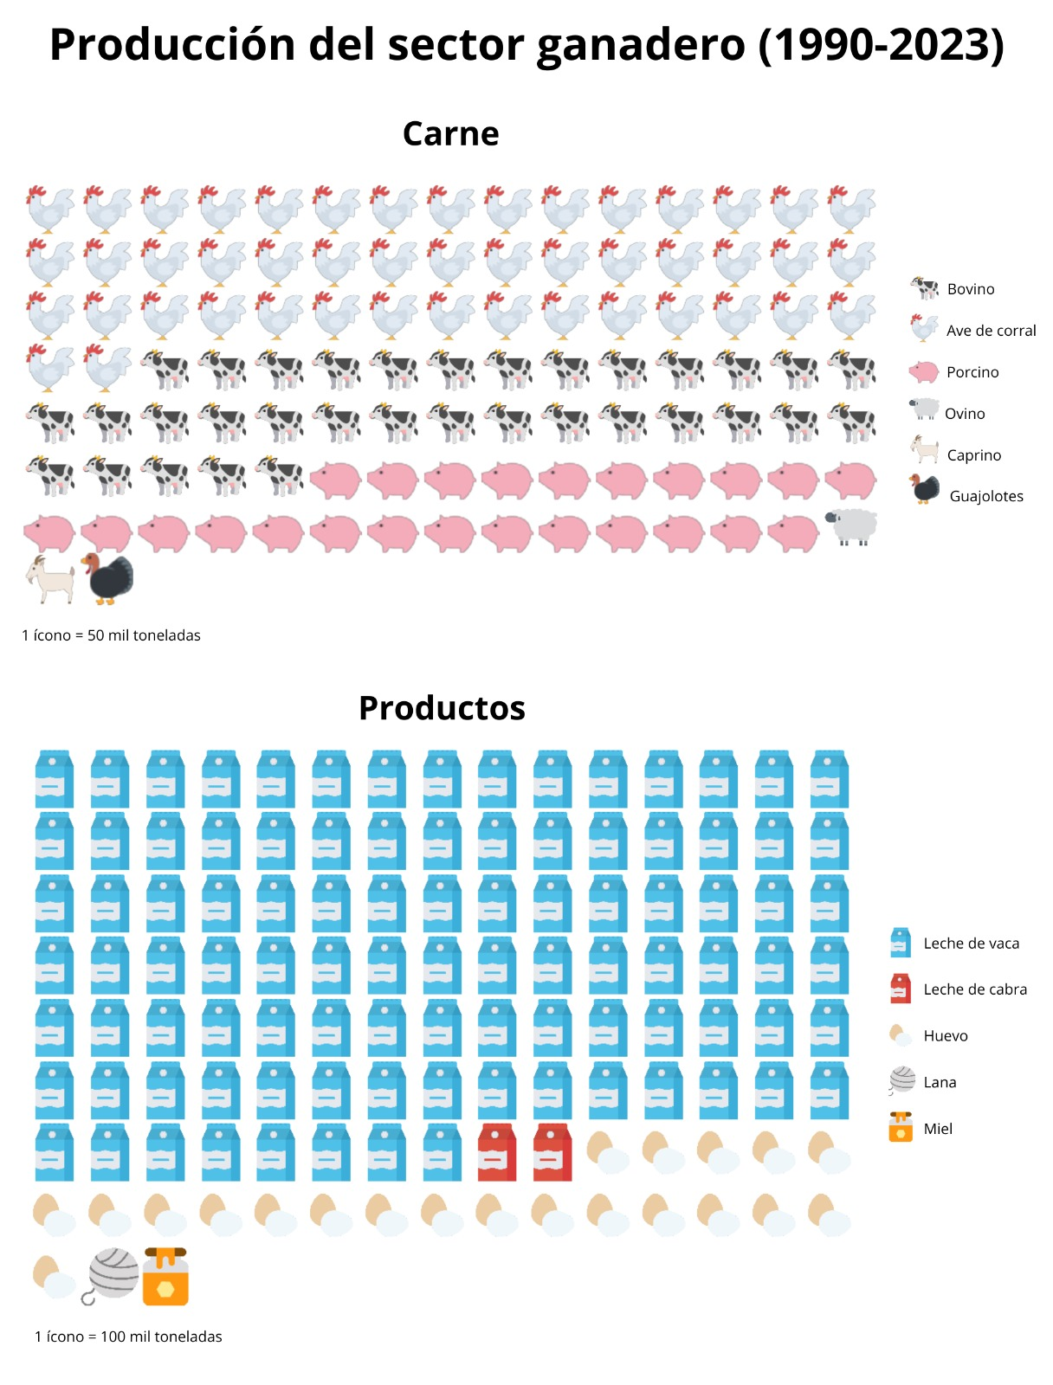
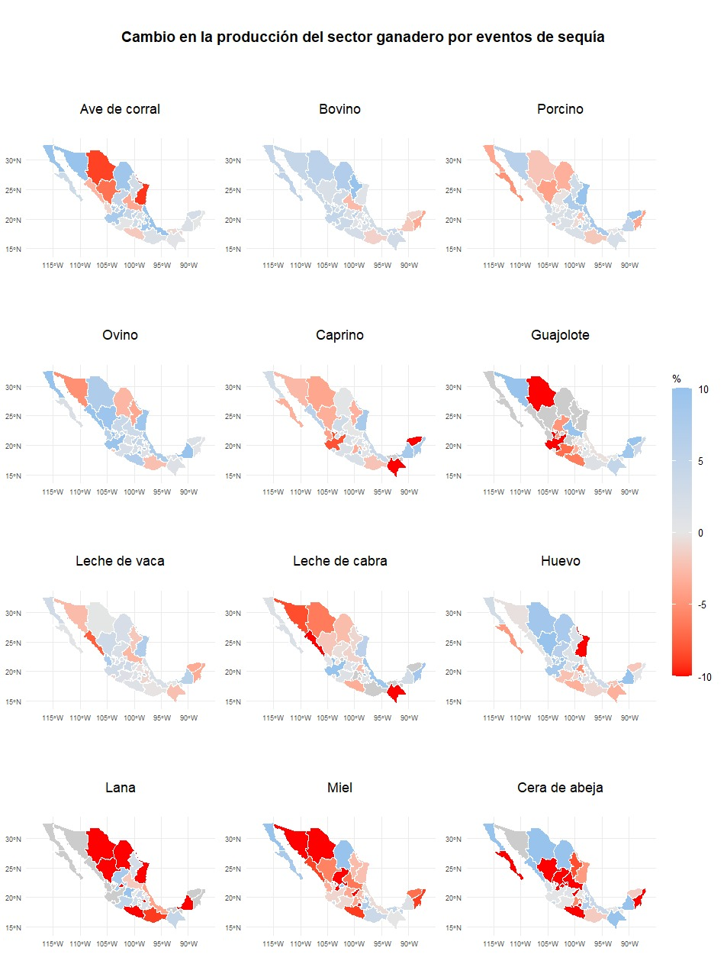
Livestock in Mexico

Slide 13
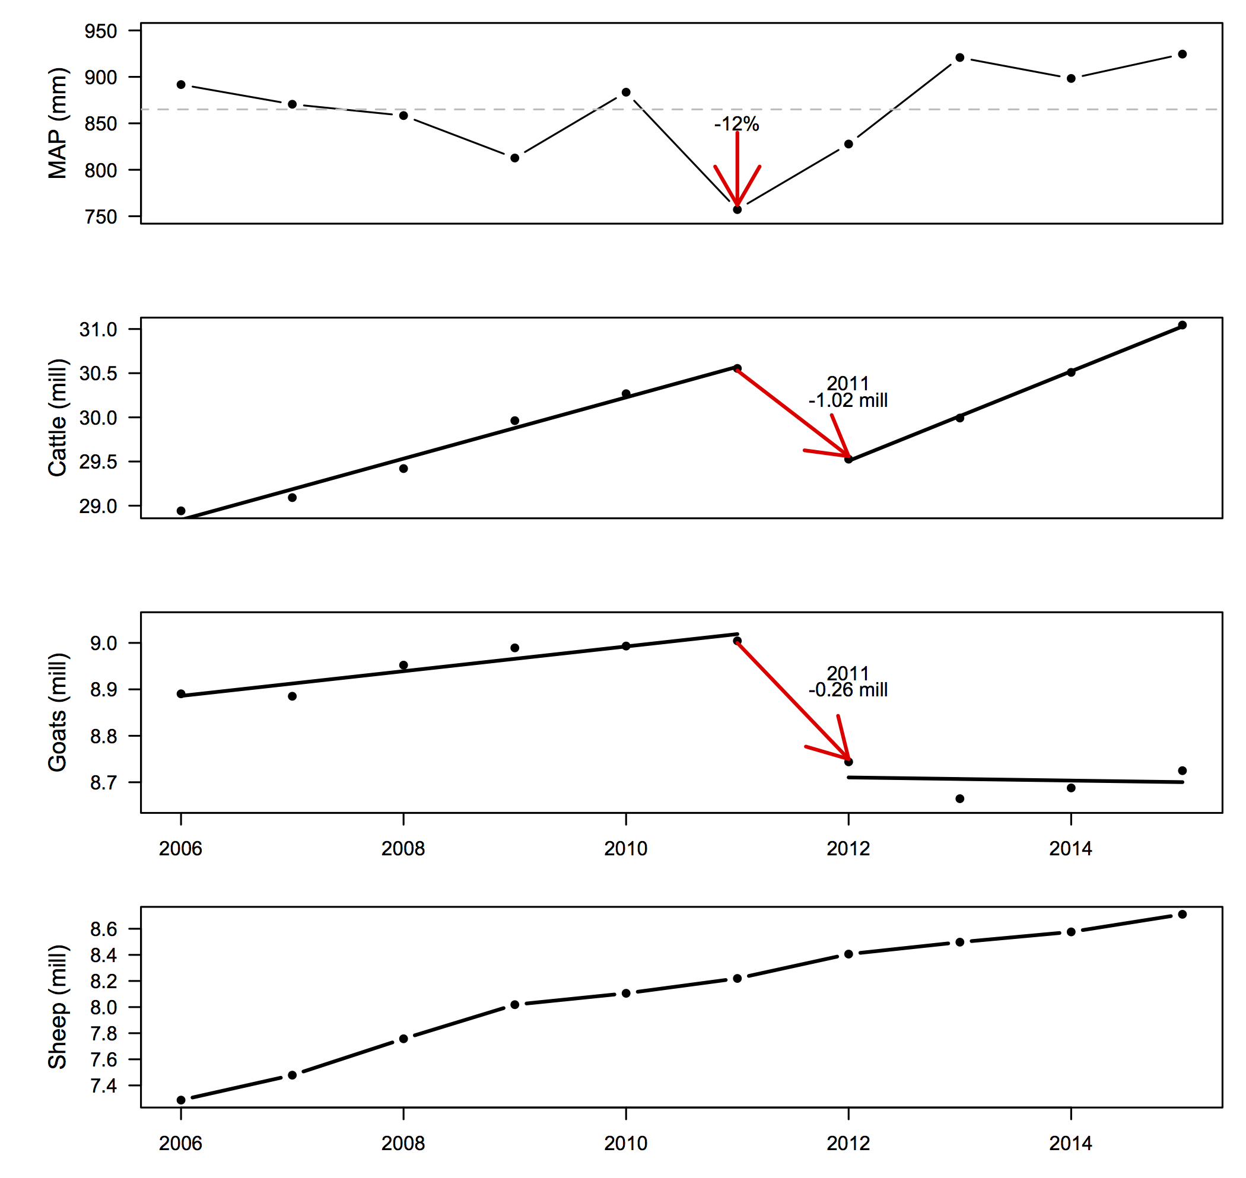
Extreme events: livestock

Slide 14

Extreme events: livestock

Slide 15
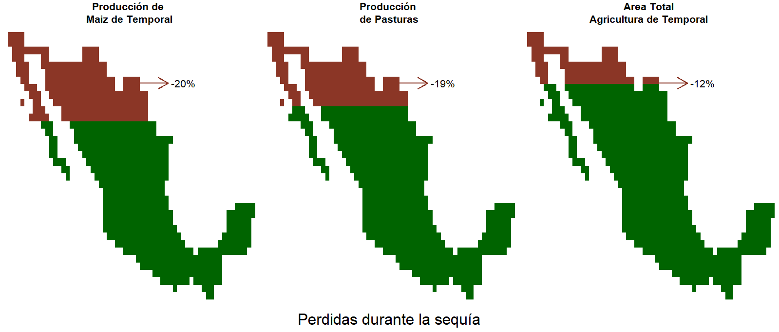
Extreme events: drought

Slide 16
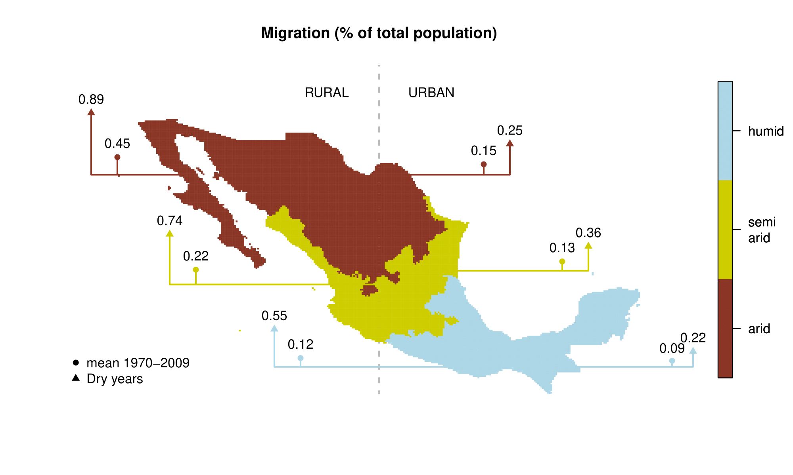
Extreme events and social fabric

Slide 17
Key messages
Climate change is intensifying across Mexico
  Drought is a dominant signal
The primary sector is increasingly affected
  Agriculture is the most vulnerable
  ~1 MUSD lost per drought event
Impacts cascade beyond production
  Livelihoods and wellbeing at risk
Urgent need for adaptation and resilience building

Slide 18
Thank you
gmurray@iies.unam.mx

