Slide 1

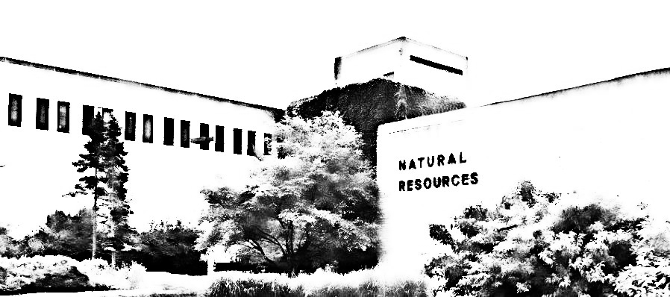
Using a Spatial Equilibrium Model to Identify Zones of Influence with Bioenergy Expansion
Raju Pokharel and Greg Latta
Michigan State University
University of Idaho
12th Forestry & Agriculture Modeling Forum
April 16, 2023
Duke Farm, NJ

Slide 2

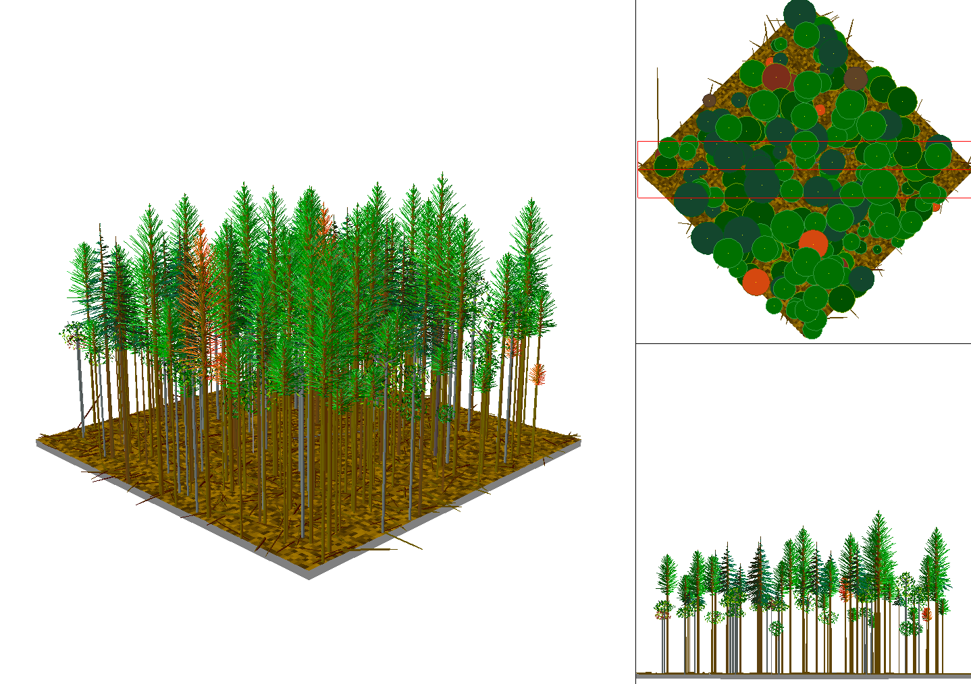

Conceptual Framework (what drives our expectations)
1. Joint Production at the Acre/Stand level
  Each acre has some mix of species and sizes
    When you harvest that acre
    You seek to merchandize all trees
  Smaller trees
    Have a merchantable pulp log
    And a biomass top
  Larger trees
    Also have saw log(s)
    And pulp and a top
Top
Pulp Log
Top
Saw Log
Pulp Log
Saw Log

Slide 3
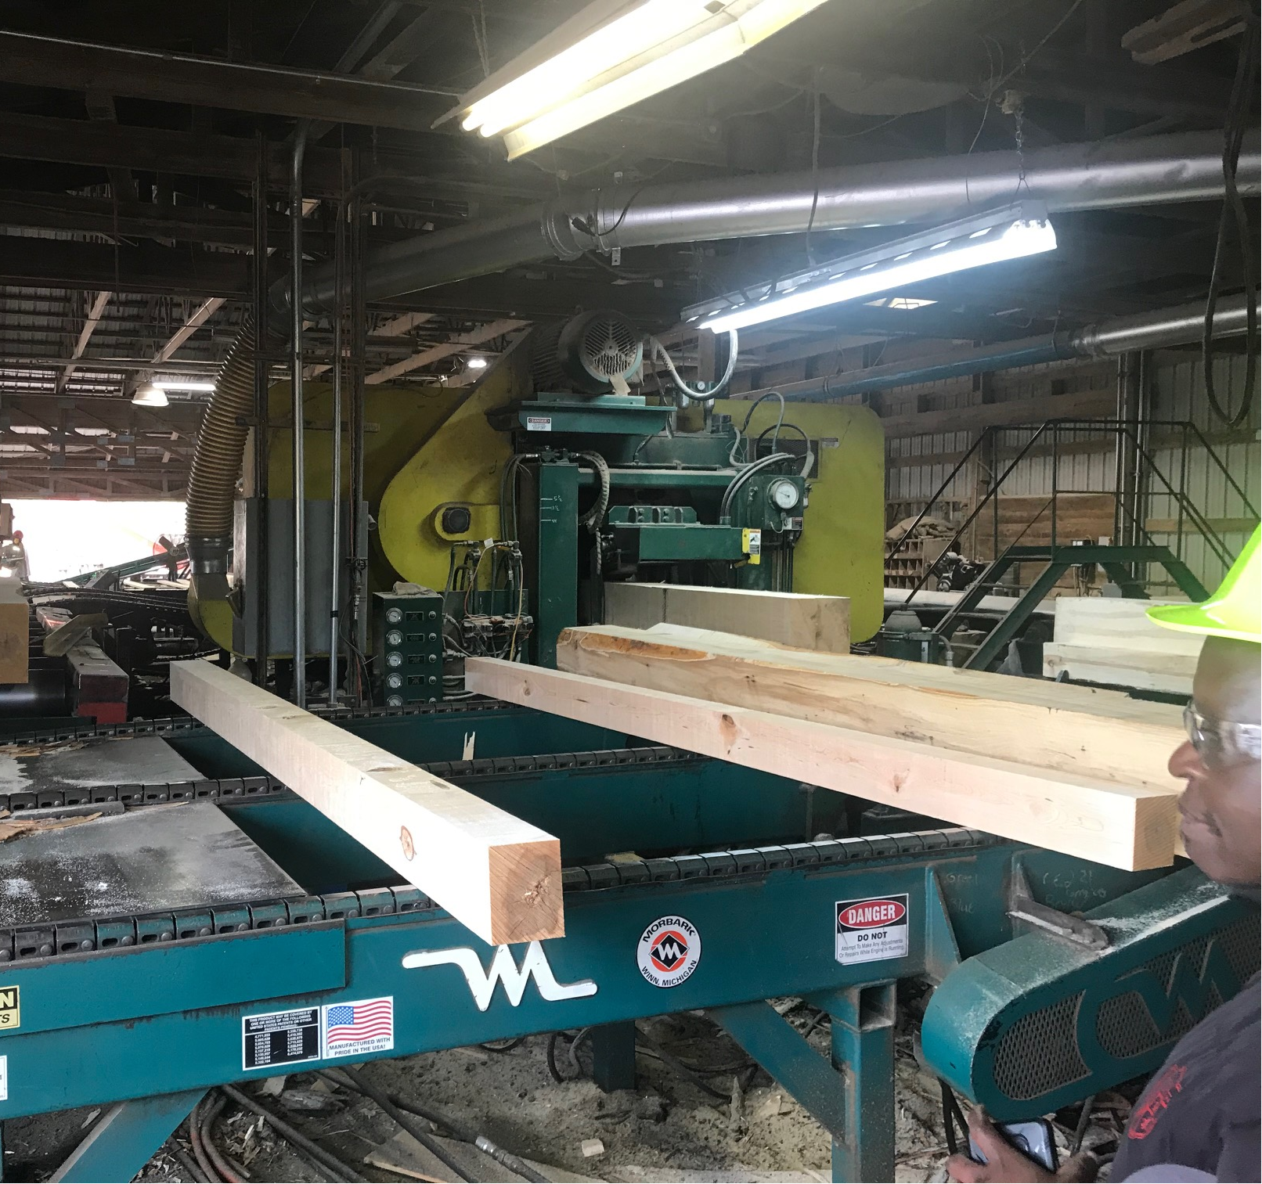
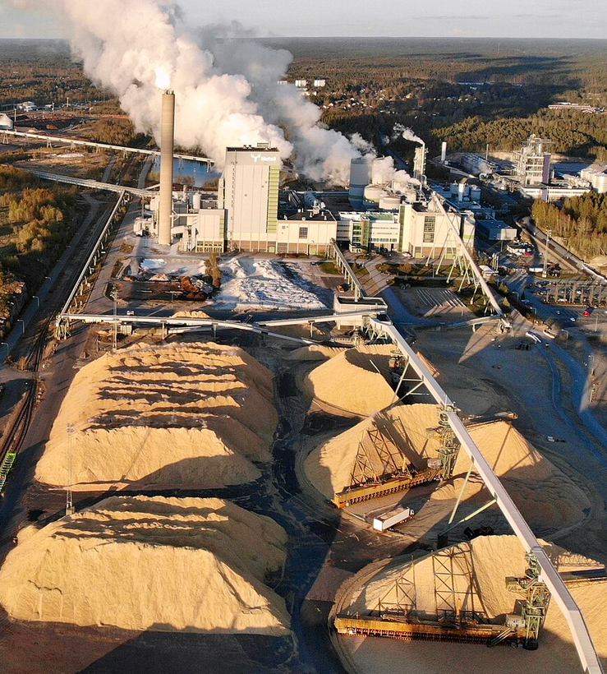
Conceptual Framework (what drives our expectations)
1. Joint Production at the Acre/Stand level
2. Competing Mills with differing inputs/outputs
  A mill is not a mill is not a mill
    A Sawmill Is different than a Pulpmill
  Sawmill
    Uses Saw Logs as an input
    Makes chips as a byproduct
  Pulpmill
    Uses Pulp Logs or Chips as an input
  They have different reactions to a new mill
    Either Complementary Or Competitive

Slide 4
Conceptual Framework (what drives our expectations)
Mill-level Demand
(willingness-to-pay)
1. Joint Production at the Acre/Stand level
2. Competing Mills with differing inputs/outputs
3. Endogenous Prices
  We assume mills are price sensitive
    At an existing equilibrium price
    They have a quantity they demand
  When the quantity available is reduced
    Willingness-to-Pay (Price) goes up
    And they may harvest different stands
    Or haul logs farther
Price ($/unit)
P’
P*
Q’
Q*
Quantity (units)

Slide 5
Conceptual Framework (what drives our expectations)
1. Joint Production at the Acre/Stand level
2. Competing Mills with differing inputs/outputs
3. Endogenous Prices
4. Zones of Influence
  We have a mill of interest
    It sources its inputs from a millshed
    We’ll call that the “Inner” zone
    This is where a lot of analyses stop
  But – there are mills in that Inner zone
    Some are complementary and others compete
    Their sourcing areas extend outside of the Inner zone
    We’ll call that the “Outer” zone
  And – there are also mills in that Outer zone
    Some are complementary and others compete
    Their sourcing areas extend outside of the Outer zone
    We’ll call that the “Beyond” zone
  There are also mills in that Beyond zone
    I think you get it - The Effects Ripple through the market
Beyond
Outer
Inner

Slide 6
Conceptual Framework (what drives our expectations)
1. Joint Production at the Acre/Stand level
2. Competing Mills with differing inputs/outputs
3. Endogenous Prices
4. Zones of Influence
A spatial partial equilibrium model can handle all these needs

Slide 7
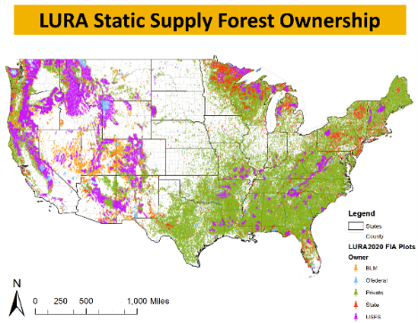
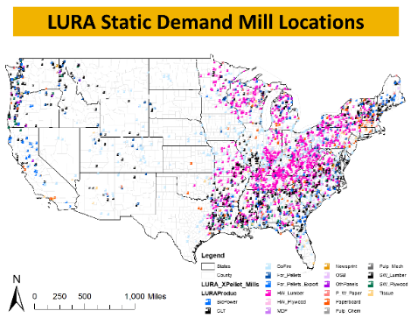
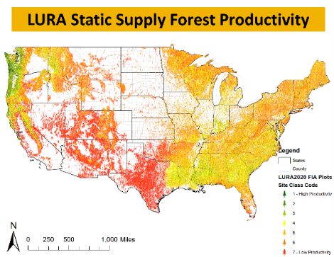
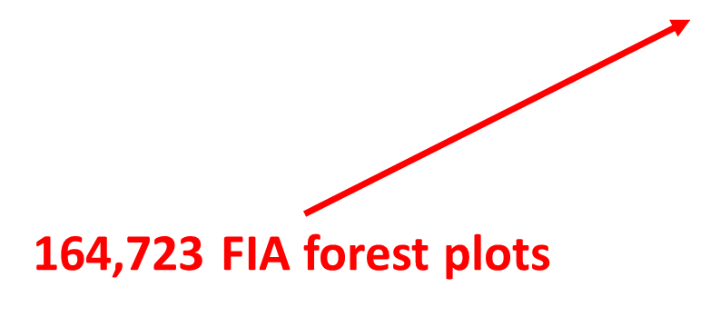
LURA Model background
Balance supply and demand with price sensitive demand
Which has a forest land base representation (164k plots)
And a forest products market representation (3.4k mills)
LURA Static Supply Forest Ownership
LURA Static Demand Mill Locations
LURA Combined Forest Sector
LURA Static Supply Forest Productivity
126 Ports/Border Crossings
3,365 Manufacturing Facilities

Slide 8
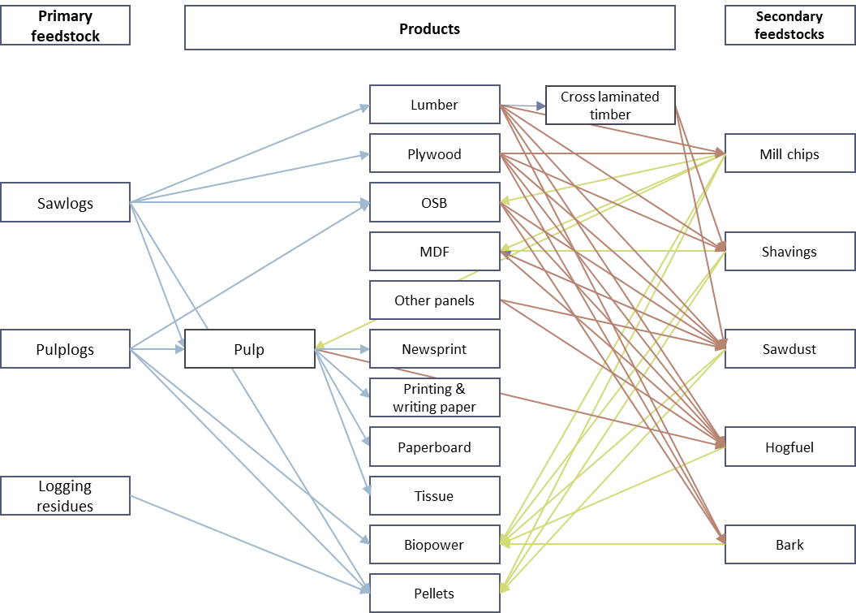
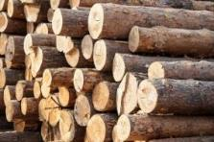
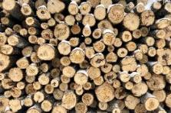
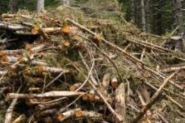
LURA Cascading wood flow
Primary feedstocks used in wood products and energy
Residues generated in wood products production
Residues used in wood products and energy

Slide 9
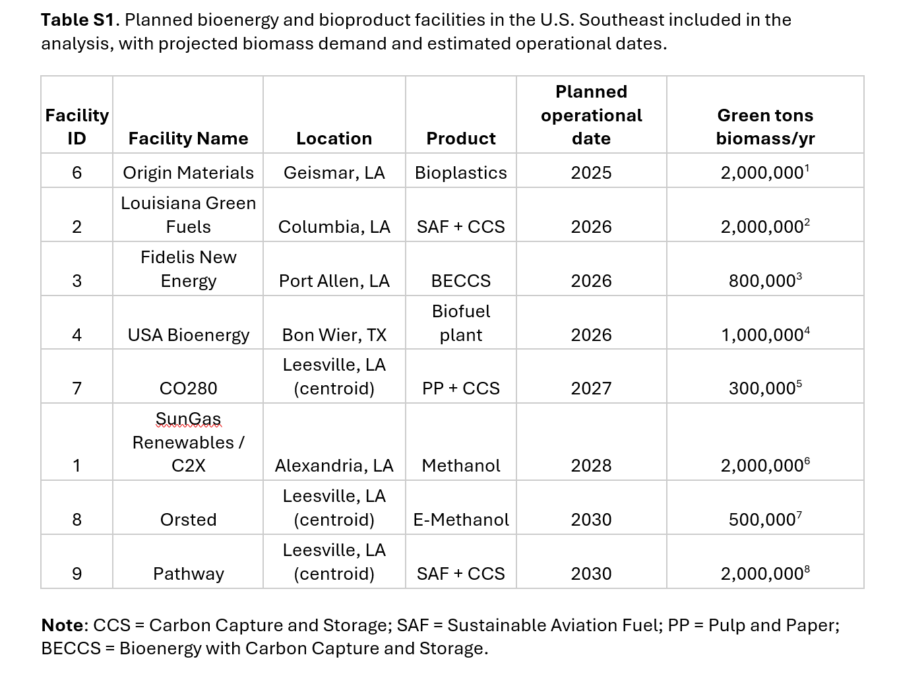
Planned
Expansion

Slide 10
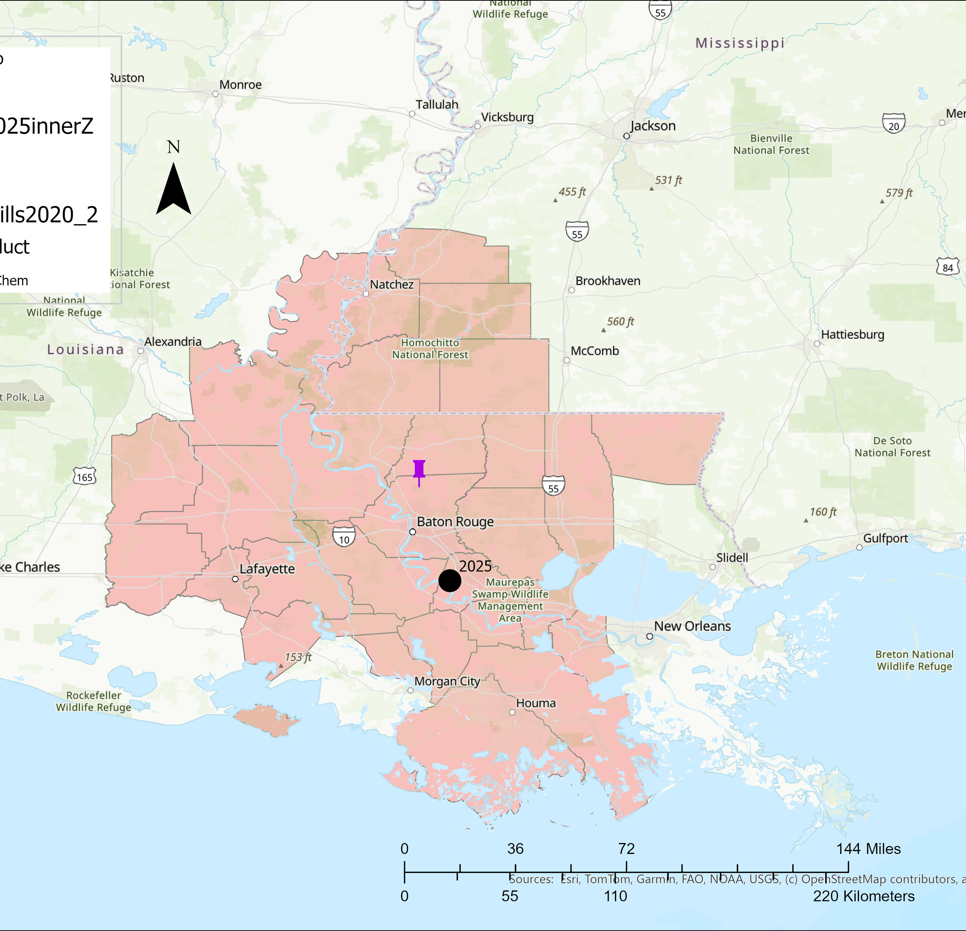
Impact of Large biopower facilities with BECCS in the southern US.
Woodshed before BECCS facility

Slide 11
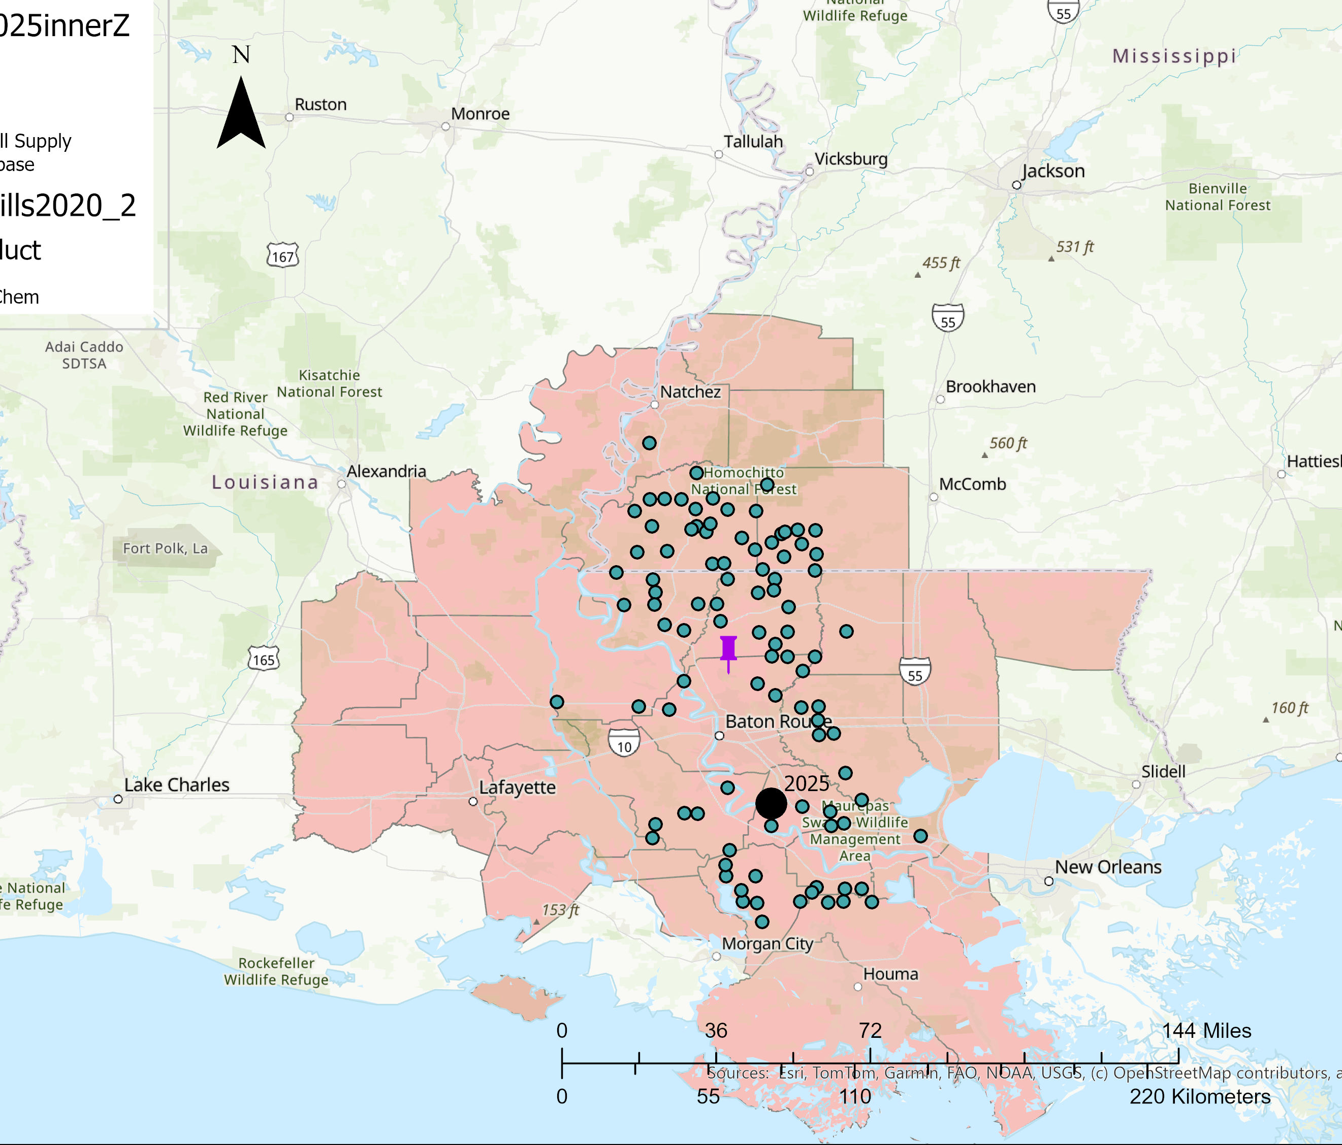
Impact of Large biopower facilities with BECCS in the southern US.
Woodshed before BECCS facility

Slide 12
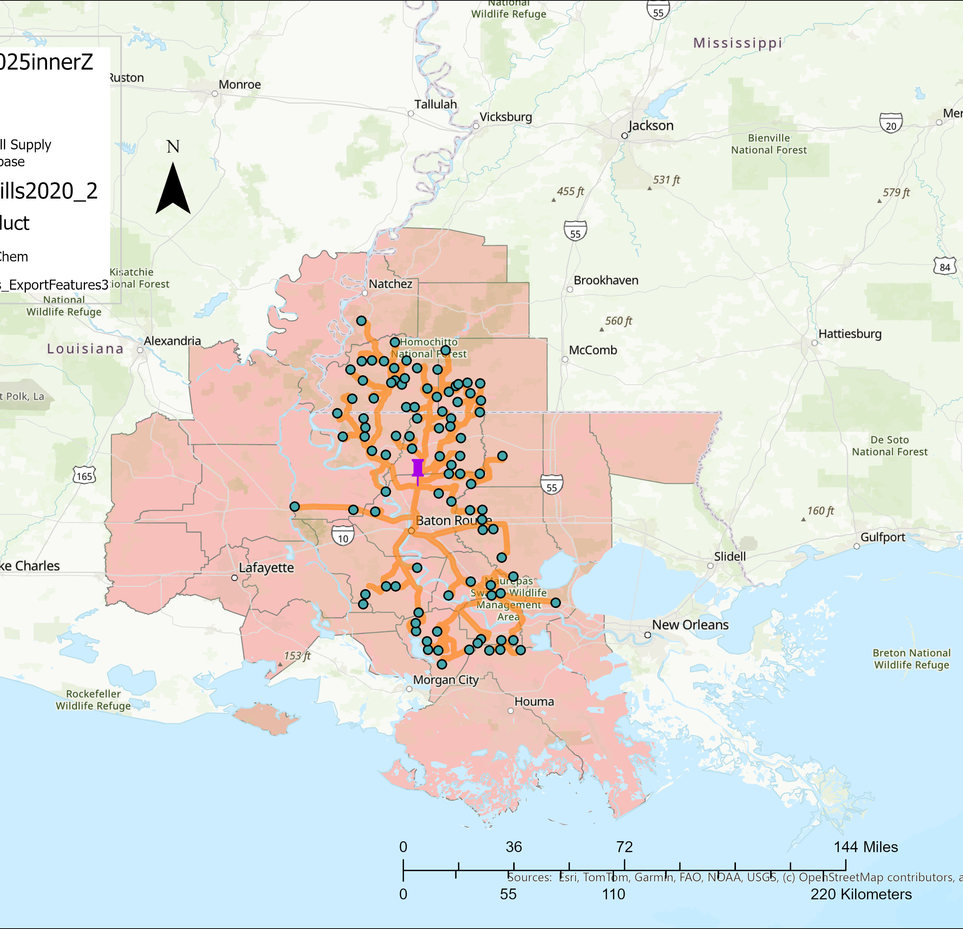
Impact of Large biopower facilities with BECCS in the southern US.
Woodshed before BECCS facility

Slide 13
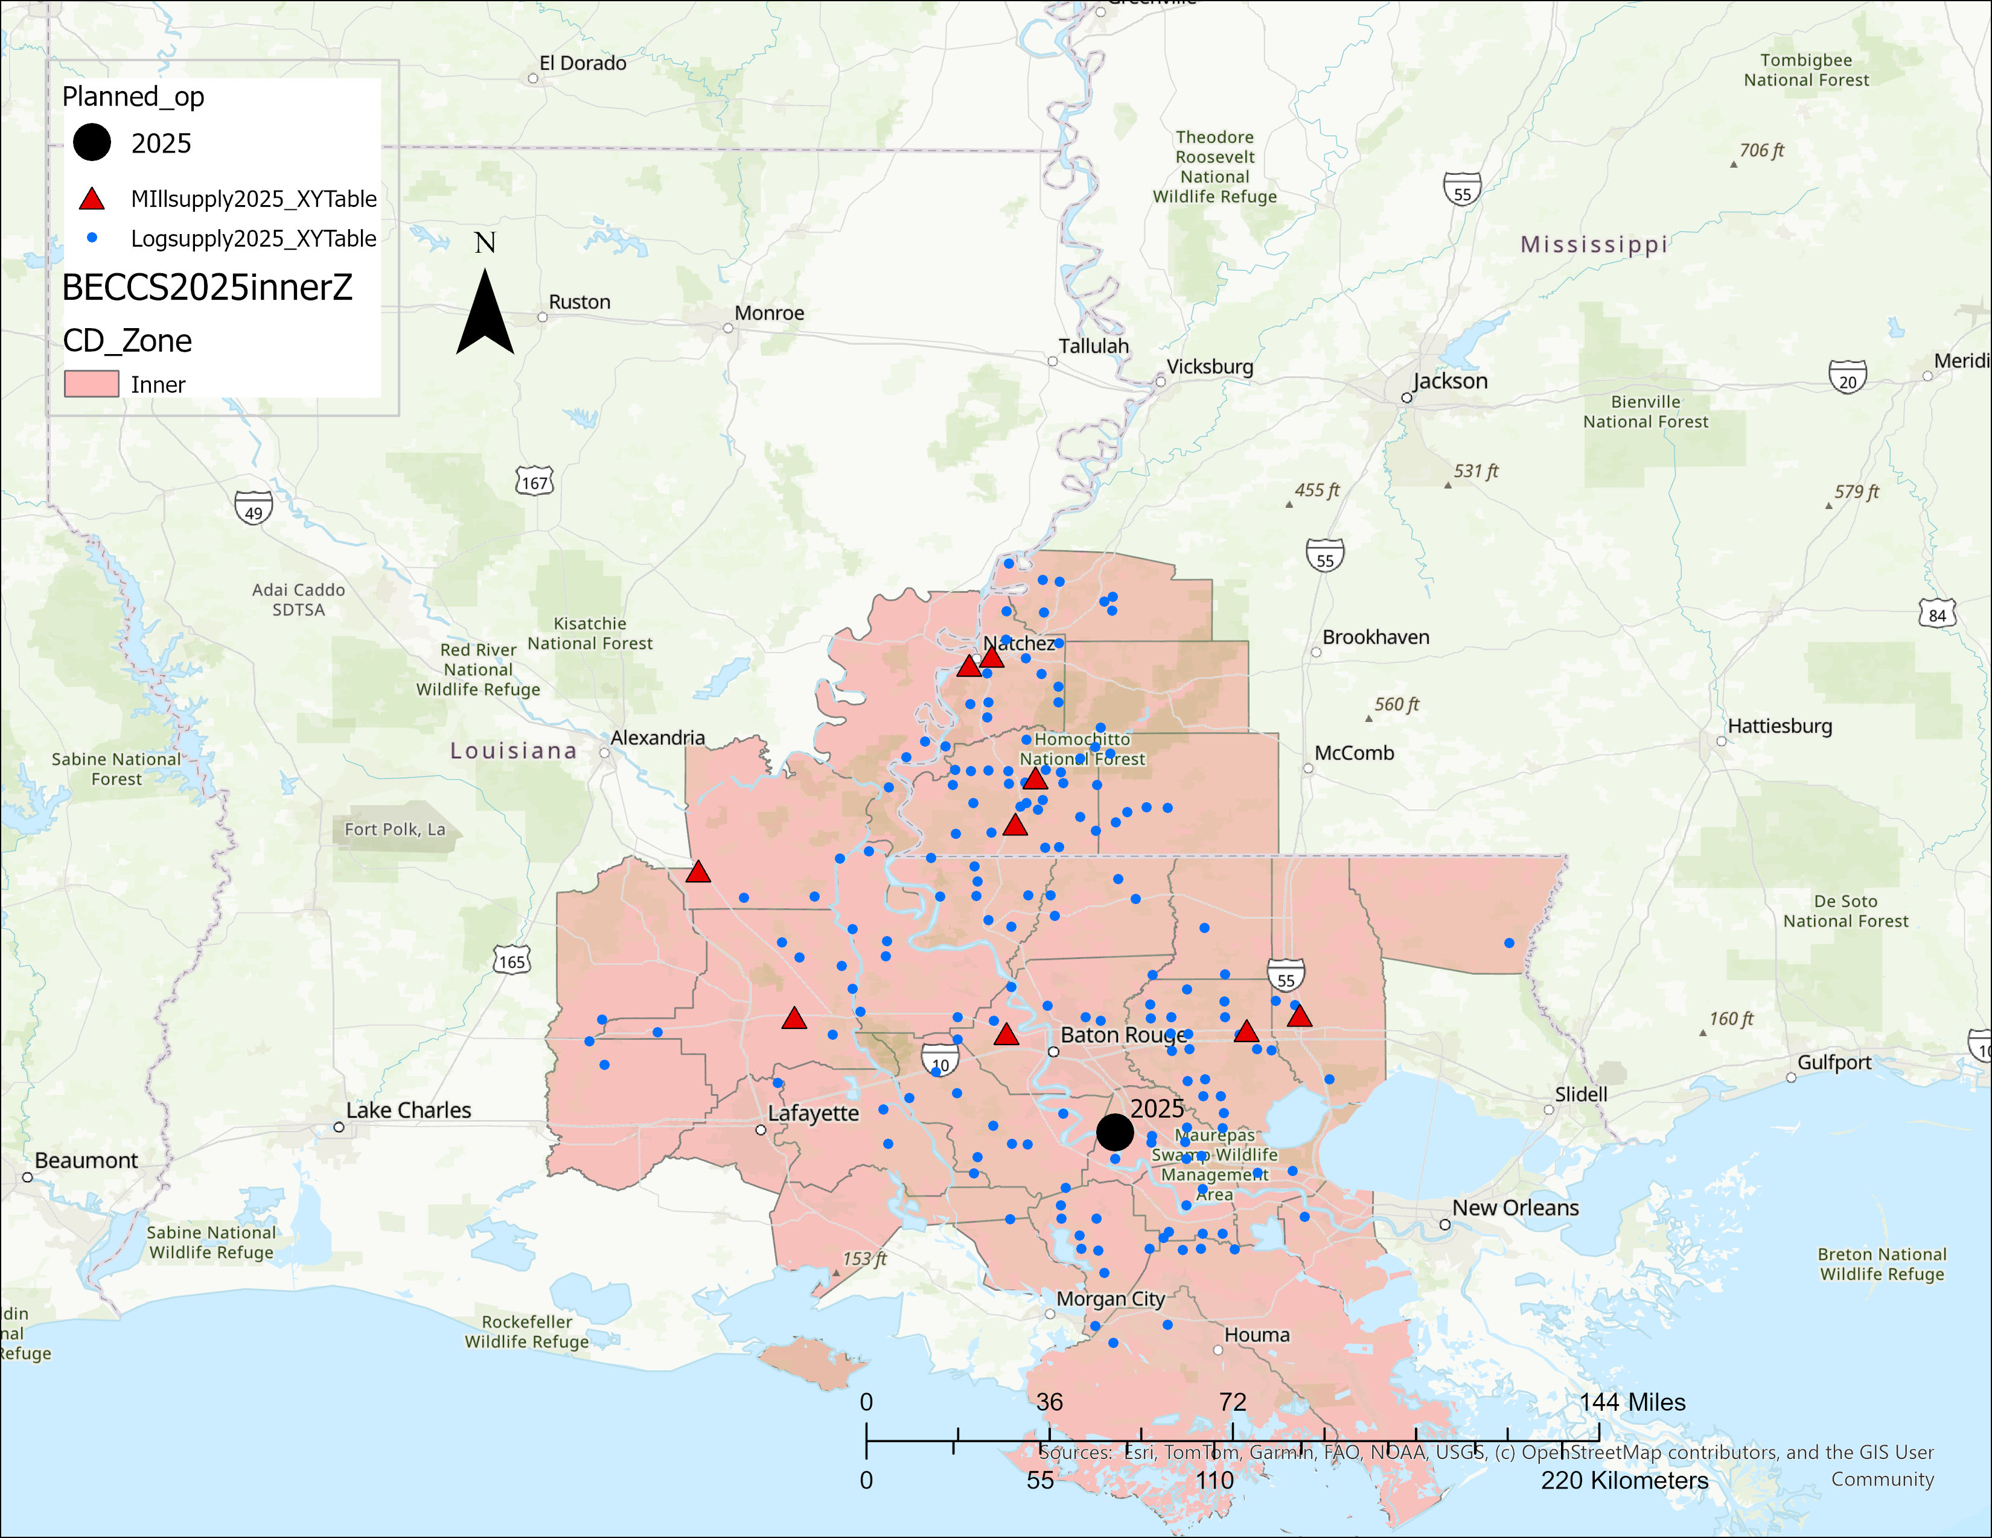
Impact of Large biopower facilities with BECCS in the southern US.
Location Year Demand (g tons)
Geismar 2025 2,000,000

Slide 14
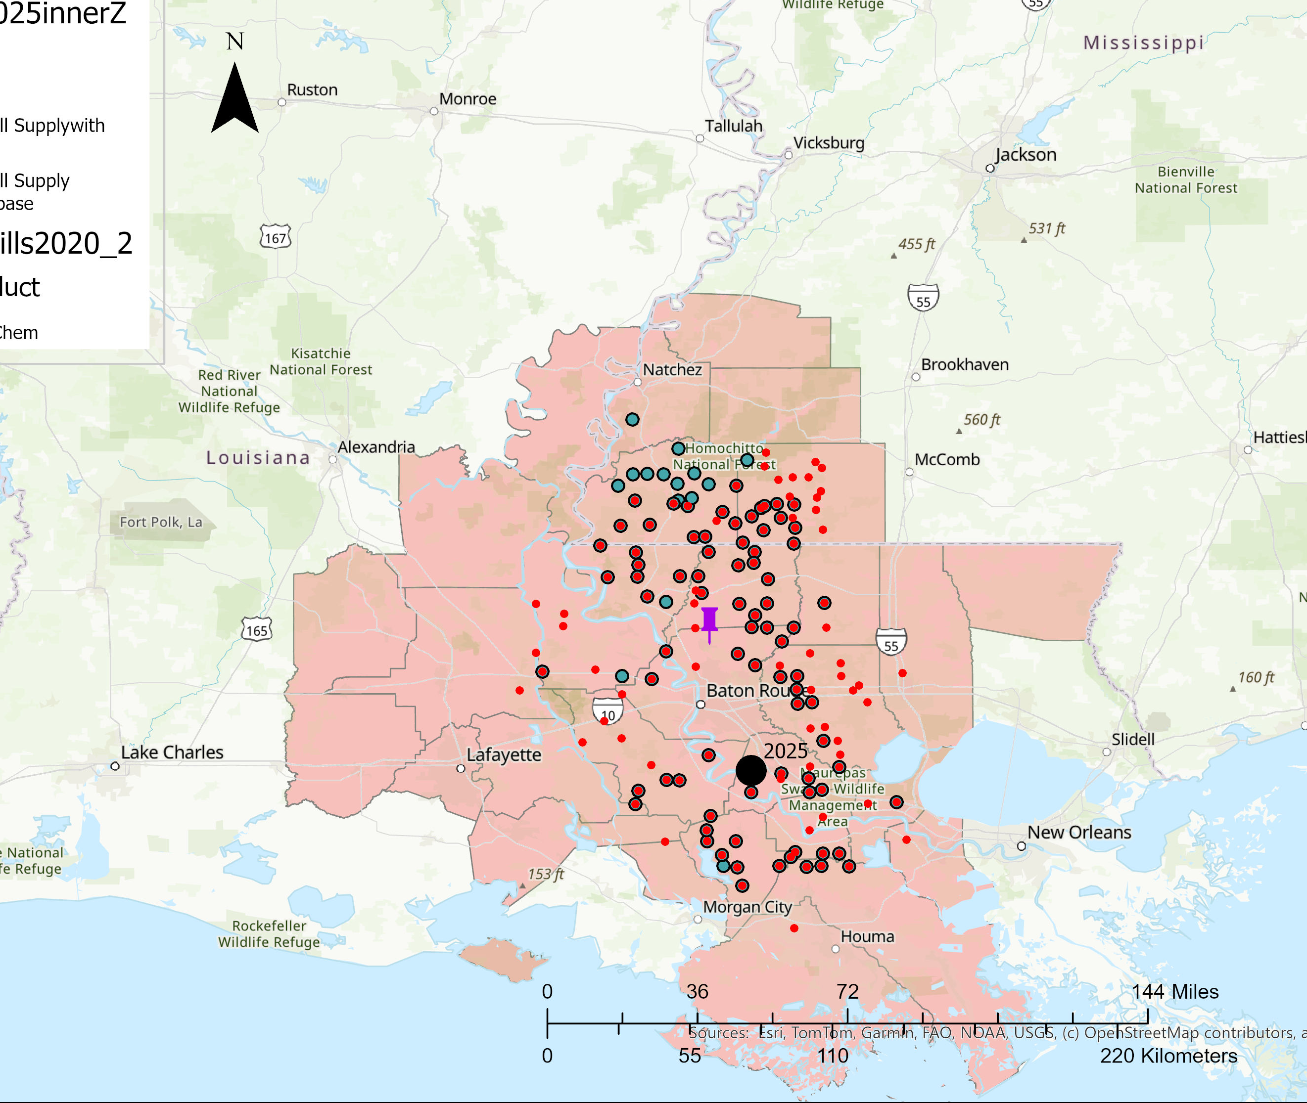
Impact of Large biopower facilities with BECCS in the southern US.
Woodshed after BECCS facility
Location Year Demand (g tons)
Geismar 2025 2,000,000

Slide 15
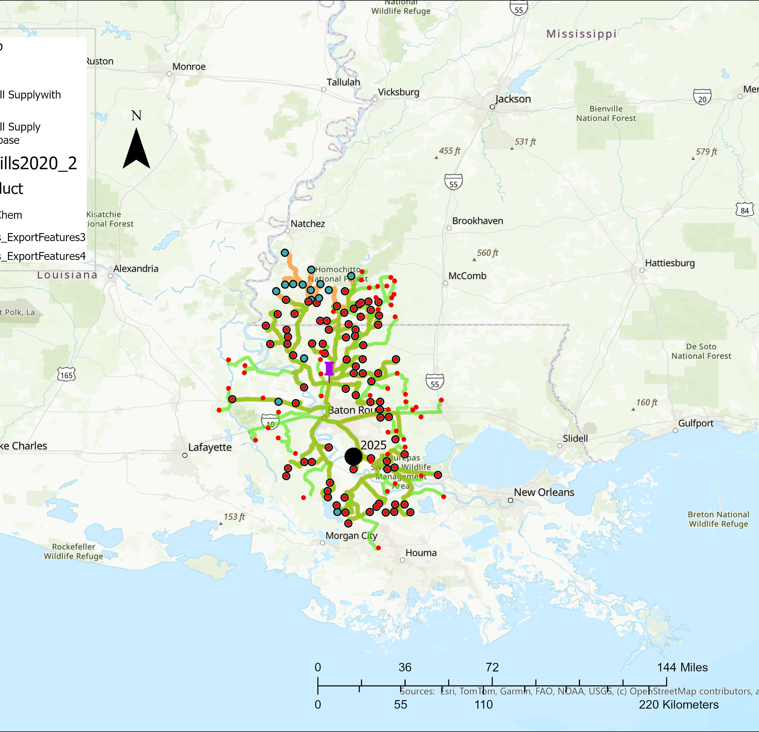
Impact of Large biopower facilities with BECCS in the southern US.
Woodshed after BECCS facility
Location Year Demand (g tons)
Geismar 2025 2,000,000

Slide 16
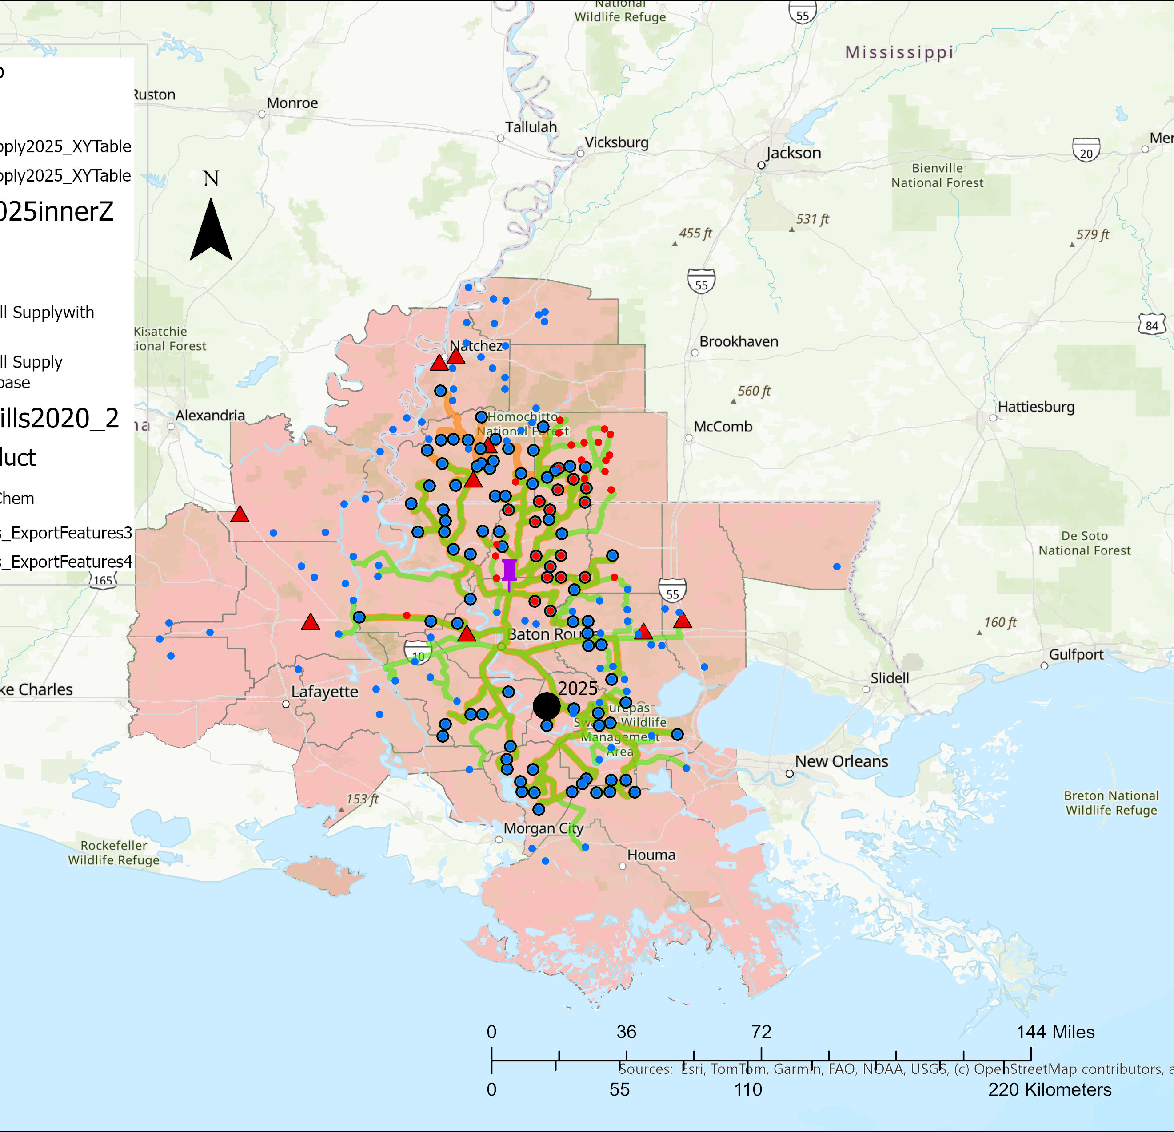
Impact of Large biopower facilities with BECCS in the southern US.
Woodshed after BECCS facility
Location Year Demand (g tons)
Geismar 2025 2,000,000

Slide 17
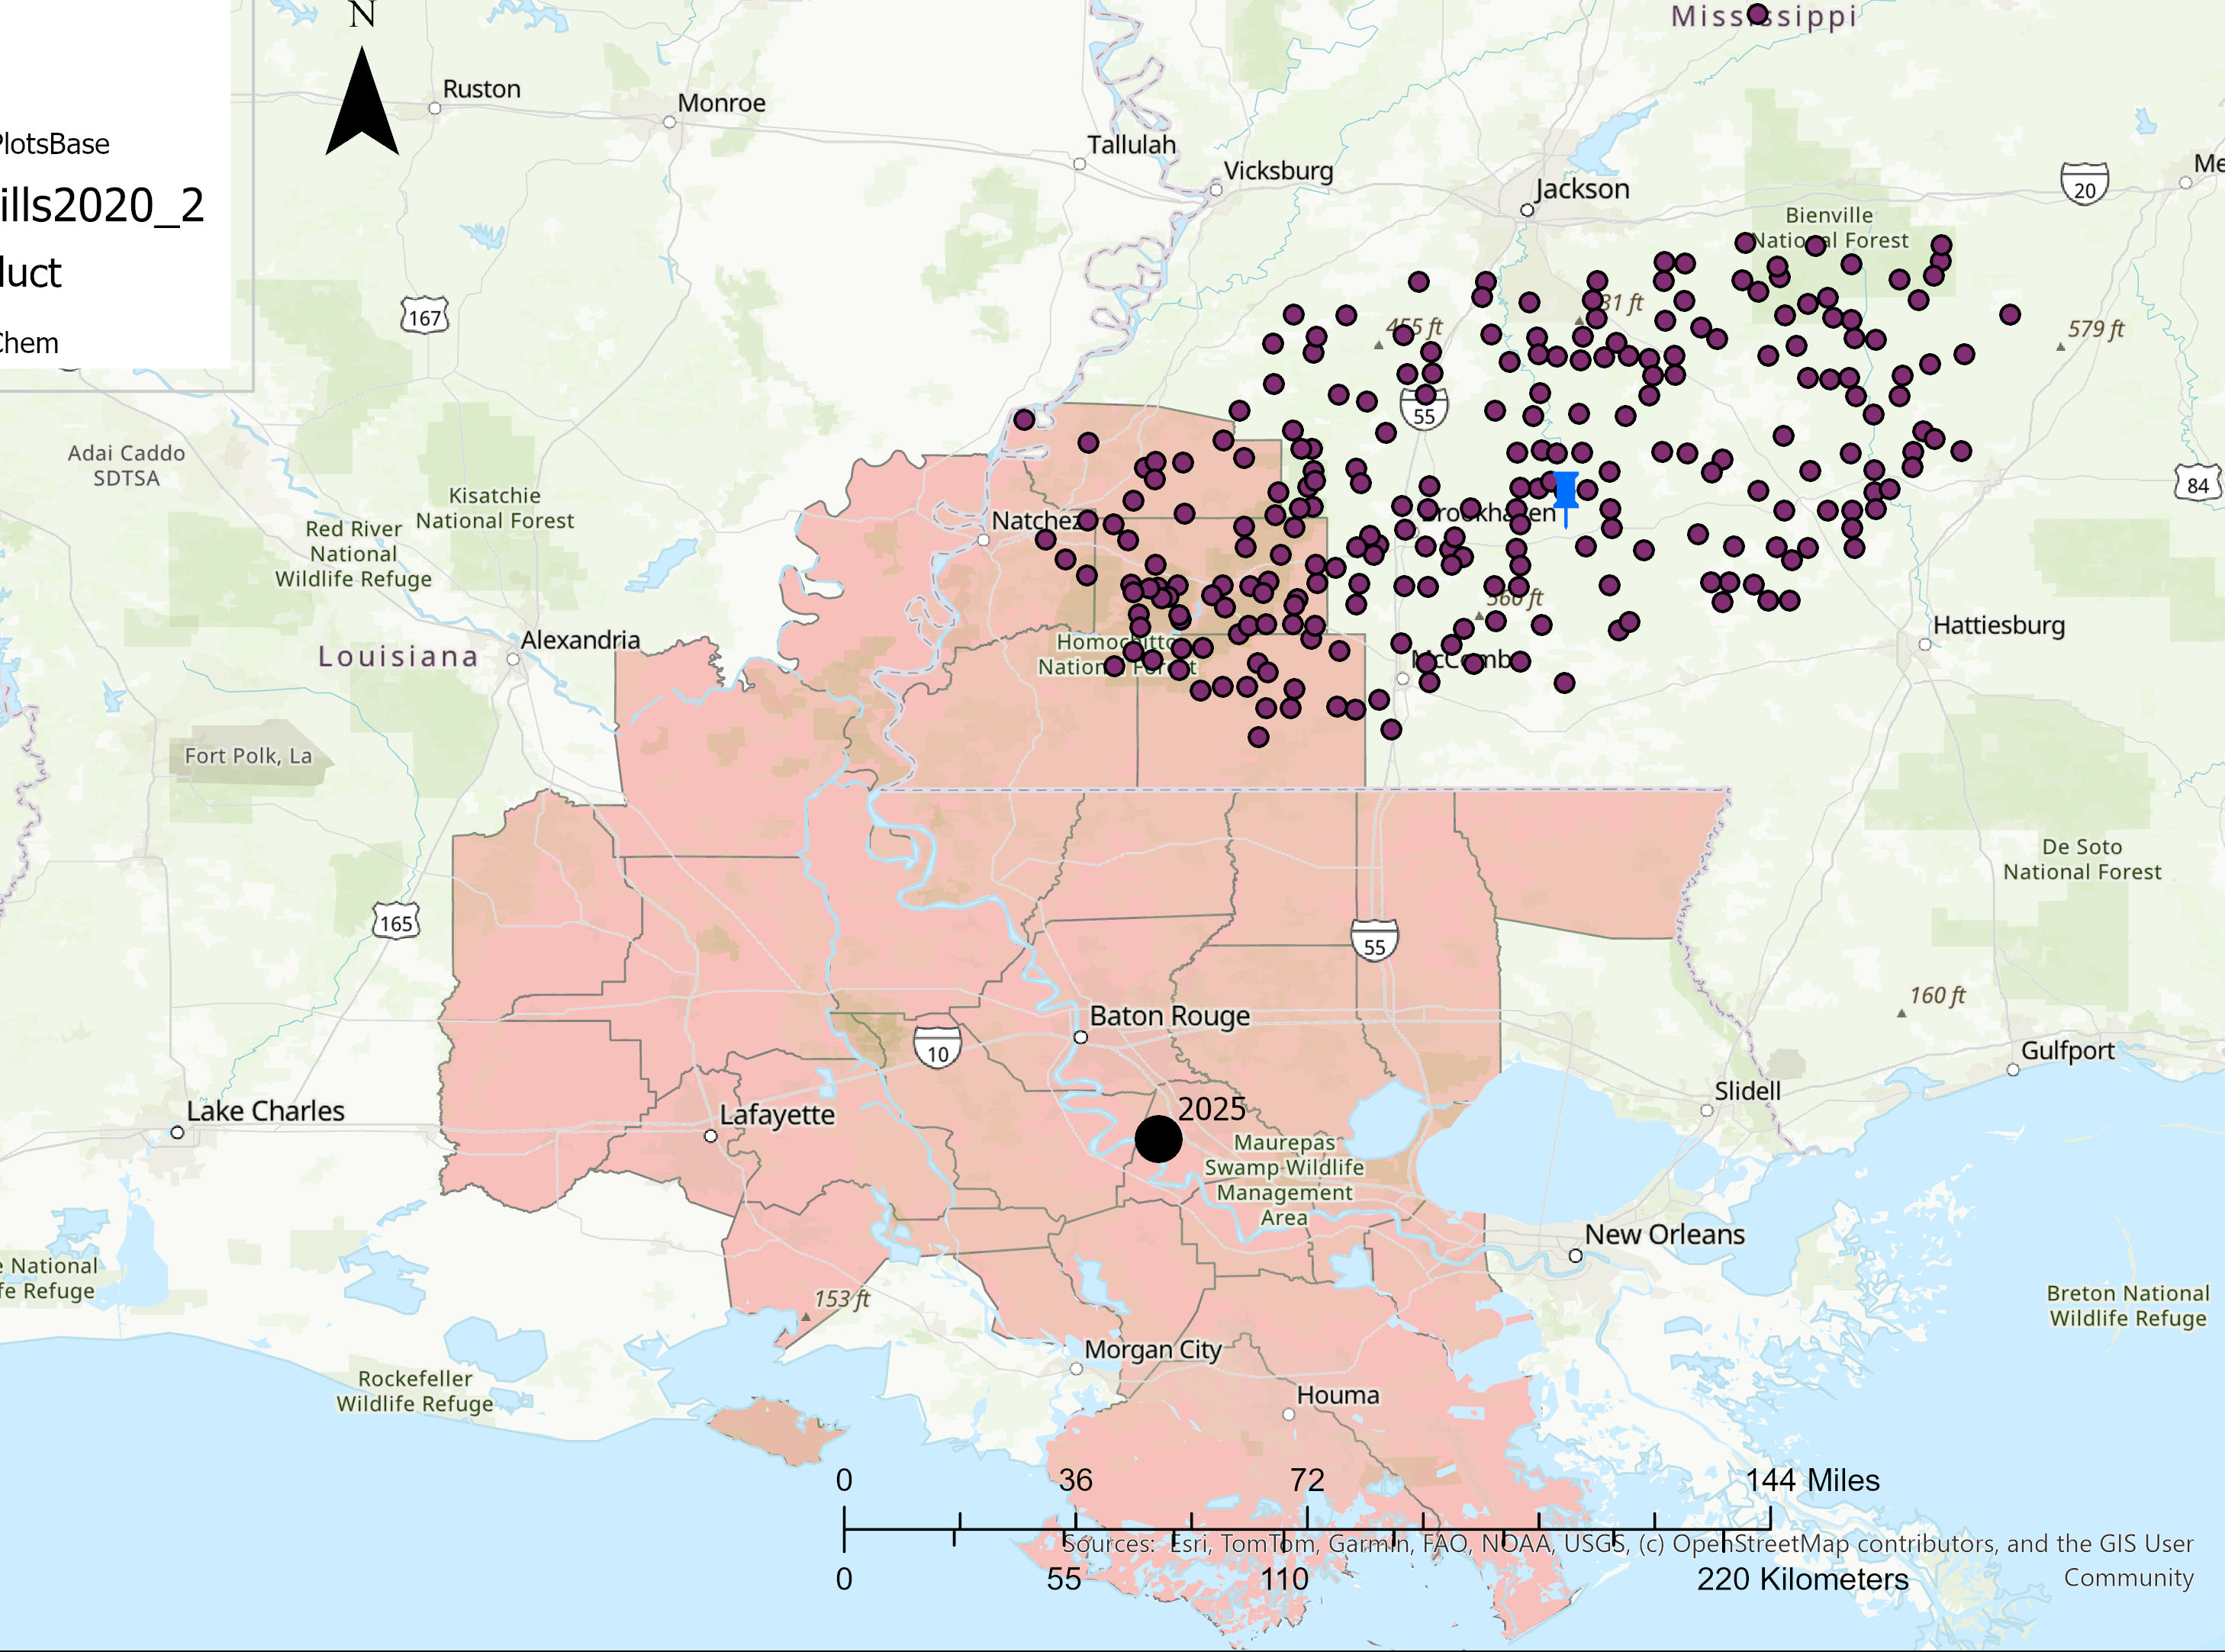
Impact of Large biopower facilities with BECCS in the southern US.
Woodshed before BECCS facility
Outside the new facility’s woodshed

Slide 18
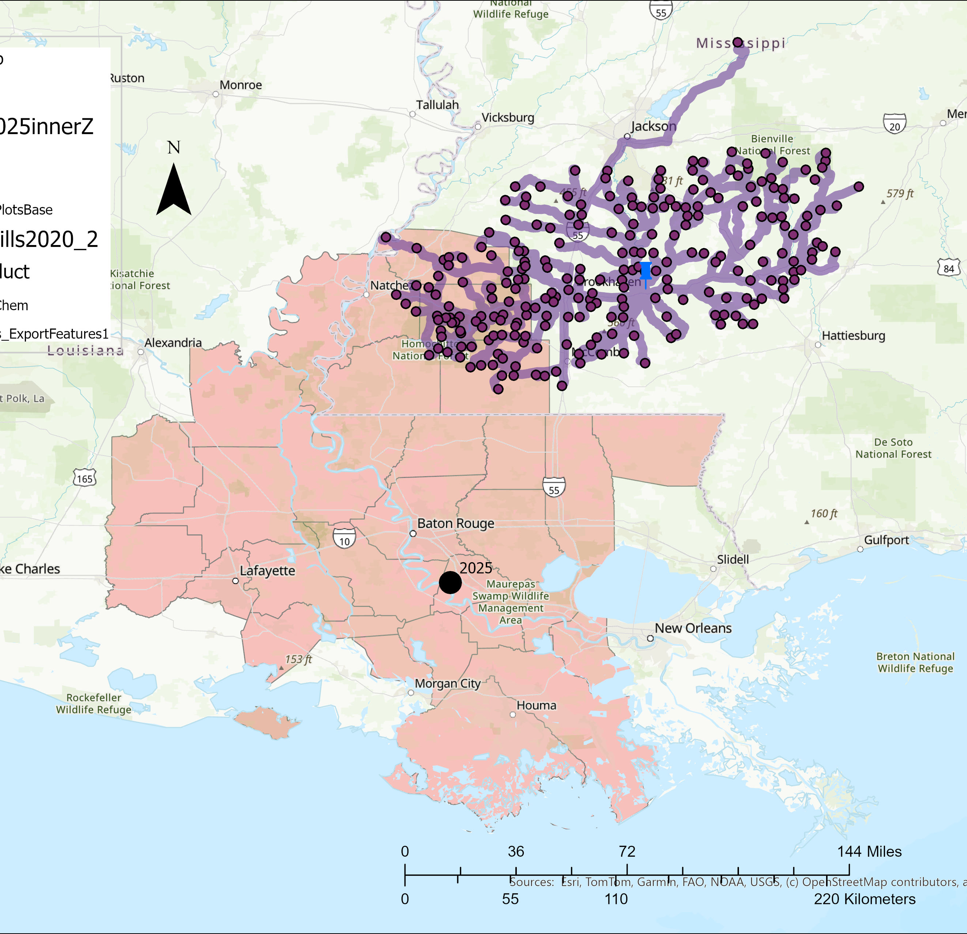
Impact of Large biopower facilities with BECCS in the southern US.
Woodshed before BECCS facility
Outside the new facility’s woodshed

Slide 19
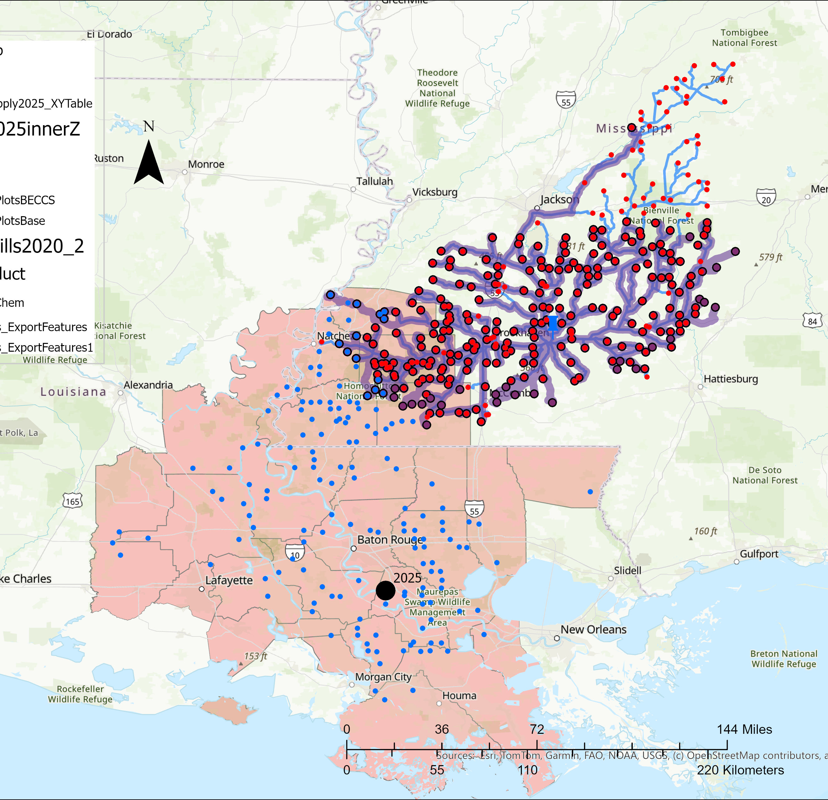
Impact of Large biopower facilities with BECCS in the southern US.
Location Year Demand (g tons)
Geismar 2025 2,000,000
Woodshed after BECCS facility
Outside the new facility’s woodshed

Slide 20
Impact of Large biopower facilities with BECCS in the southern US.
Location Year Demand (g tons)
Geismar 2025 2,000,000
Woodshed after BECCS facility
Outside the new facility’s woodshed

Slide 21
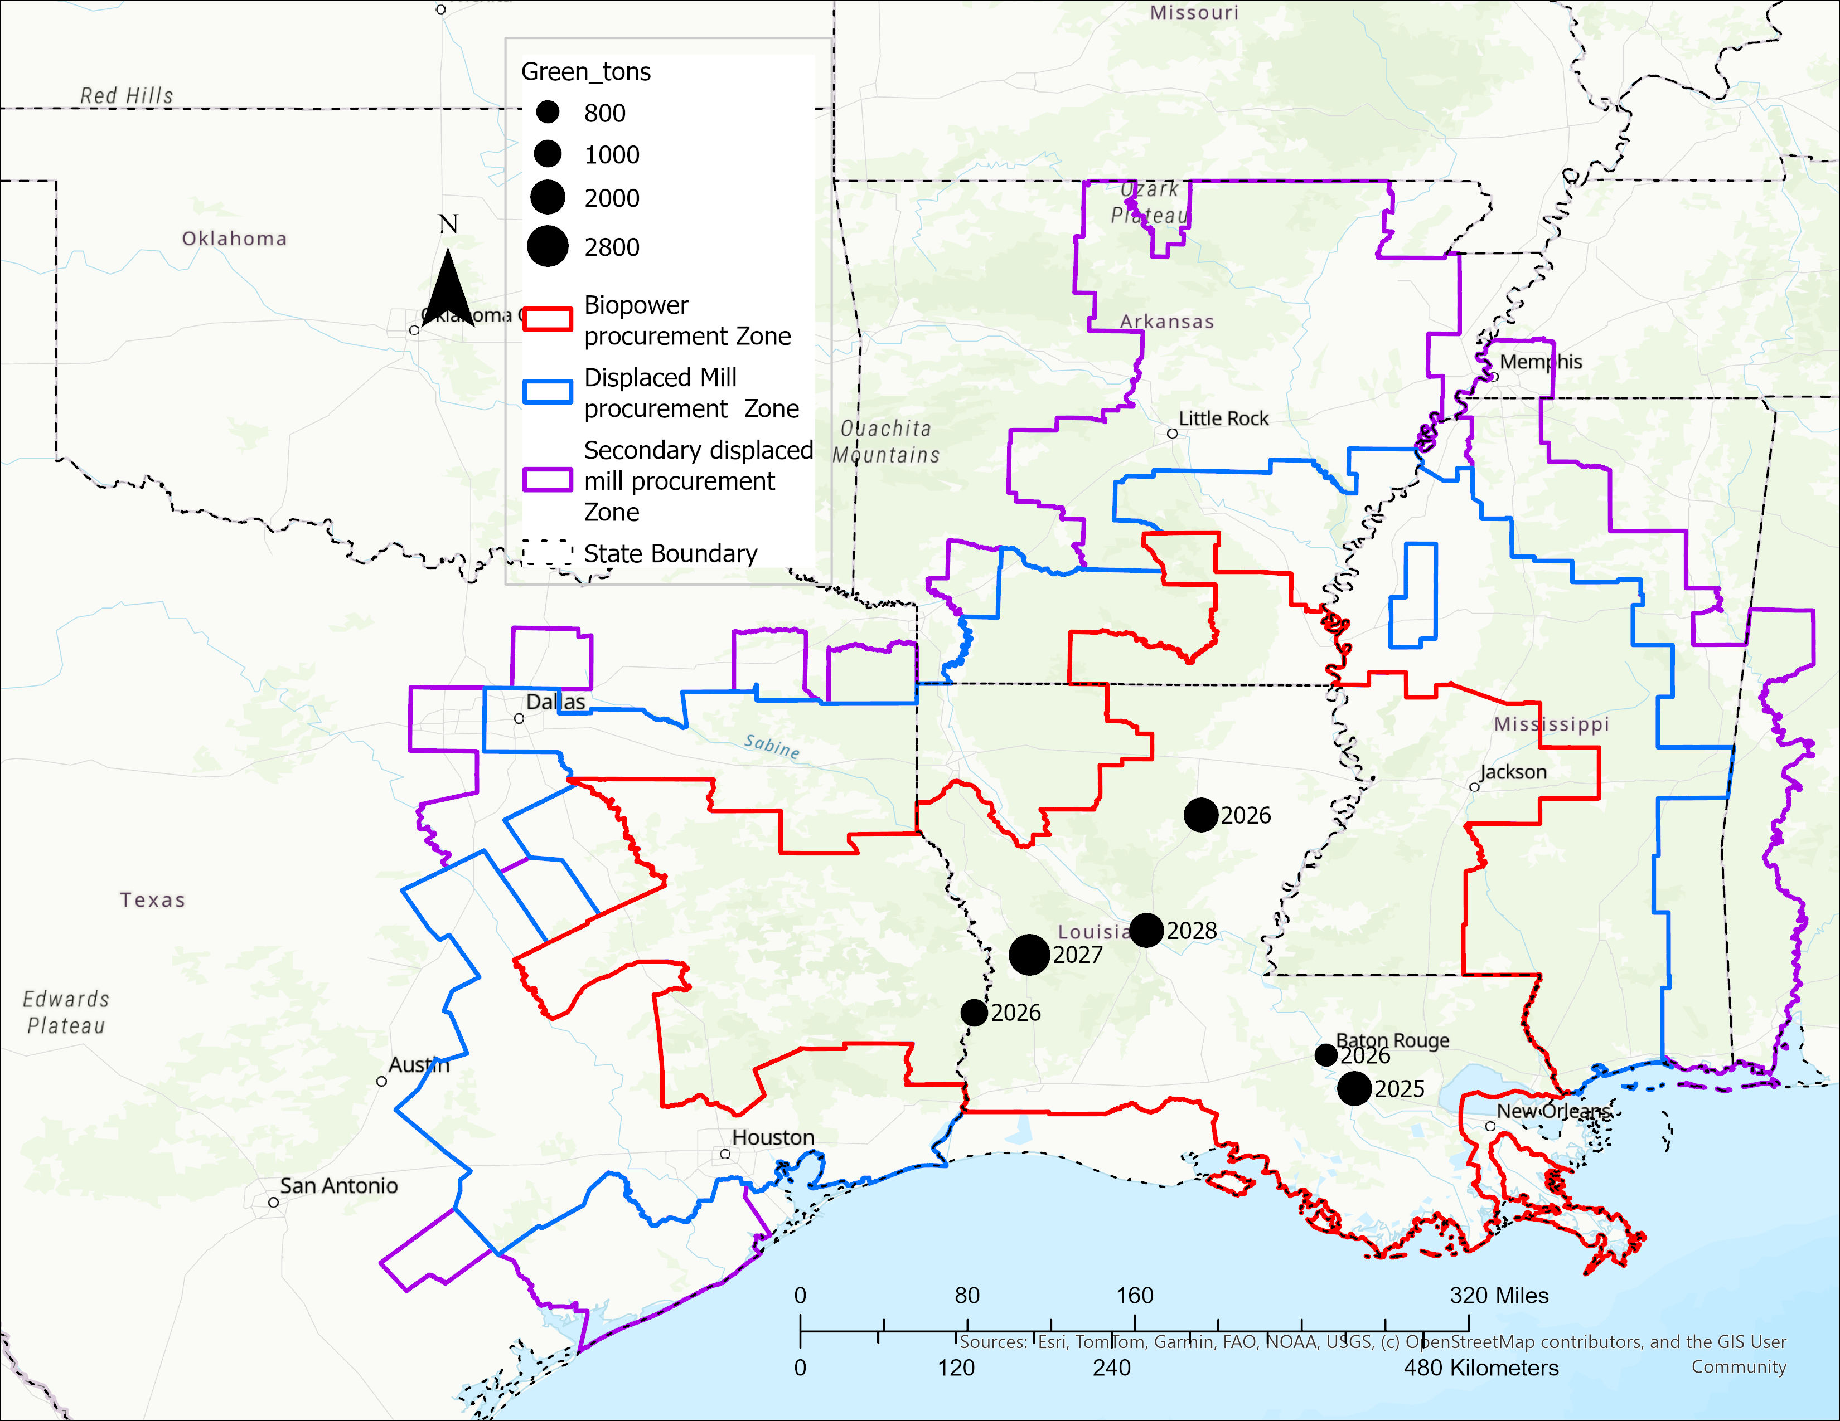
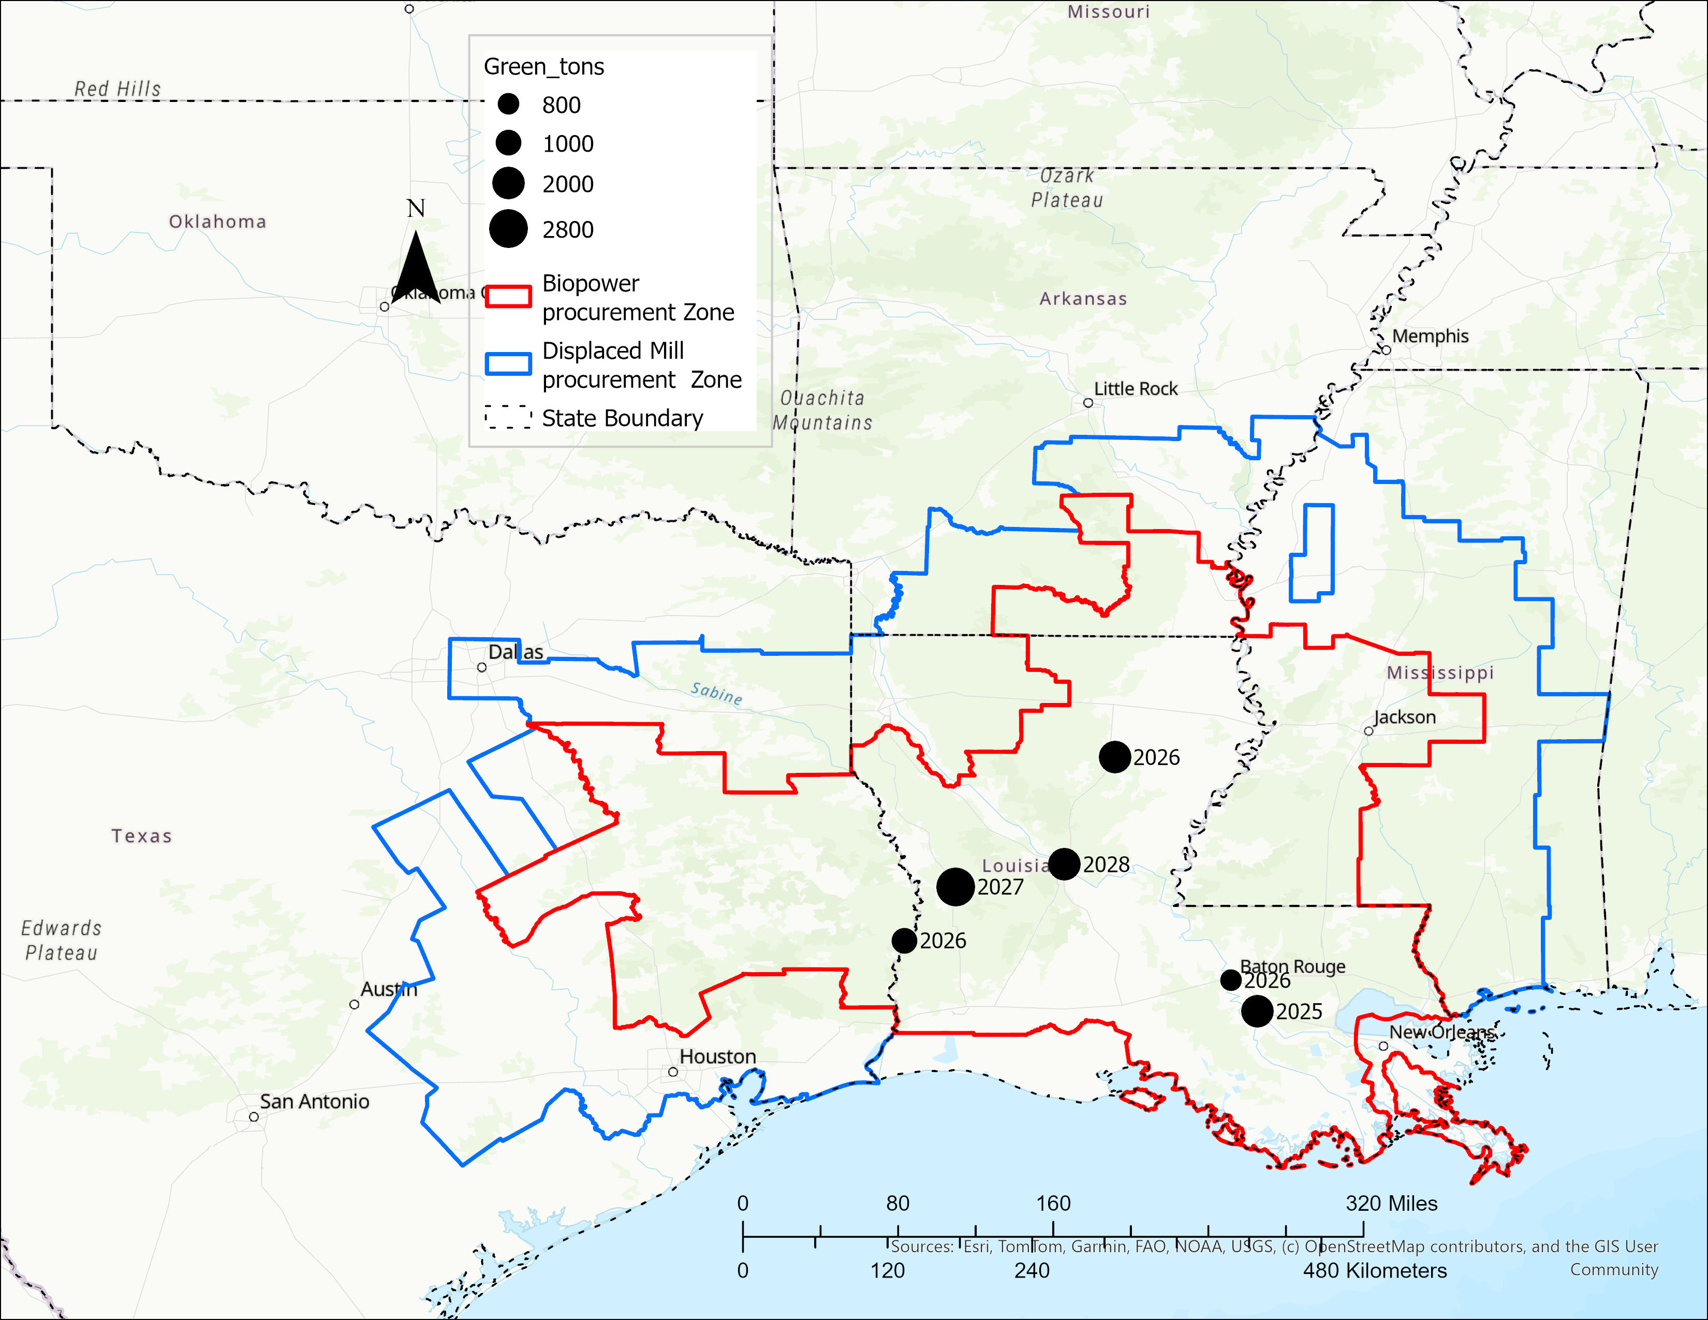
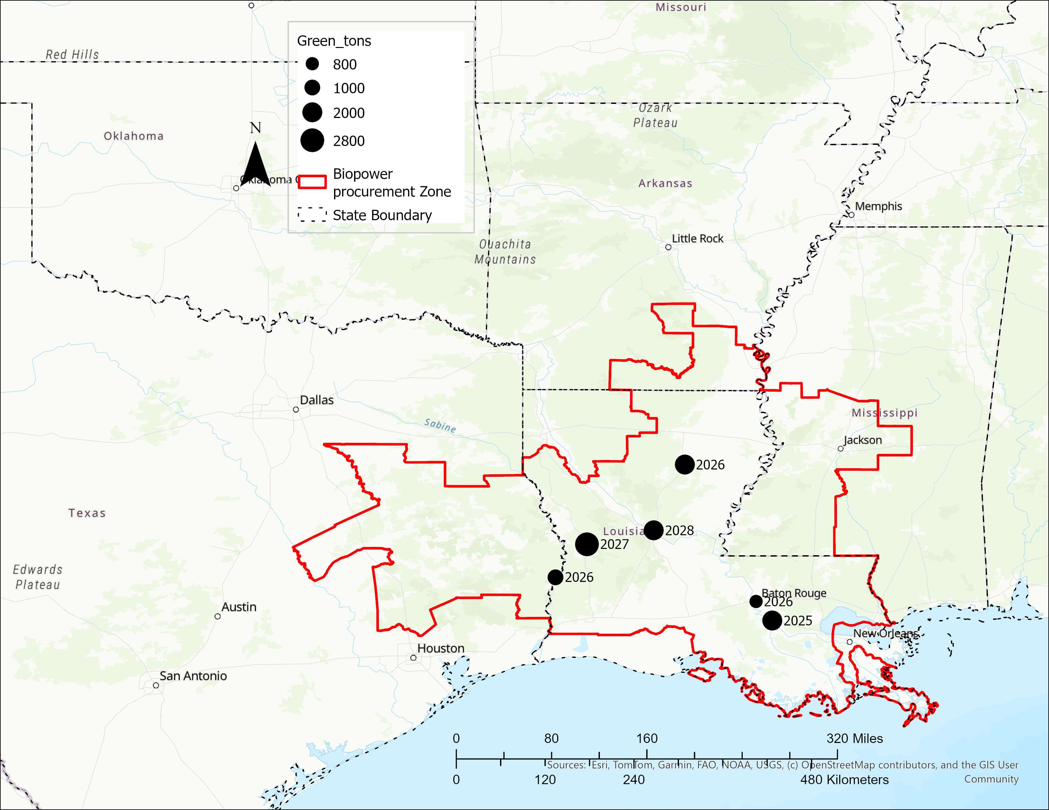
Evaluated impacts of 9 BECCS facilities on forest product procurement and markets
Estimated to drive demand for biomass by 2030, making biomass the dominant forest product, surpassing sawtimber.

Slide 22
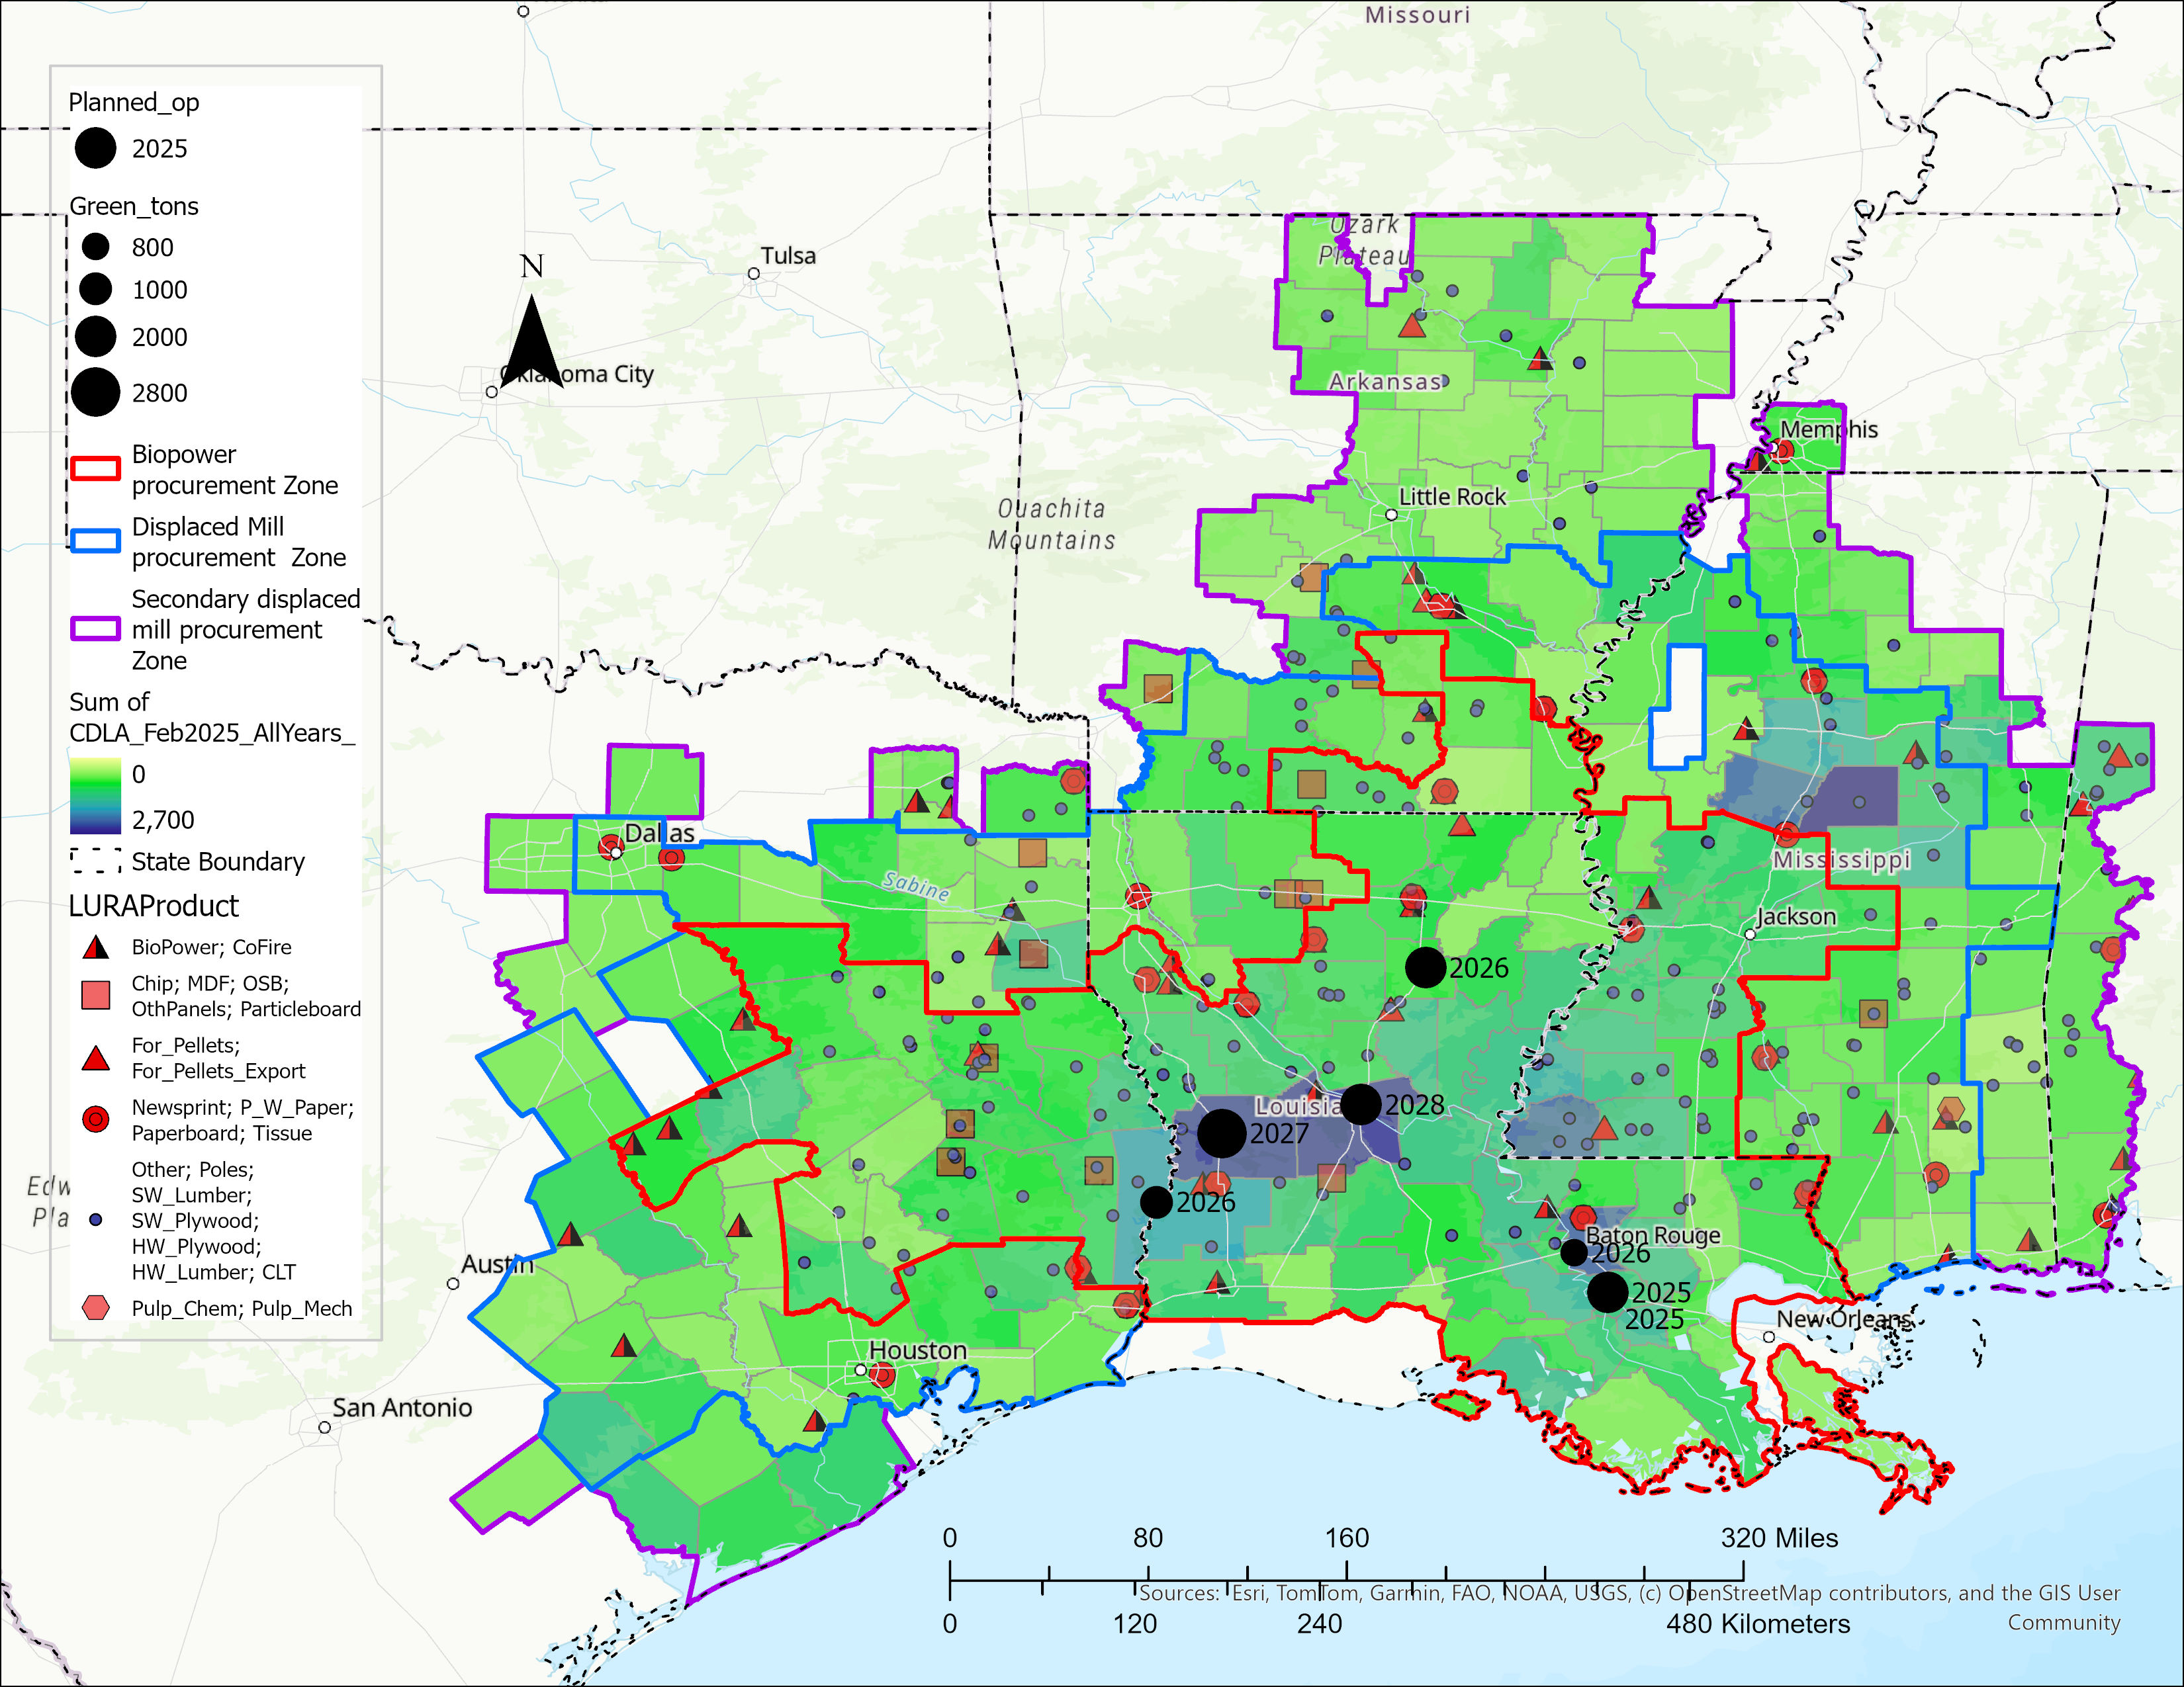
Forest Biomass and Mill residues
Location Year Demand (g tons)
Geismar 2025 2,000,000
Columbia 2026 2,000,000
Port Allen 2026 800,000
Bon Wier 2026 1,000,000
Leesville 2027 300,000
Alexandria 2028 2,000,000
Leesville (2) 2030 2,500,000
Total 10,600,000

Slide 23
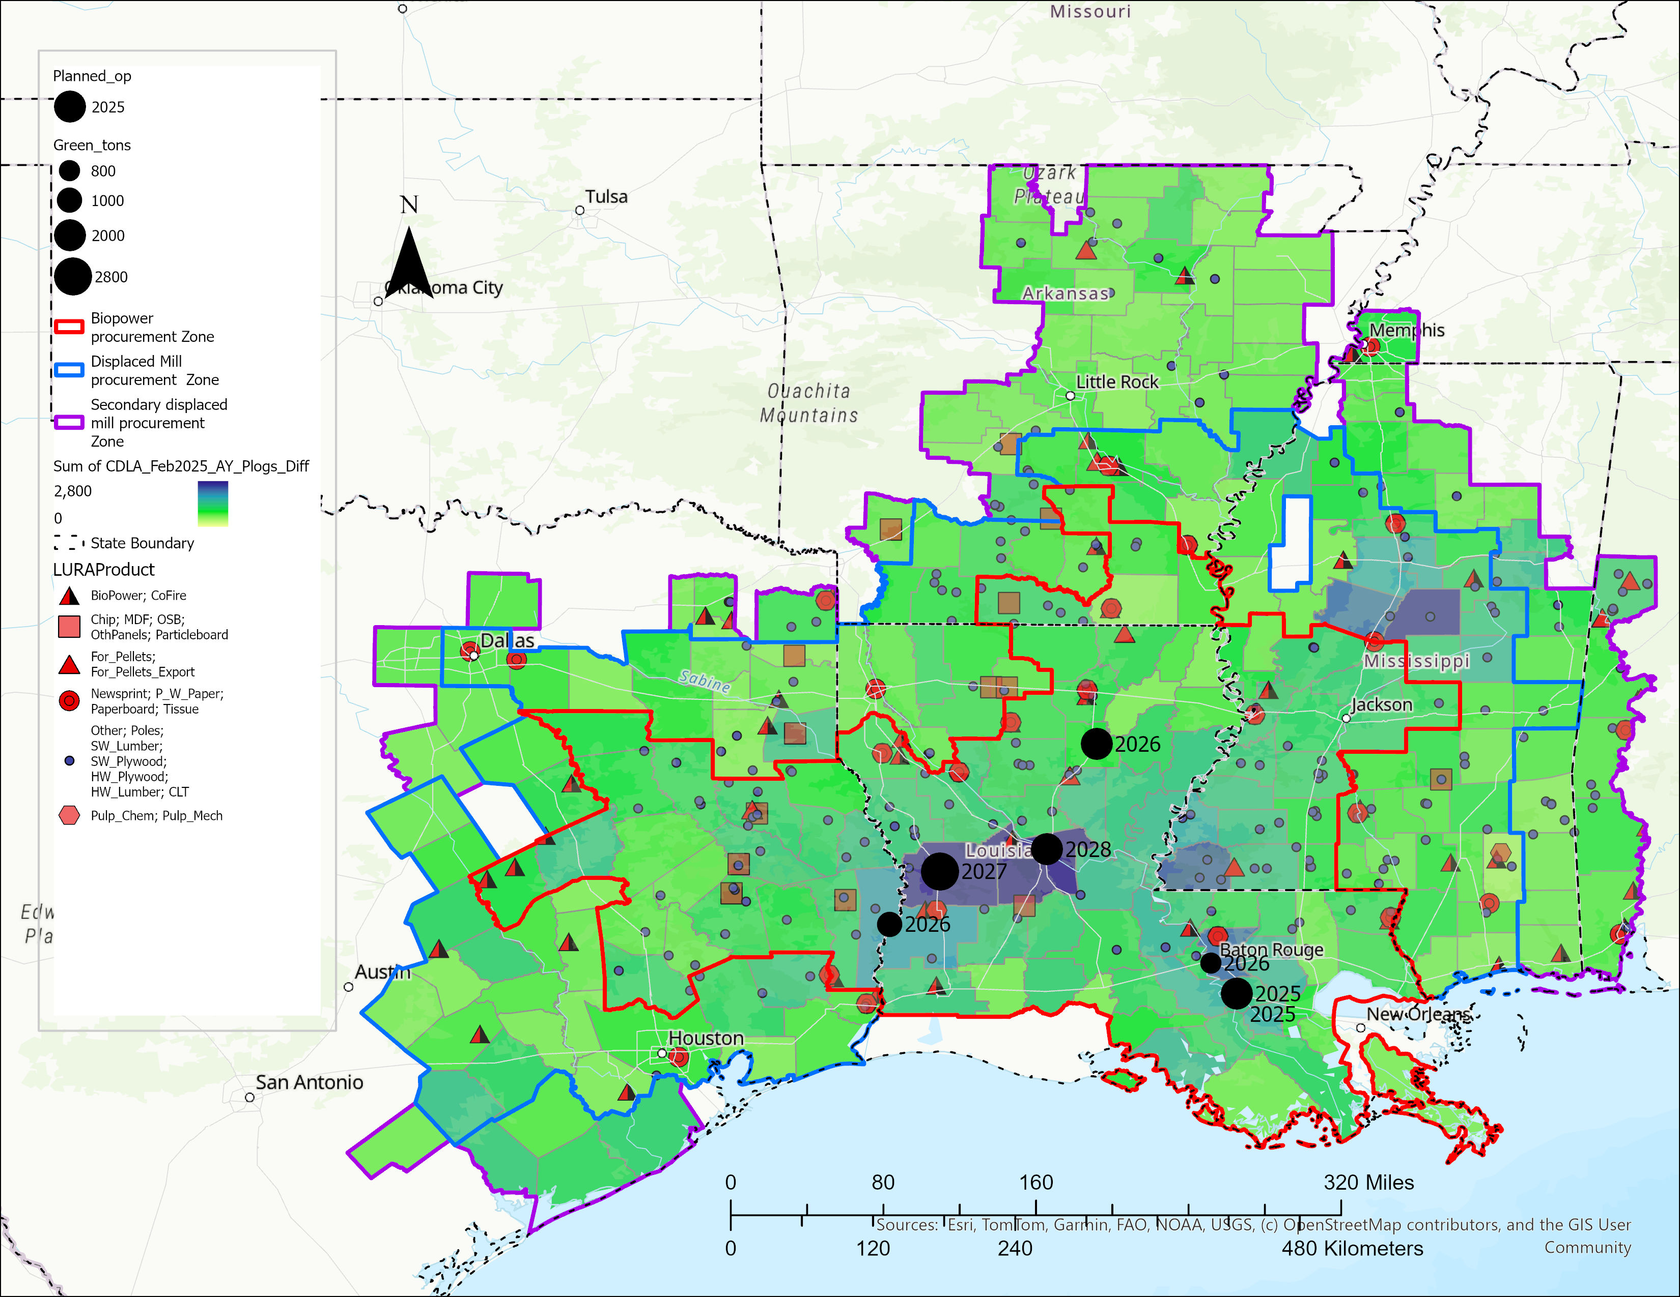
Forest Biomass only
Location Year Demand (g tons)
Geismar 2025 2,000,000
Columbia 2026 2,000,000
Port Allen 2026 800,000
Bon Wier 2026 1,000,000
Leesville 2027 300,000
Alexandria 2028 2,000,000
Leesville (2) 2030 2,500,000
Total 10,500,000

Slide 24
Impact of Large biopower facilities with BECCS in the southern US.
24

Slide 25
Impact of Large biopower facilities with BECCS in the southern US.
25

Slide 26
Impact of Large biopower facilities with BECCS in the southern US.
26

Slide 27
Key takeaways
Forest biomass-based biopower can shift markets from sawtimber to energy production, reshaping regional economies.
Short-term impacts expand procurement areas, but stabilize over time due to substitution and management changes.
Provides a needed boost to the forestry sector amid declining traditional wood product markets.
BECCS integration offers significant climate mitigation potential through carbon reduction.

