Slide 1

From Field to Framework
Integrating Agriculture into Climate Damage Assessment
Marcus C Sarofim
US EPA, Climate Change Division (2008–2026)
NYU Marron Institute · Johns Hopkins Energy Policy & Climate
https://substack.com/@thesaraphreport
My statements in this presentation are my own and do not necessarily reflect
the views of any of my current or former organizations.
Forestry & Agriculture Modeling Forum · April 14, 2026

Slide 2
Agriculture in SC-GHG
and multi-sector damage models
CONTEXT
Model
Reference
Crops covered
Share of
global damage
Scale
GIVE
Moore et al.
2017
Maize, rice,
wheat, soybeans
Global
47%
DSCIM
Hultgren et al.
2022
Maize, rice, wheat,
soybeans, sorghum, cassava
Global
1%
FrEDI
Hsiang et al.
2017
Cotton, maize,
soybean, wheat
US only
<1%
None of the three models are process based. All have CO₂ as an implicit function of temperature. A wide range of damages. These could be addressed by the ag modeling community.
GIVE = Global Damages Framework · DSCIM = Data-driven Spatial Climate Impact Model · FrEDI = Framework for Evaluating Damages and Impacts

Slide 3
MOTIVATION
Great ag science doesn't automatically feed policy tools
WHAT AG MODELERS PRODUCE
WHAT MAKES FOR GOOD
POLICY ANALYSIS TOOLS
(like the SC-GHG and FrEDI)
Process-based crop simulations
(LPJmL, DSSAT, EPIC)
Econometric yield-climate relationships
Flexibility to apply to any global temperature scenario
Ability to run hundreds or thousands of times to fill out the probabilistic climate and socioeconomic space
Ability to handle temperature and CO₂ independently
✗
Integrated economic models
(FASOM, GTAP, IMPACT)
Not plug-and-play
Rich scenario analysis for RCPs

Slide 4
ARCHITECTURE
Approach 1: Pattern scaling
CALIBRATION PHASE (done once, offline)
Global Climate
Models (GCMs)
Downscaling
(e.g., LOCA)
Calibrate pattern
scaling tool
(e.g., STITCHES)
Very slow ⏱⏱⏱
Slow ⏱⏱
Slow ⏱⏱
OPERATIONAL PHASE (run for each trajectory)
FaIR
Global ΔT
Pattern scaling
→ regional T,
P, CO₂
Sectoral damage
model
(e.g., LPJmL + FASOM)
Impact analysis
Fast ✓
Fast ✓
Somewhat slow ⏱
Key advantages: CO₂ is an explicit input at every step. Pattern scaling preserves the full regional complexity. Running the model at all time steps can handle path dependencies.
Disadvantage: Sectoral models can be slow: problematic when hundreds or thousands of simulations required
STITCHES (Tebaldi et al. 2022) — a pattern scaling emulator calibrated on CMIP6 output — enables this pathway with reduced-complexity models

Slide 5
ARCHITECTURE
Approach 2: By-degree (warming level)
PRE-COMPUTATION PHASE (done once, offline)
GCMs
Downscaling
Damage model
run at multiple
warming level
Damage functions
f(ΔT) or f(ΔT, CO₂)
Very slow ⏱⏱⏱
Slow ⏱⏱
Slow ⏱⏱
OPERATIONAL PHASE (run for each trajectory — very fast)
FaIR
Global ΔT
look up f(ΔT)
Damage functions
f(ΔT) [or f(ΔT,CO₂)]
Impact Analysis
Fast ✓
FAST ✓
Fast ✓
Key advantage: Once pre-computed, damage functions pair near instantly with global temperature projections.
Key disadvantages: Difficult (but not impossible) to include complexities like path dependency, independent CO₂, socioeconomic relationships, etc.
FrEDI uses the by-degree approach — agriculture needs an explicit CO₂ dimension to avoid burying fertilization assumptions

Slide 6
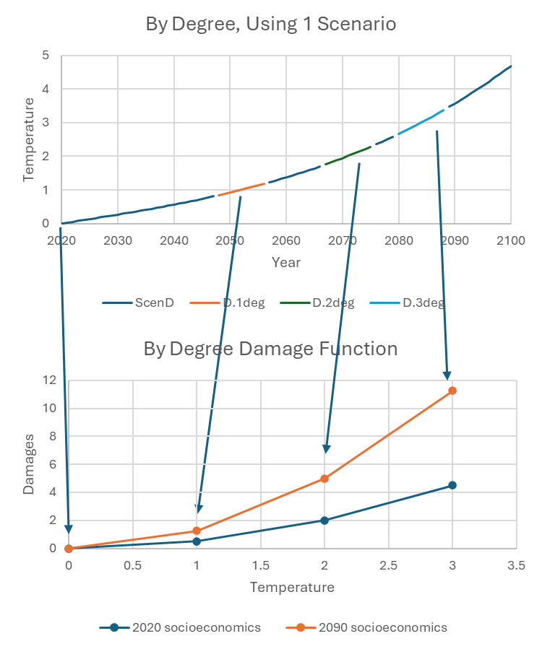
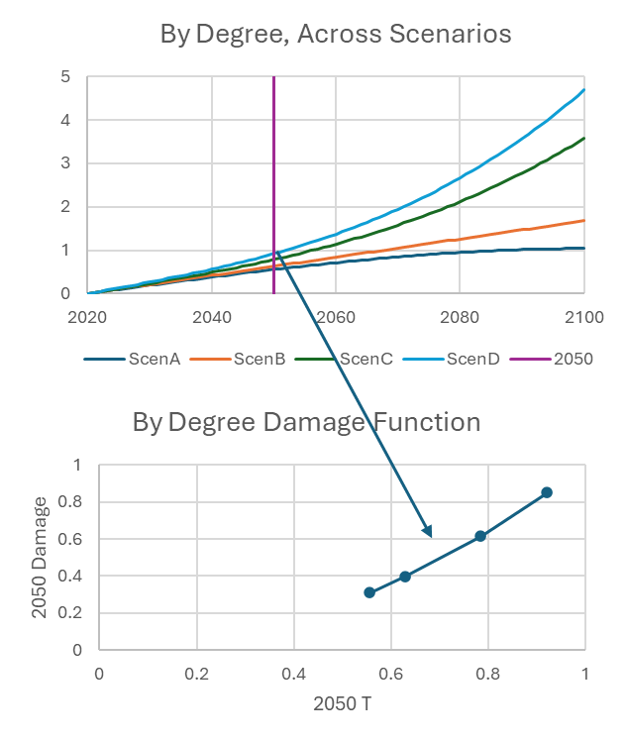
ARCHITECTURE
By-degree: two implementation options
Considerations:
*Adding independent CO₂
*Socioeconomic and path dependence
*Use multi-year windows to capture interannual variability

Slide 7
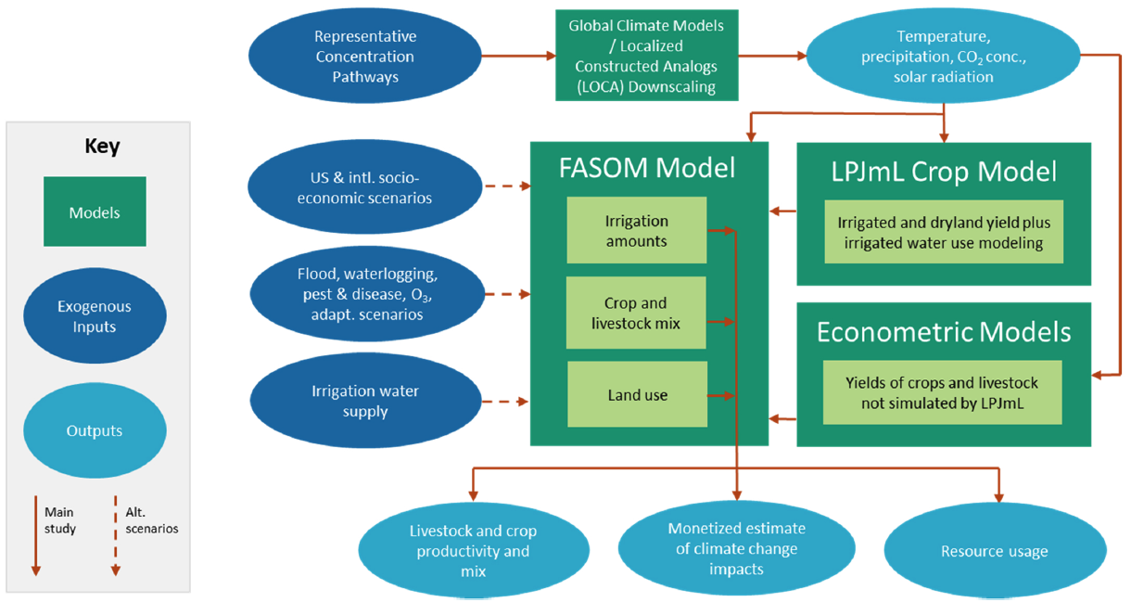
FEI ET AL. 2023
Fei et al. 2023

Slide 8
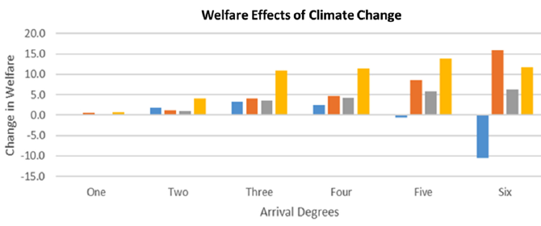
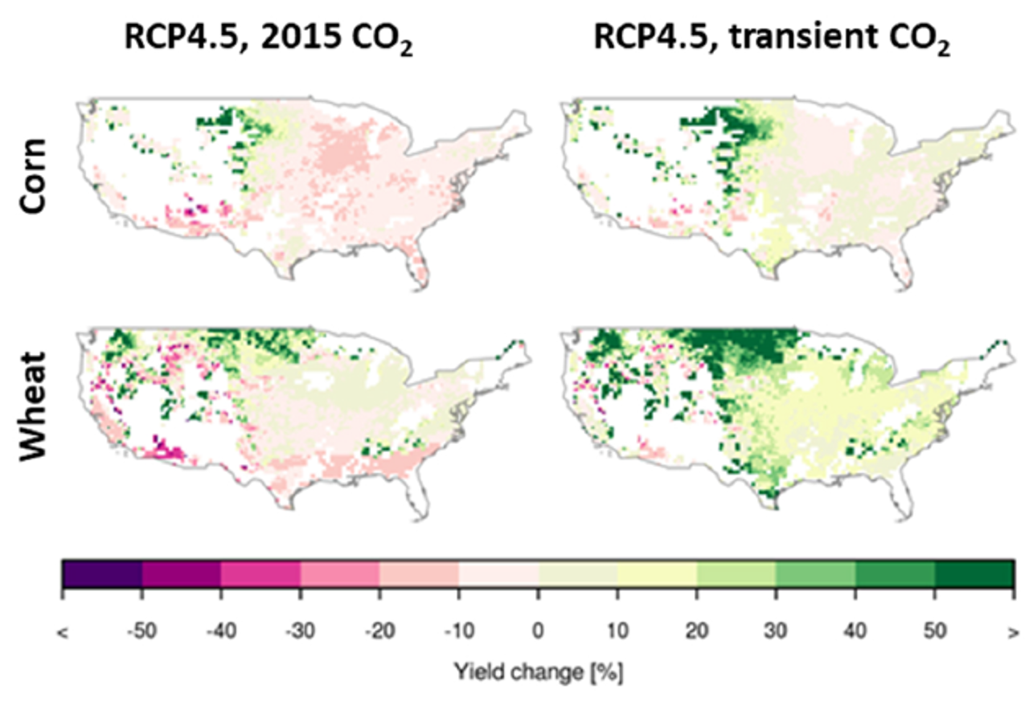
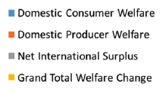
FEI ET AL. 2023
Results: yields and economic welfare
YIELD EFFECTS (with CO₂)
↑↑
↑
Wheat, grassland
Soybean
→
↓
Sorghum
Corn
LPJmL/FASOM results by domestic °C
Net welfare (LPJmL)
+$12B/yr
Net welfare (econometric)
−$28B/yr
Net welfare (GGCMI)
Even worse

Slide 9
FEI ET AL. 2023
Sensitivity factors and model comparison
YIELD MODEL COMPARISON (RCP8.5)
SENSITIVITY FACTORS (welfare, 3–6°C) (stylized)
Model
Corn
Wheat
Soy
CO₂ only
−$40B
Replace LPJmL → econometric
−$14–24B
Add intl. climate/ag effects
LPJmL
(this study)
↓
↑↑
↑
↑↑
−$4B/yr
1993 Midwest flood @ 10yr frequency
−$4B
Add waterlogging from average precip
Econometric
(this study)
↓
↑↑
~
↑
−$4B
Add climate induced ozone damage
GGCMI-CMIP6
ensemble
↓↓
↑
↓
↑
−$2B
Add pest & disease
+$3–6B
Add crop adaptation (e.g., breeding)
See Sampedro et al. 2023 for CH₄ induced O₃ damages

Slide 10
TAKEAWAYS
Takeaway and Wishlist
Informing policymakers is helped by a tool that can be run quickly and easily.
That requires (careful) simplifications.
Agriculture results can be more useful when translated into damage functions.
4
CO₂ fertilization: build a 2D response surface
Extreme flooding: GCM drizzle bias
Pest/weed expansion → pesticide → water quality
GCMs & even some downscaling methods often underestimate extreme precip events.
A 1993-scale Midwest flood → $41B/event; at 1-in-10yr frequency → $4B/yr annualized.
Climate sensitivity decouples ΔT and CO₂ across trajectories. By-degree functions should treat both as explicit inputs.
Warming expands pest ranges and accelerates weed growth → more herbicide and pesticide use → downstream water quality and ecosystem impacts.
Substack post: thesaraphreport.substack.com · Fei et al. 2023, Anthropocene 42:100386

