Slide 1
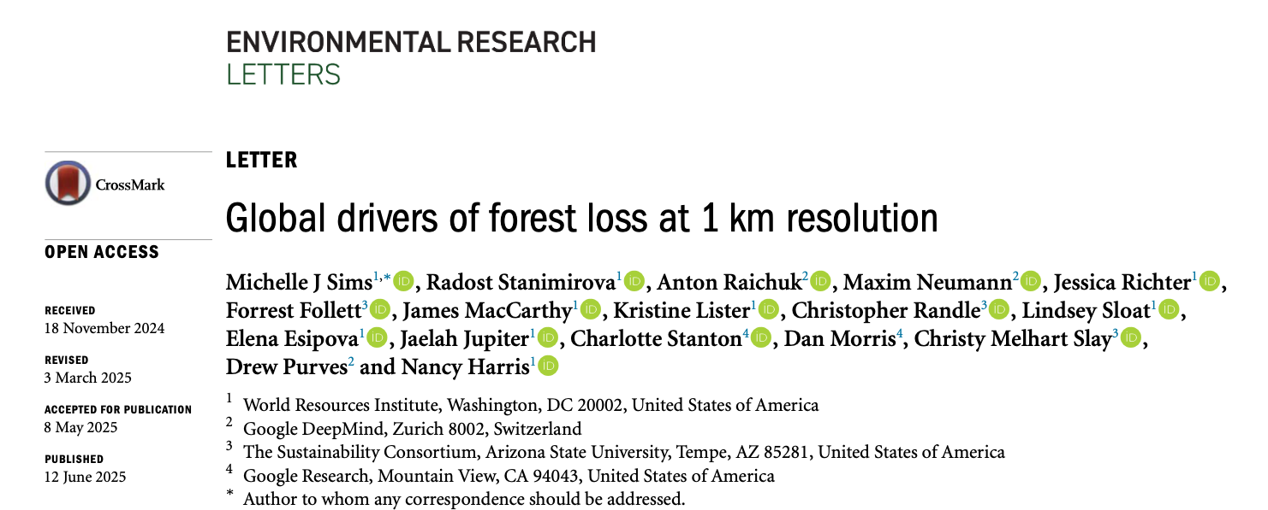






Mapping natural drivers of forest loss at global scale
Radost Stanimirova
World Resources Institute
Notes:
Hello everyone and thank you for having me at the Forestry and Agriculture Modeling Forum. It’s a pleasure to be here and speak in this session. Thank you Justin for the introduction.
Today I will be sharing with you our findings from a recent paper we published in Environmental Research Letters, titled "Global drivers of forest loss at 1 km resolution." In particular, I will be focusing on the dynamics and impacts of natural disturbances on forests. I would like to acknowledge my coauthors, including Michelle Sims from the World Resources Institute as well as our collaborators and coauthors at Google DeepMind.
Resources:
https://www.wri.org/insights/global-trends-forest-fires
https://www.wri.org/news/release-global-forest-loss-shatters-records-2024-fueled-massive-fires
https://www.wri.org/insights/forest-loss-drivers-data-trends

Slide 2
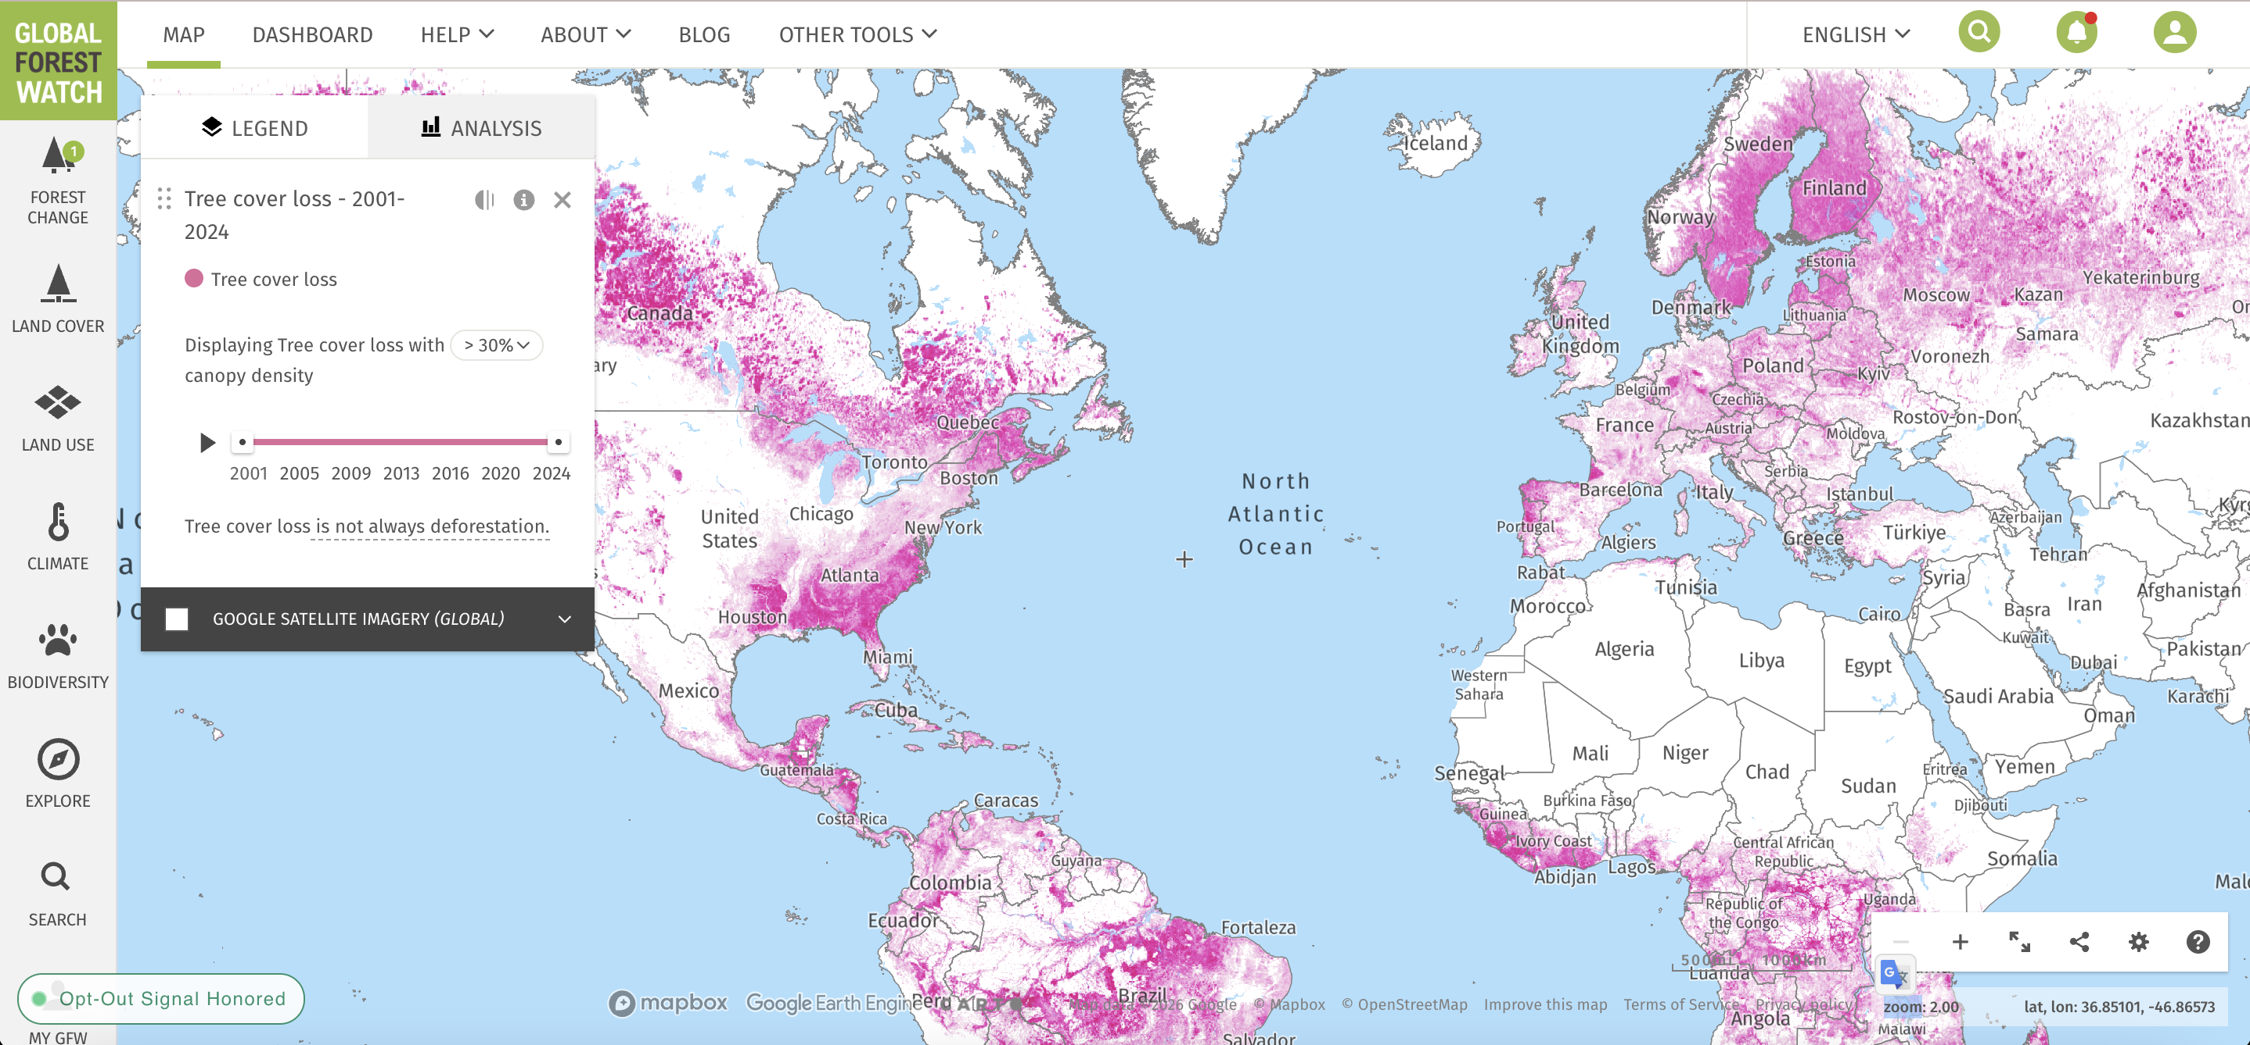
Not all forest loss is the same
Forest loss data on Global Forest Watch include all types of stand-replacement disturbances to trees
Distinguishing temporary losses (e.g., degradation, management) from long-term forest conversion (e.g., deforestation) is important for:
  understanding different carbon and ecological implications
  developing appropriate policy response
  tracking progress on global targets to end deforestation
Global tree cover loss (Hansen et al. 2013), available on Global Forest Watch
Link: https://gfw.global/7MQzOM
Notes:
Global Forest Watch (GFW), established in 2014 by a consortium of partners led by the World Resources Institute, is a forest monitoring initiative that provides open access to data about the current status of forests and recent forest change.
One of the major breakthroughs in global forest cover monitoring that was key in launching Global Forest Watch was global data on annual forest loss, produced by the University of Maryland, first published in 2013. (Hansen et al. 2013). This data, which is made available on GFW, have been a major advancement in consistent and transparent forest cover monitoring at a global scale
However, the data map all forest loss, and therefore do not distinguish deforestation, or permanent losses due to land use change, from temporary disturbances due to management or degradation, such as harvesting or selective logging.
Important to distinguish these types of losses and what is causing them due to the different carbon and ecological implications, as well as to develop appropriate policy or management responses.

Slide 3
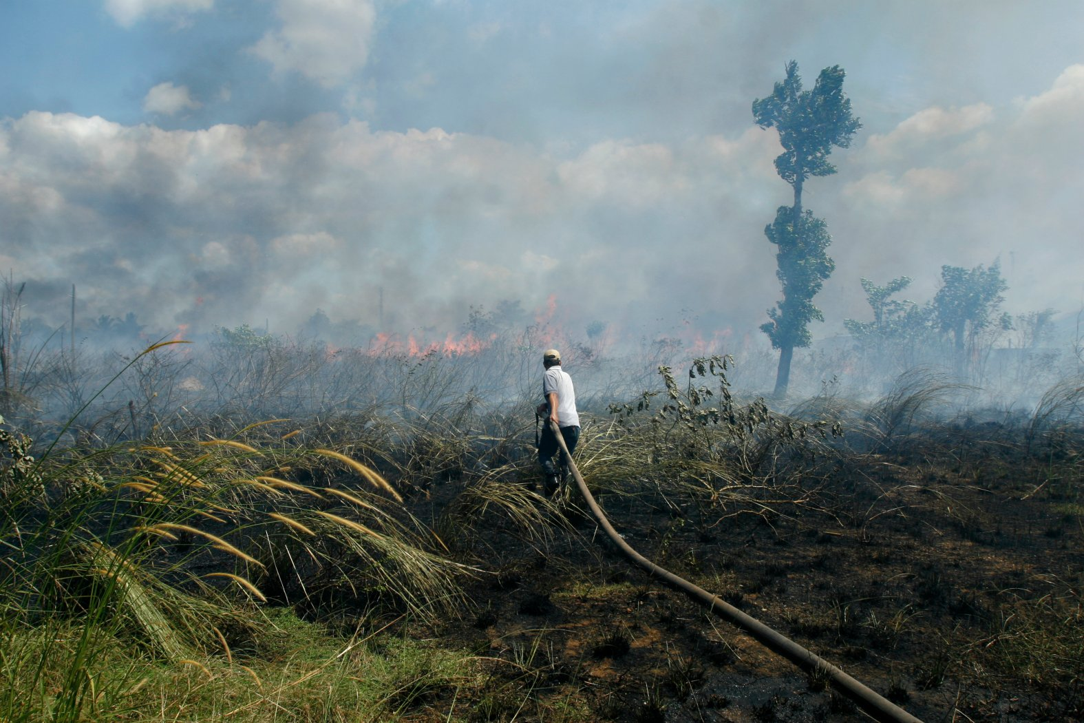
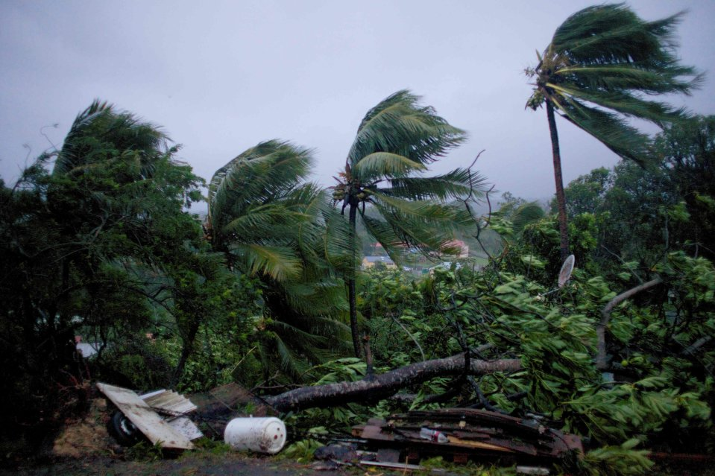
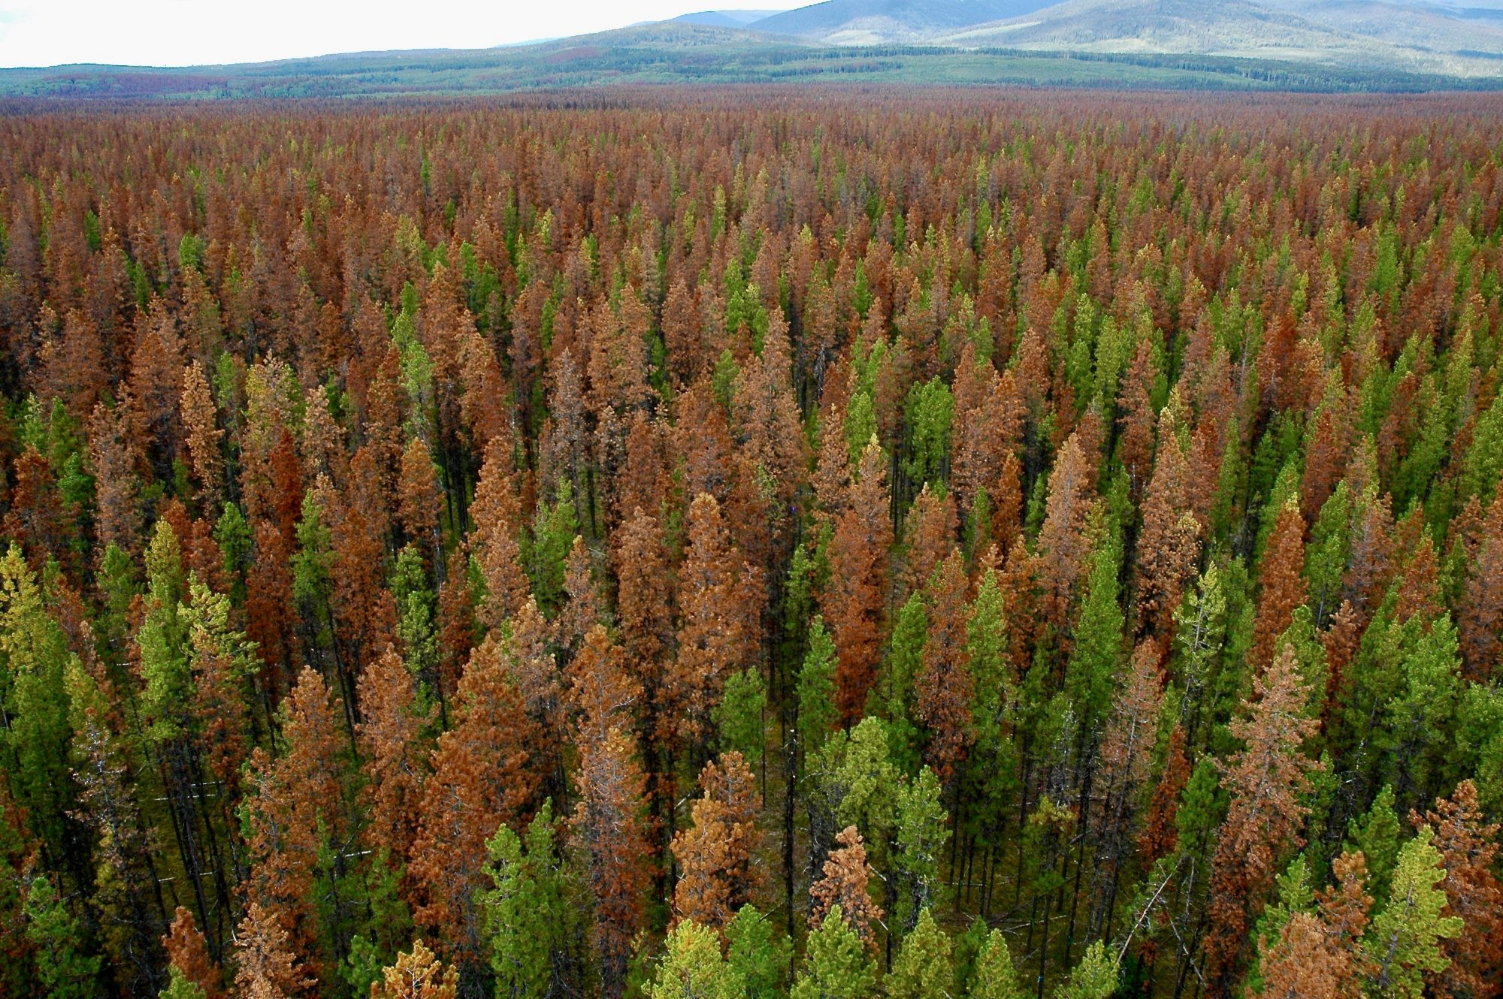
Why natural disturbances matter
Natural disturbances behave differently
Often temporary (forest regrowth)
Cyclical and climate-driven
Highly variable across regions
Growing component of global forest dynamics
Insect outbreaks & storm impacts intensifying
Wildfires increasing in intensity and frequency
Wildfire
Hurricane
Insect outbreak
Notes:
Given the focus of this session, I would like to highlight how different and important natural disturbances are in forest dynamics.
Natural disturbances behave differently than permanent human driven deforestation such as clearing forests for permanent agriculture (such as commodity crops) or human settlements. Natural disturbances are often temporary such as when trees are knocked down by storms, changing rivers or landslides, as such they can be cyclical features of a forest's ecology and can have ecological benefits. Natural disturbances encompass a lot of different events from bark beetle outbreaks to hurricanes and as a result can be highly variable across regions.
Natural disturbances have been a growing component of global forest dynamics. Although forests may regrow following natural disturbances, they may experience degradation or changes to forest structure and species composition. When these events are more extreme or more frequent, they can profoundly alter the condition of the ecosystem. And the lines are blurry. In many cases, climate change has contributed to increasing the extent, frequency or severity of many “natural” disturbance events, including wildfires and pest outbreaks, compromising forests’ overall condition and ability to recover.
Work by my colleagues at WRI has shown that wildfires are increasing in intensity and frequency. While fires are natural in some ecosystems such as boreal forests, in tropical forests they are mostly human-caused, often set on agricultural land to prepare new areas for farming. Though fire is a natural part of how boreal forests function ecologically, fire-related tree cover loss in these areas has risen rapidly, increasing by about 160,100 hectares per year over the last 24 years.Climate change is the main reason for this. Northern high-latitude regions are warming at a faster rate than the rest of the planet, contributing to longer fire seasons, greater fire frequency and severity, and larger burned areas in boreal forests. Although forests have the ability to recover from fire, the combined pressures of land conversion and a changing climate can hinder that recovery and raise the likelihood of future fires.
It's important to differentiate these disturbances from permanent deforestation because they require a different interpretation, carbon accounting, and policy response.

Slide 4
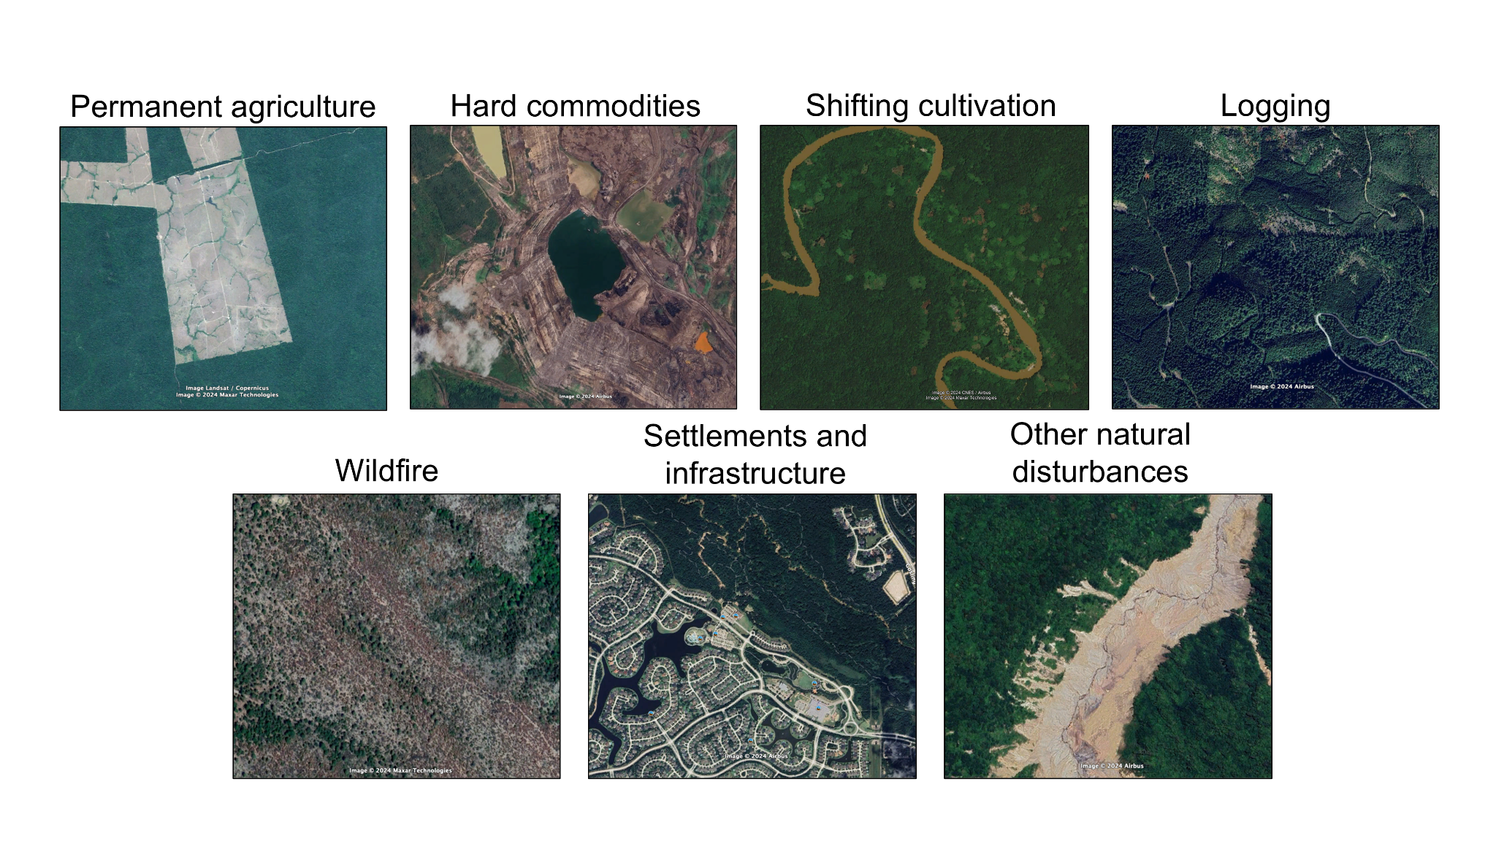
Driver definitions
Driver: Defined as the direct cause of forest loss, including both temporary disturbances (natural or anthropogenic) or deforestation. The dominant driver is that which caused the majority of tree cover loss within each 1 km cell over the time.
Temporary disturbances
Drivers of deforestation
Permanent agriculture
Hard commodities
Settlements and infrastructure
Drivers of temporary disturbances
Shifting cultivation
Logging
Wildfire
Other natural disturbances
Notes:
In this work, a driver is defined as the direct cause of forest loss, and can include both temporary disturbances (natural or anthropogenic) or permanent loss of forest due to a change to a non-forest land use (e.g., deforestation).
The dominant driver is defined as the direct driver that caused the majority of forest loss within each 1 km cell over the time period.
Permanent agriculture is the loss of forest for agricultural use from small to large scale, which could be commodity crops, such as cocoa, palm oil, pasture, or any other type of agriculture
Hard commodities include small to large scale mining and energy infrastructure, such as solar panels, oil drilling, etc.
Shifting cultivation is a specific type of agriculture found in the tropics, defined here as small scale rotational agriculture where forest is cleared and crops are cultivated for a few years, and then abandoned and forest is allowed to regenerate.
Forest management includes harvesting in timber and wood fiber plantations, as well as clearcut or selective logging
Wildfire includes loss due to fire, with no conversion to agriculture following. Could be natural or anthropogenic fires
Expansion of urban areas and settlements and other urban infrastructure
Other natural disturbances can include events such as hurricanes, insect outbreaks, landslides, etc.
Deforestation often has more severe impacts compared to temporary disturbances, including permanent loss of carbon stocks, profound habitat disruption and loss of ecosystem services.

Slide 5
Driver definitions
Driver: Defined as the direct cause of forest loss, including both temporary disturbances (natural or anthropogenic) or deforestation. The dominant driver is that which caused the majority of tree cover loss within each 1 km cell over the time.
Wildfire*
Other natural disturbances**:
Storms
Flooding
Landslides
Windthrow
Lava flows
Sediment flow/meandering rivers
Insect outbreaks
* Fires may be started by natural causes (e.g. lightning) or may be related to human activities (accidental or deliberate).
** If forest loss due to natural causes is followed by salvage logging, it is classified as logging.
Notes:
In our work we did a global characterization of drivers of forest loss, accounting for all of these drivers and their regional contributions to loss. For today's talk, I will focus on the findings from the "wildfire" and "other natural disturbance" driver categories.
Wildfire could be started by natural causes (such as lightening, for example) or it may be related to human activities (accidental or deliberate). Use of fire for clearing land is captured in the permanent agriculture category. An escaped campfire, however, would be labeled wildfire in our categorization.
Other natural disturbances is a heterogeneous catchall category that includes storms, flooding, landslides, windthrow, lava flows, meandering rivers, and insect outbreaks. However, note that if forest loss due to natural causes is followed by salvage logging, a very common practice in Europe, it is classified as logging instead.

Slide 6
Methods overview
Training data collection
Model development and testing
Validation of final map & sample-based estimates
Active learning
Notes:
These are the main steps of the data development process. Will cover these in the presentation today.

Slide 7
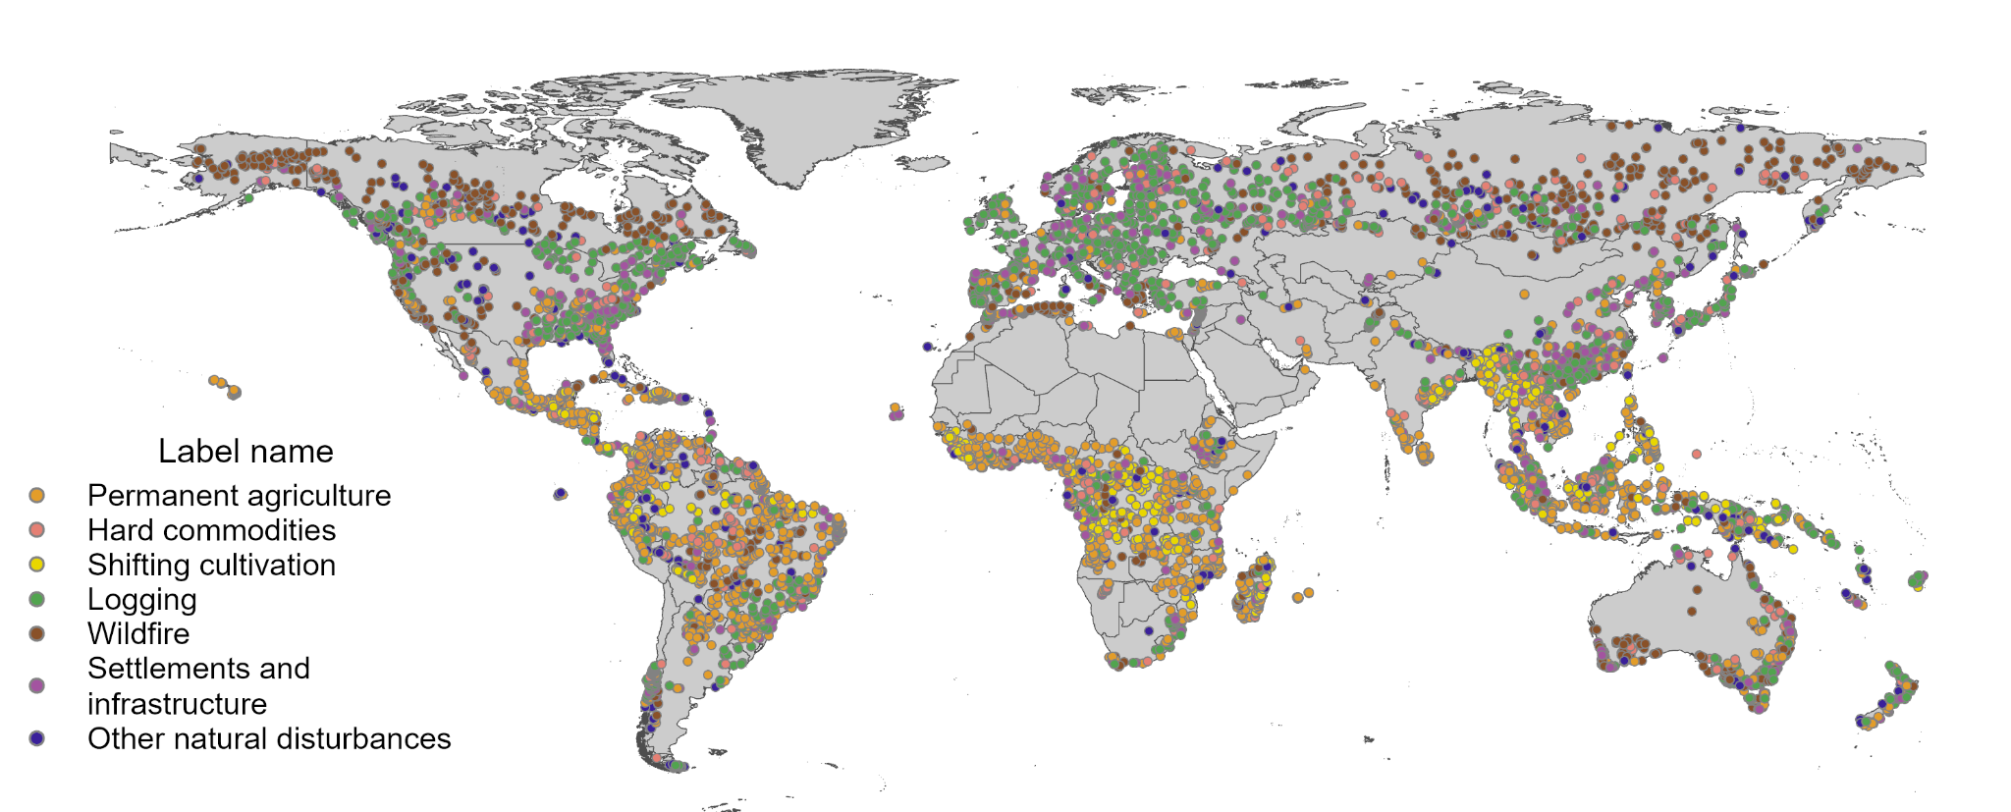
Training data collection
Interpreted a total of 7,786 plots
Initial random sample based on the seven driver classes & aided by ancillary data
Additional training data collected through active learning process (30% of training data)
Notes:
To train the model, we collected a set of over 7,000 training samples.
We generated an initial set of training data using a global random sample based on the seven driver classes and aided by ancillary data, to ensure adequate samples were drawn for each driver.
These were interpreted by a team of 9 image analysts based on visual interpretation of very high resolution satellite imagery.
We collected additional training data through an active learning process. We identified areas where the model performance needed improvement, where model uncertainty was higher, or where dynamics were not well represented in our training data, and specifically targeted those areas for training data collection. 30% of our data was collected through an active learning process.
For interpretation, we developed an application in Google Earth Engine so that interpreters could load various data, including Landsat, Sentinel, Planet imagery, Landsat time series of SWIR1 and various indices, as well as the loss data and other contextual layers
Used very high resolution imagery from Google Earth Pro and Esri Wayback
Interpreters used the GEE interface to record their labels.
Image analysts recorded the primary, or dominant, driver, secondary driver (where applicable), confidence in assigning their label. Only the primary driver label was used for training. Each plot was reviewed for quality by senior analysts with domain expertise.

Slide 8
Training data and model configuration
Model architecture: customized convolutional neural network model with residual connections (ResNet, He et al, 2015)
  shallow and wide
  Relatively lightweight and efficient
Spatial context: larger context window (1.5 km) with 15m pixel spacing
Data augmentation: training data random augmentations
Validation approach: trained via 5-fold cross validation
Uncertainty reduction: ensembled a set of trained models to reduce model uncertainty
Input Data Source | Bands
Global Forest Change (Hansen et al. 2013) | 13 bands including two Landsat 7 composites of 4 channels each (red, NIR, SWIR1, SWIR2)
Sentinel-2 | 5 bands with 10m and 20m resolution channels for three years (B3, B4, B5, B7, B12)
Tree cover loss due to fire (Tyukavina et al. 2022) | Single binary band
Dynamic World (Brown et al. 2022) | 3 land cover class probability bands for three years
FABDEM (Hawker et al. 2022) | 3 bands: elevation, slope, aspect
GHS Population | Single band for 7 time intervals
Mining composite (Maus et al. 2022, Tang et al. 2023, Dethier et al. 2023) | Single binary band
Latitude/Longitude | Two values
Region annotation | Single value
Notes:
We tested multiple models, including random forest, vision transformers, and ResNet, a variant of convolution neural networks
ResNet performed the best, so we tuned it’s architecture to better fit our 1 km geospatial data
ResNet: Deep Learning architecture. Relies on convolutional layers with predefined structure to extract local information and gradually propagate the information to the level of the whole image.
The image is just a single layer, we have multiple layers plus a stem block of layers at the beginning and the classification head
We performed random augmentations on training data to avoid overfitting - (random shifts, rotations, flipping, ...)
To improve the robustness of classification and decrease the noise, we experimented with using ensembles.
Where we simply run X independent models and before ingesting data into EE we aggregate the probabilities of these X model outputs.
Constructed datasets from 7 remote sensing sources across a time range of 22 years
112x112 pixels at input
Single global model, but using one-hot region encodings as inputs

Slide 9
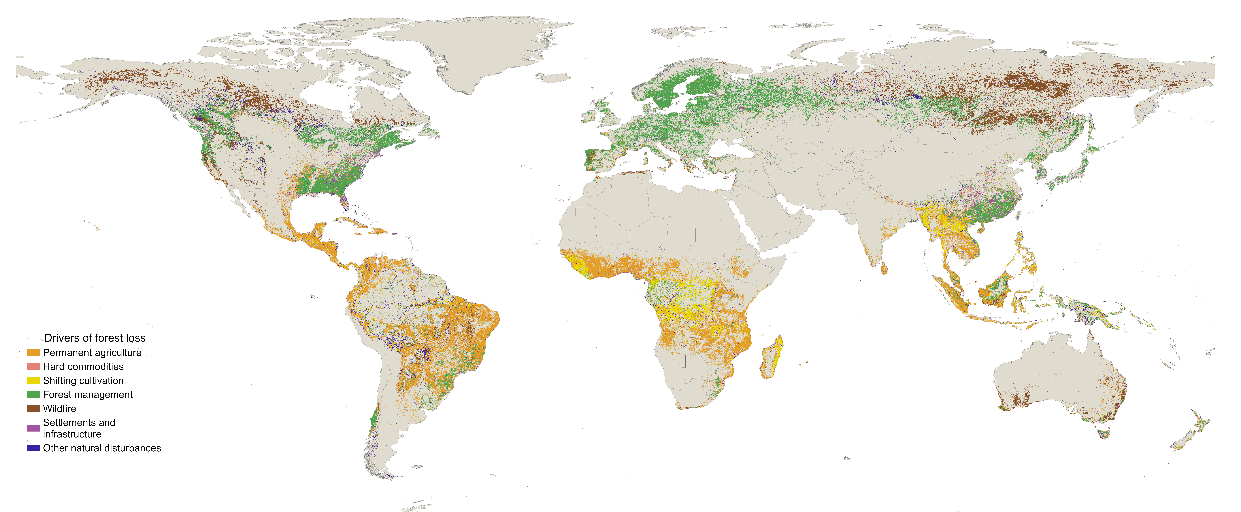
Drivers of forest loss (2001-2024)
Notes:
This is the map of global drivers of forest loss from 2001 to 2024. You can see that the tropics are dominated by permanent agriculture (shown in orange) and shifting cultivation (shown in yellow, most visible in the Congo basin). Northern latitudes are dominated by logging shown in green and wildfire show in brown. At the global scales, losses due ot natural drivers are not visible.

Slide 10
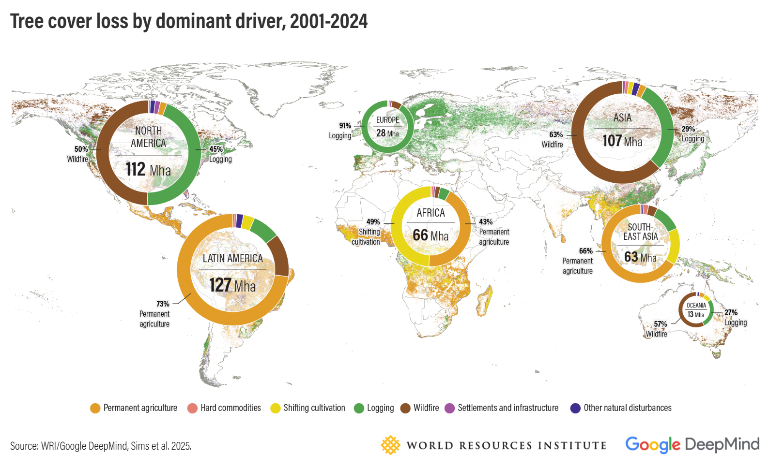
Forest loss by dominant driver (2001-2024)
Notes:
This is the breakdown of forest loss by dominant driver in each region. You can see, for example, that 73% of forest loss in Latin America is due to permanent agriculture, 91% of forest loss in Europe is driven by logging, 63% of forest loss in Asia is due to wildfire. Now let's dive into the results specifically for wildfire and other natural disturbances.

Slide 11
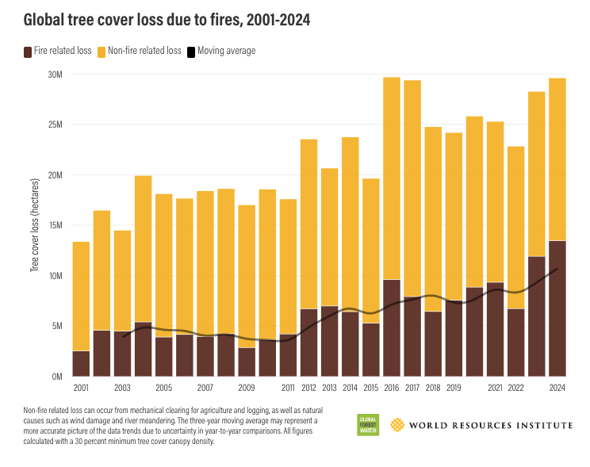
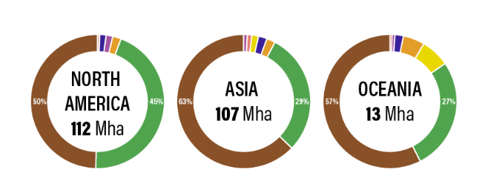
Wildfires are getting worse
Wildfire is the second largest driver of global forest loss, accounting for 152 Mha (29%) since 2001
Wildfire leading driver of loss: North America (50%), Asia (63%), Oceania(57%)
Forest fires are getting worse, burning more than twice as much tree cover today as they did 20 years ago, largely due to climate change.
Notes:
Globally, wildfire is the second largest driver of forest loss, following permanent agriculture. Wildfire accounts for 152 Mha of loss or 29% of all forest loss between 2001 and 2024. Wildfire is a large and important driver in North America (50% of forest loss, dominated by Canada), Asia (63% of forest loss, dominated by Russia), and Oceania (57% of forest loss). Russia and Canada together account for 70% of all global wildfire loss.
The graph on the left hand side shows time on the x-axis and tree cover loss on the y-axis. The brown color represents forest loss due to fire and in yellow/orange the non-fire related loss. Looking at the graph it quickly becomes clear that fire related loss has been increasing through time, especially in 2023 and 2024. Fire related loss has increased in both fire adapted regions such as boreal forests and in tropics where fire is largely human caused.
In many fire-adapted forests in these regions, periodic wildfires are a natural part of ecosystem dynamics and support ecosystem health and biodiversity. However, the warming and drying effects of climate change are increasing fires’ frequency, length and severity, which in turn increases fire-related GHG emissions in a fire-climate feedback loop.
More than 60% of all fire-related tree cover loss between 2001 and 2024 occurred in boreal regions. Though fire is a natural part of how boreal forests function ecologically, fire-related tree cover loss in these areas has risen rapidly, increasing by about 160,100 hectares per year over the last 24 years.
Climate change is the main reason for this. Northern high-latitude regions are warming at a faster rate than the rest of the planet, contributing to longer fire seasons, greater fire frequency and severity, and larger burned areas in boreal forests.
Almost all fires that occur in the tropics are started by people, rather than by natural causes like lightning strikes. Managed fires are commonly used in the region to clear land for new pasture or agriculture. But these fires can escape and escalate, with warmer and drier conditions fueling their spread. Deforestation and forest degradation associated with agricultural expansion also make forests in these regions more vulnerable to fires by contributing to rising temperatures and dried-out vegetation.

Slide 12
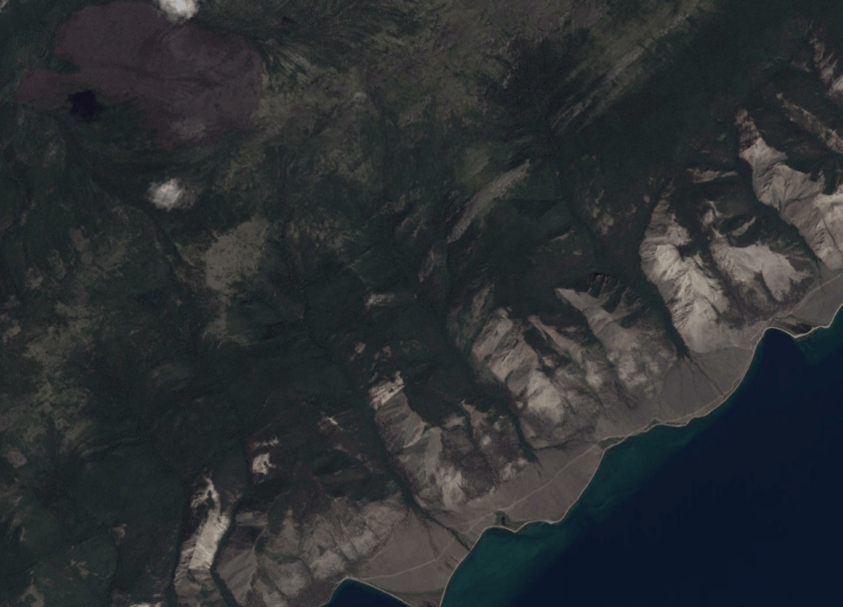
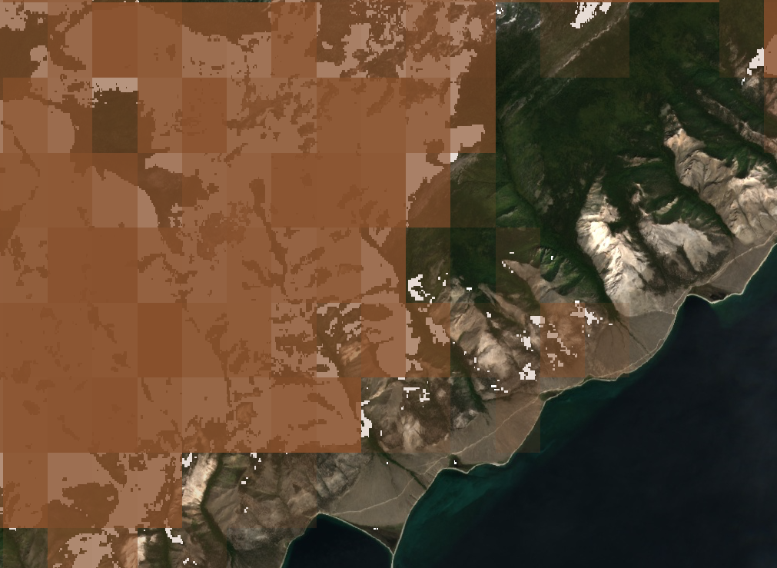
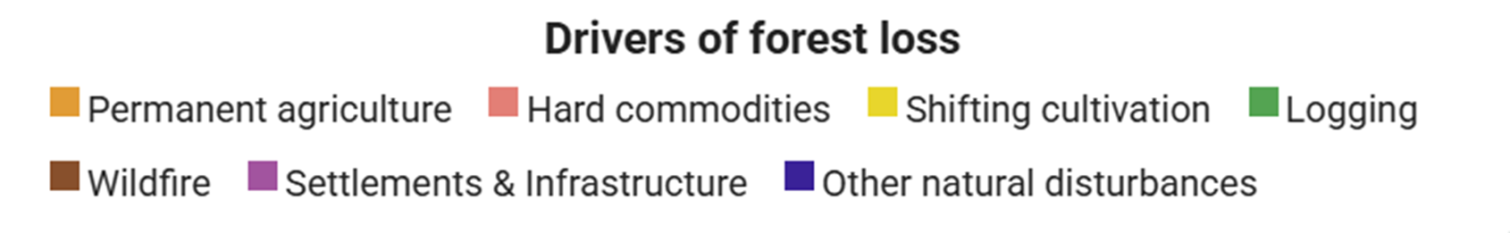
Wildfire in boreal Russia
Notes:
These effects are evident in places like Russia, where 74% of tree cover loss from 2001-2024 can be attributed to wildfires, or 66 million hectares.

Slide 13
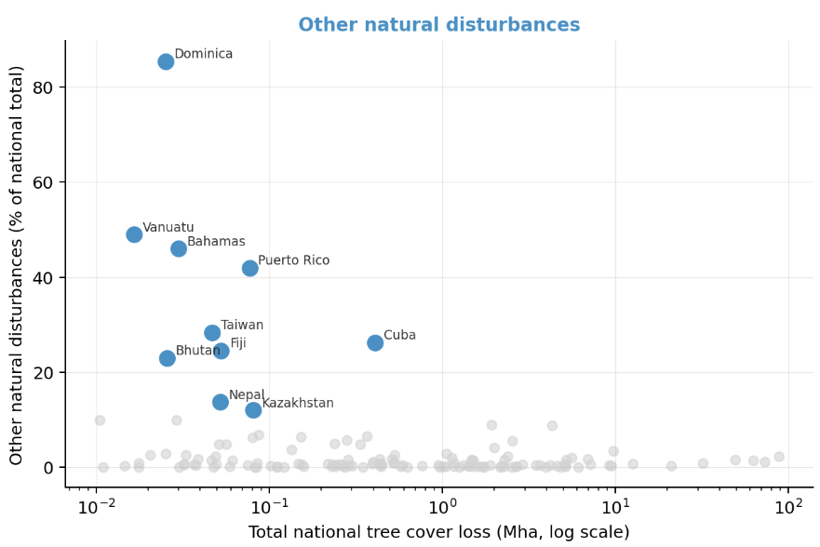
Other natural disturbance
Other natural disturbances are minor globally at 7.3 Mha (1.4%) since 2001
Episodic increases, driven by specific events, important in certain regions
  Insect outbreaks fueled by climate change have occurred in USA & Russia
  Caribbean hurricanes Irma & Maria (2017) caused extensive forest loss
Notes:
Other natural disturbances represent a small proportion of forest loss globally (7.3 Mha, only 1.4%) from 2001 to 2024. The greatest % forest loss due to other natural disturbances is in Latin America, Asia, Oceania, with approximately 2% loss each.
The graph on the right hand side, the x axis shows total national tree cover loss and the y-axis shows other natural disturbance as a percent of the national total. The highlighted and labeled countries represent the highest % of national forest lost but as you can see they also have low over all forest loss.
Loss due to other natural disturbances is dominated by episodic pulses from specific events. Largest loss by area is driven by bark beetle outbreaks, which over the past three decades have become more severe fueled by climate change and have occurred across North America and Russia, threatening the health of these regions’ forests.
Furthermore, small island nations are disproportionately exposed to natural disturbances relative to their forest size – extreme weather events such as hurricanes can wipe out a large fraction of natural tree cover in a single year.
In 2017, hurricanes Irma and Maria cause extensive forest loss in Puerto Rico, Cuba, Dominica. Cyclone Winston in 2016 damaged tree cover in the Fiji archipelago. Taiwan forest loss is due to landslides in steep terrain following typhoons. Bhutan and Nepal are also subject to landslides.
Africa and Southeast Asia are almost entirely insulated from wildfire and natural disturbance as forest loss drivers — their losses are human-driven (agriculture, shifting cultivation), which has different implications for policy response.

Slide 14
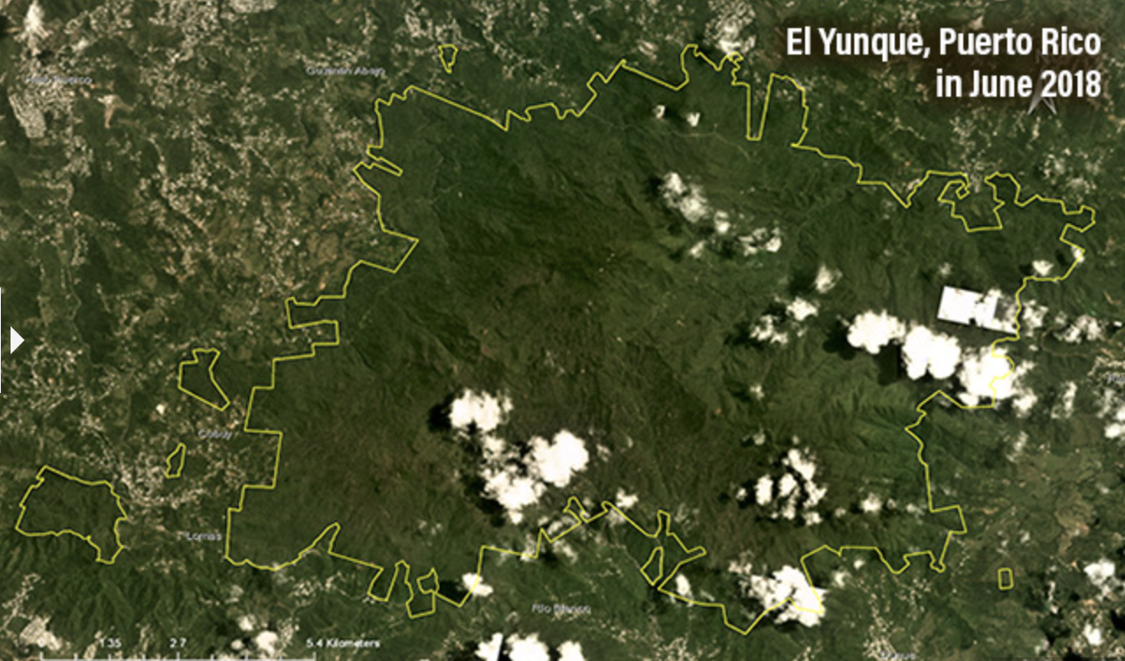
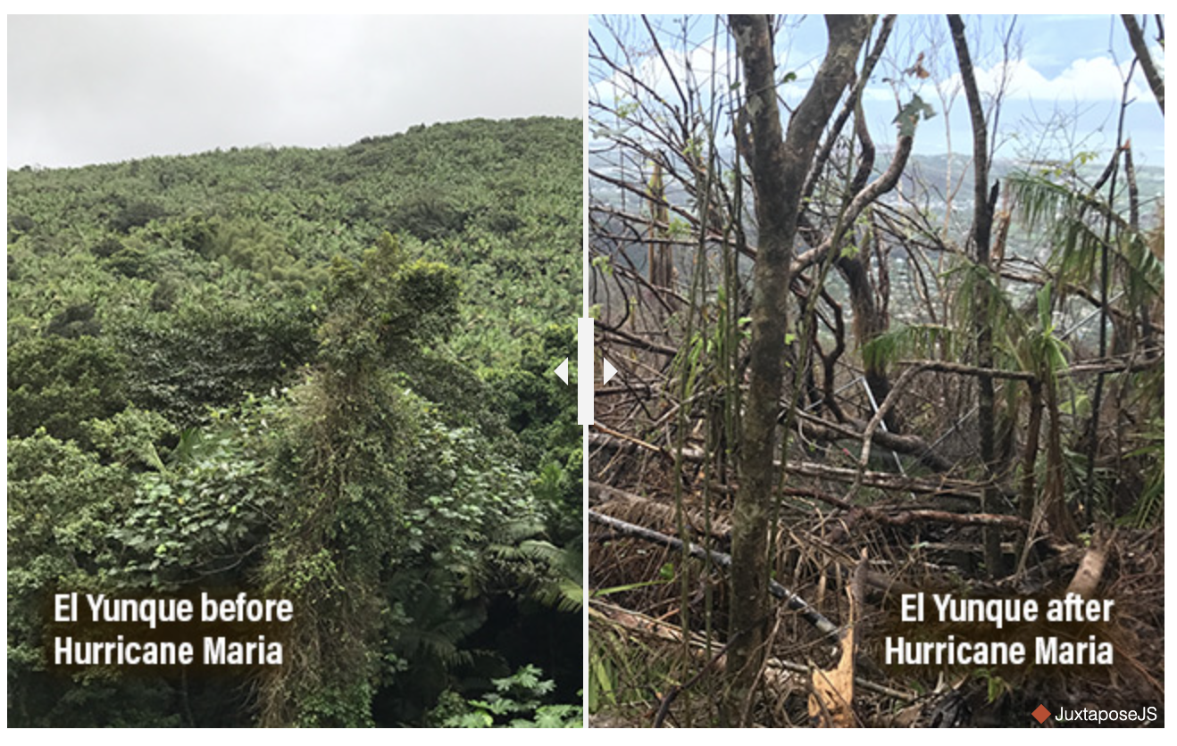
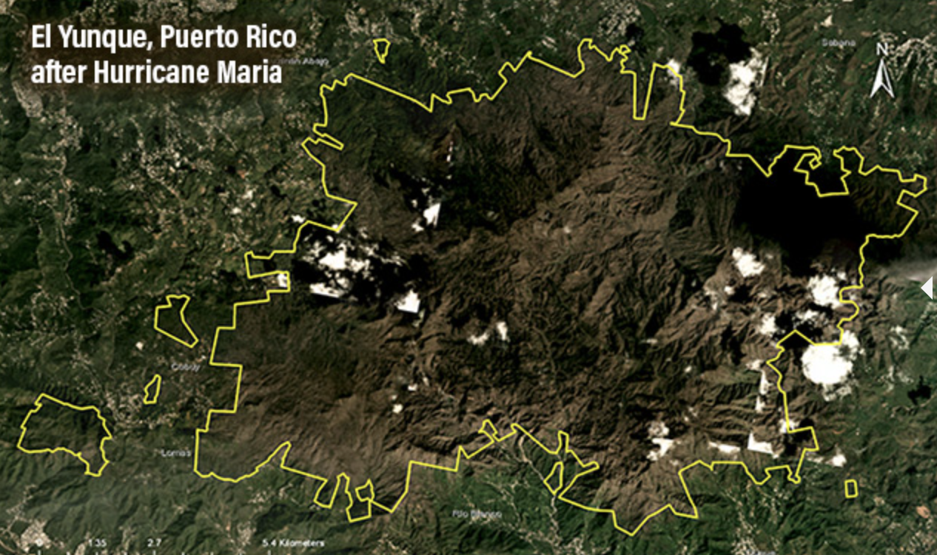
Hurricane Maria in Puerto Rico
Notes:
These are some images and examples of the damage that hurricane Maria inflicted on El Yunque national forest in Puerto Rico in 2017.
https://www.wri.org/insights/while-puerto-ricos-people-still-suffer-effects-hurricane-maria-its-forests-are-faring-much

Slide 15
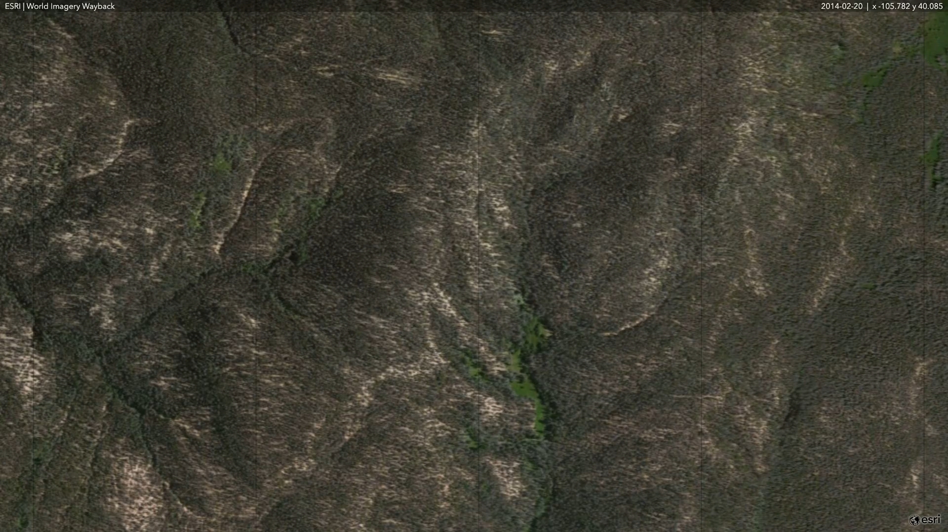
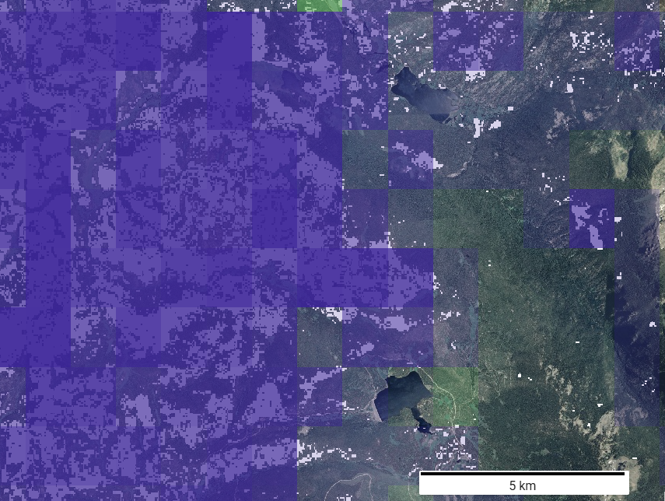
Mountain pine beetle outbreak in the U.S.
Arapaho National Forest, U.S.
Notes:
Mountain pine beetle causing tree mortality in Colorado, U.S.

Slide 16
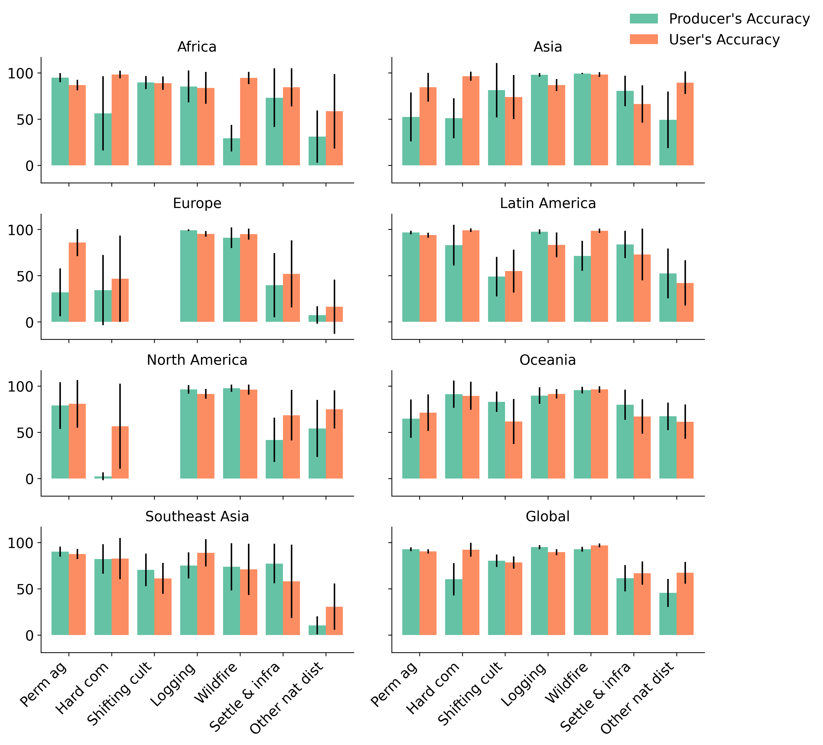
Global overall accuracy is 90.5%, user's and producer's accuracy vary
Overall high per class and per region accuracies
Overall high user's and producer's accuracy for wildfire globally and for regions most impacted
Other natural disturbances and hard commodities had lower producer’s accuracy and higher standard error due to their heterogeneous characteristics
Notes:
Overall accuracy 90.5%.
Global per class user’s and producer’s accuracy were highest for permanent ag, logging, and wildfire classes (over 90% for both user’s and producer’s accuracy)
Other nat dist had lower producer’s accuracy and higher standard error due to their heterogeneous characteristics.
Producers accuracy = error of omission = measures how well real-world, ground-truth features are represented on a classified map
Users accuracy = commission error = measures how often a map-classified feature represents that class on the ground

Slide 17
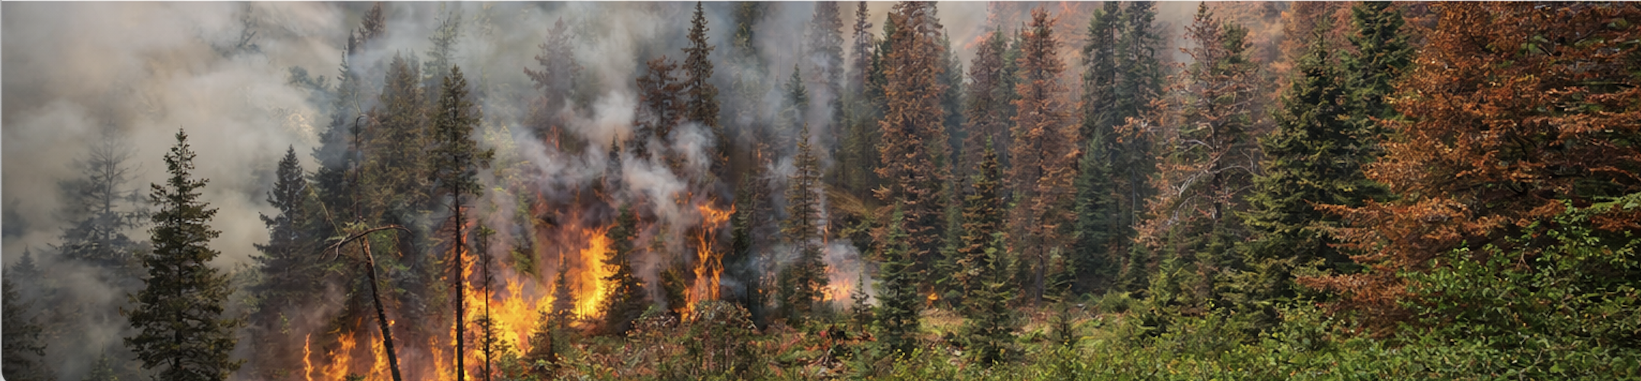
Implications
Wildfire and other natural disturbances account for 30% of global forest loss but are largely temporary — forests can recover, enabling carbon sequestration and habitat regeneration if disturbance frequency and severity remain within natural bounds
Increasing fire and storm frequency and severity driven by climate change can exceed forest recovery capacity, shifting ecosystems from carbon sinks to permanent sources
Climate-driven bark beetle outbreaks can increase the susceptibility and severity of subsequent wildfires — natural disturbance interactions are intensifying and compounding losses

Slide 18
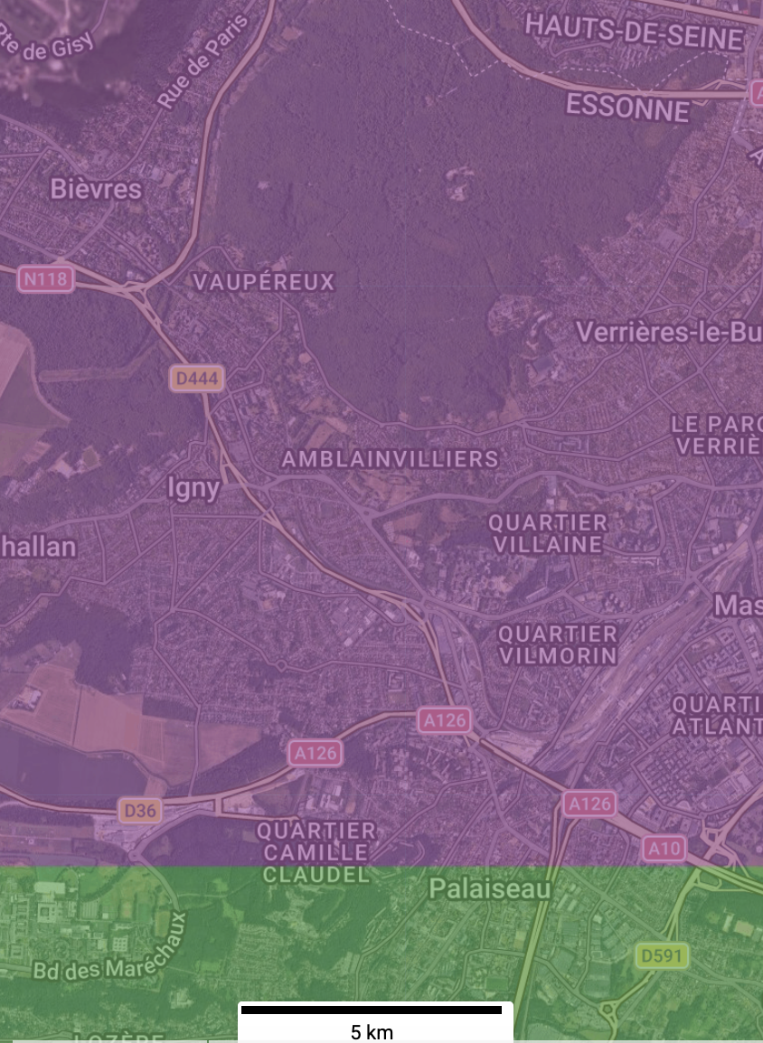
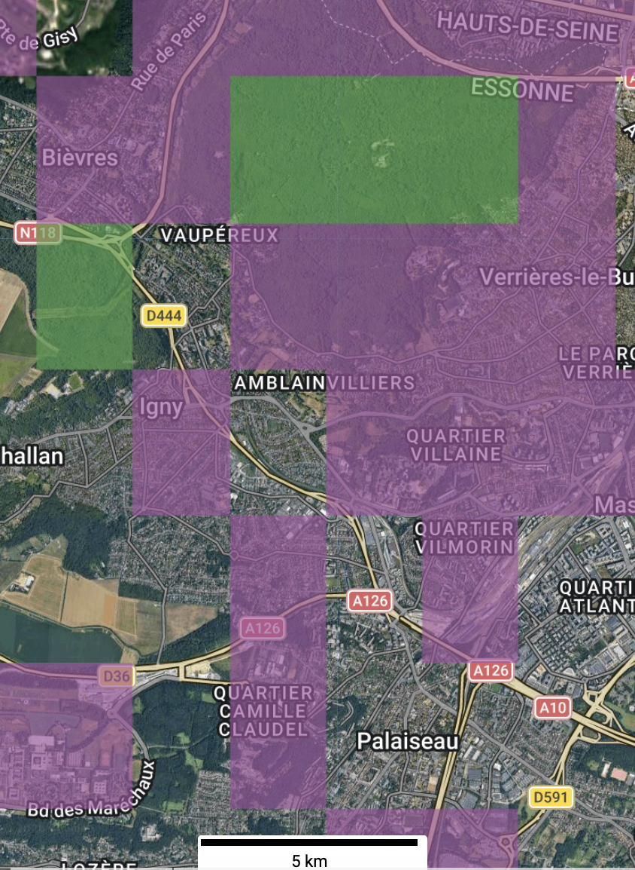
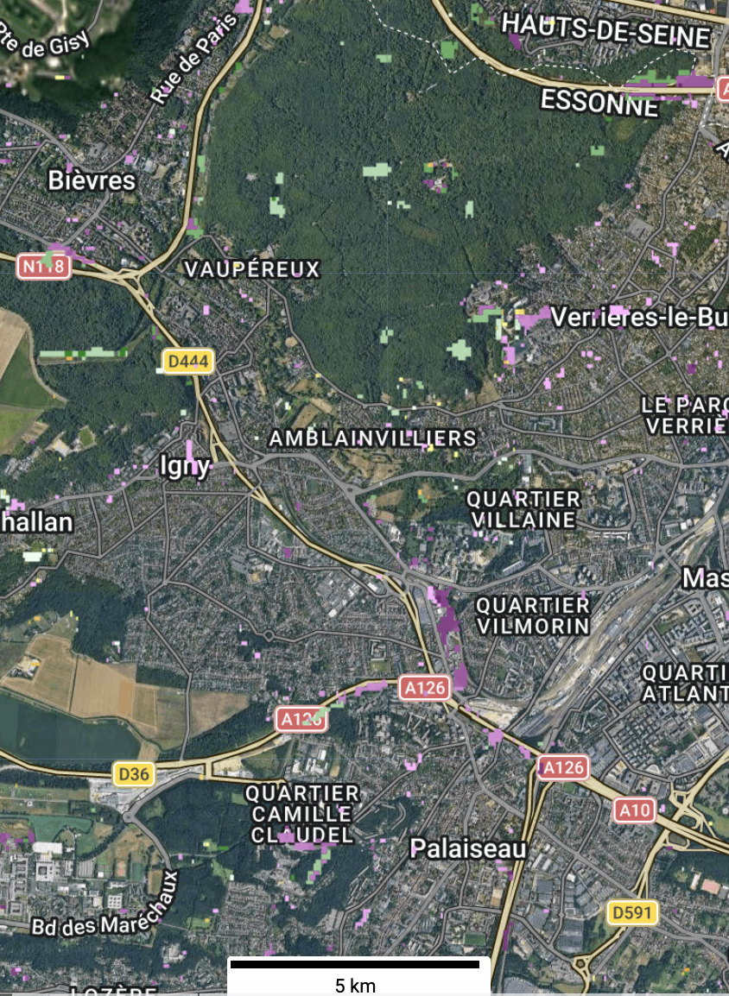
Future work
Dominant driver of forest loss at 10 km (Curtis et al. 2018)
Dominant driver of forest loss at 1 km (Sims et al. 2025)
Annual drivers of forest loss at 30 m (testing)
Notes:
In 2018, WRI and the Sustainability Consortium created a 10 km driver of forest loss map. On the left hand side image, you can see the 10 km driver map featuring two classes – settlements in purple and logging in green. This is an example just outside of Paris, France.
In the middle is an example from the product I have shared with you here today – 1 km drivers for the same slice of Paris co-created with Google DeepMind. You can already see that the distinction between classes and loss is becoming clearer but still generalized.
All the way on the right hand side is an example of the work we are currently doing to map drivers of forest loss annually at 30 m resolution. This increased spatial and temporal resolution will help capture temporal sequences of change (such as insect outbreak to wildfire to salvage logging, for example, and improve attribution. It's hard to see but in the panel on the right hand side the different colors represent different years of loss.

Slide 19
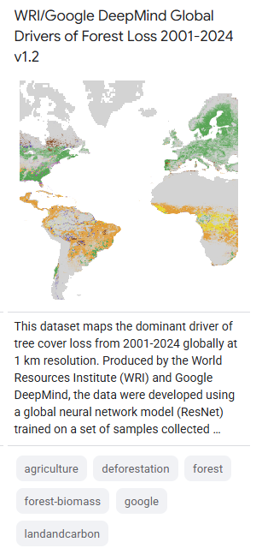
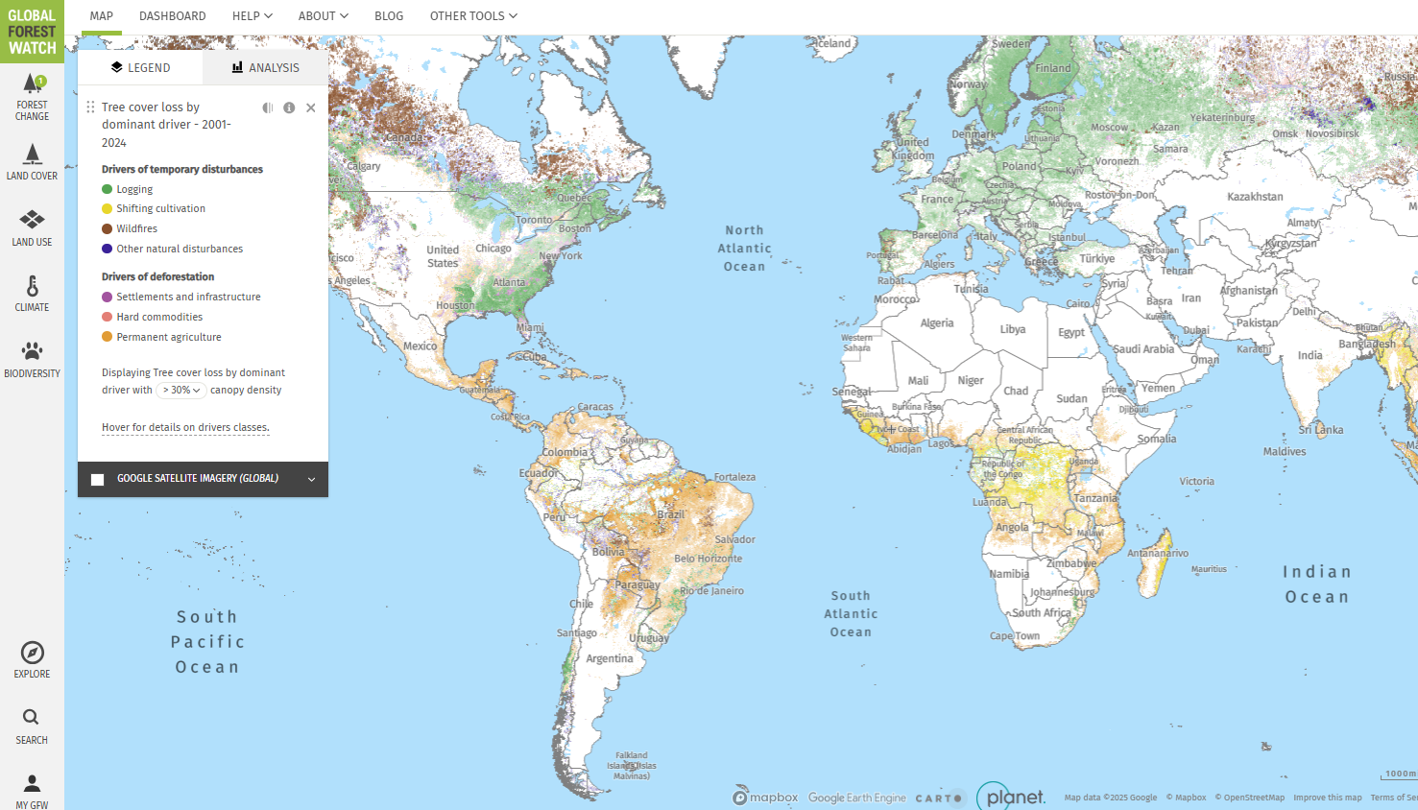


Annual Updates
Updated to 2024
Update to 2025 to be released shortly
Available on Google Earth Engine, Global Forest Watch
Available for download from Zenodo & WRI Data Explorer (maps, training and validation data)
View the data on GFW:
Notes:
We plan to update the data annually with each UMD forest loss update, and have done so for 2023 and 2024.
Data is available on GEE and GFW
Maps, training and validation data available for download on Zenodo

Slide 20
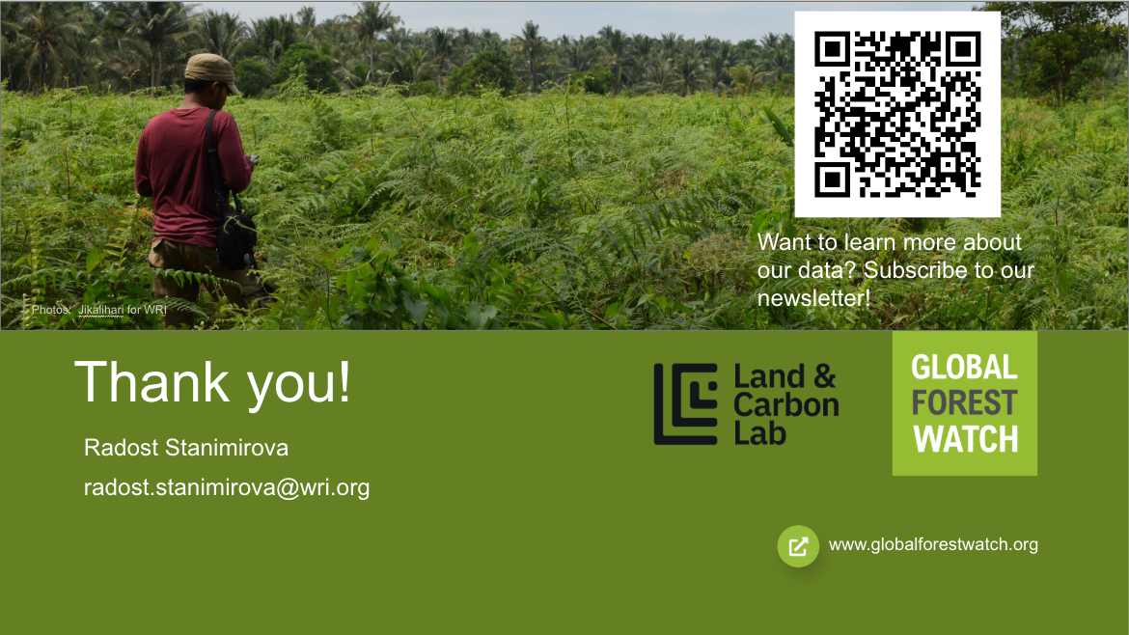
Notes:
Thank you so much for your time and attention. Please feel free to ask questions now or reach out to me via email at a later point. Here is a QR code if you would like to subscribe to our newsletter and receive information about updates and data releases.

Slide 21
Additional slides

Slide 22
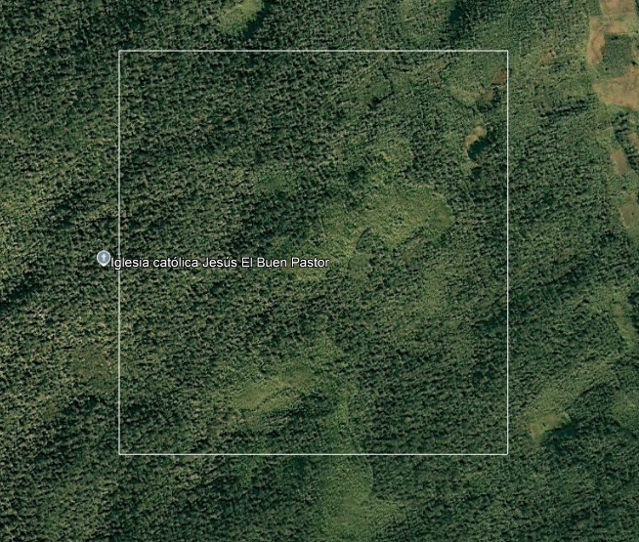
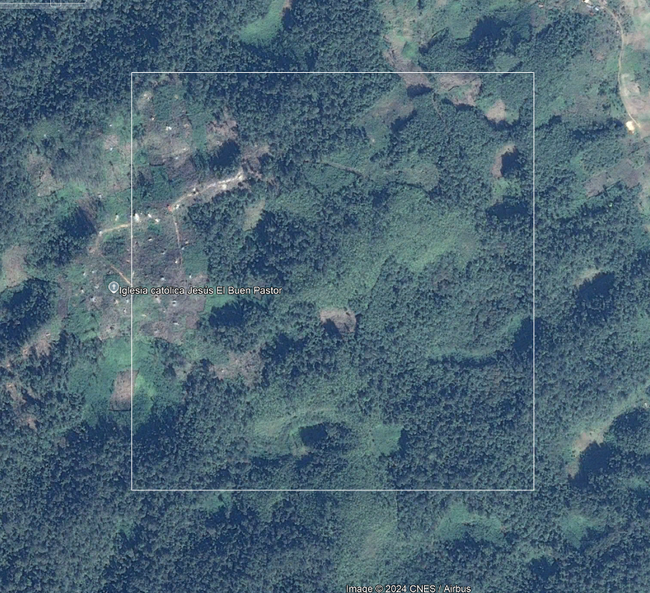
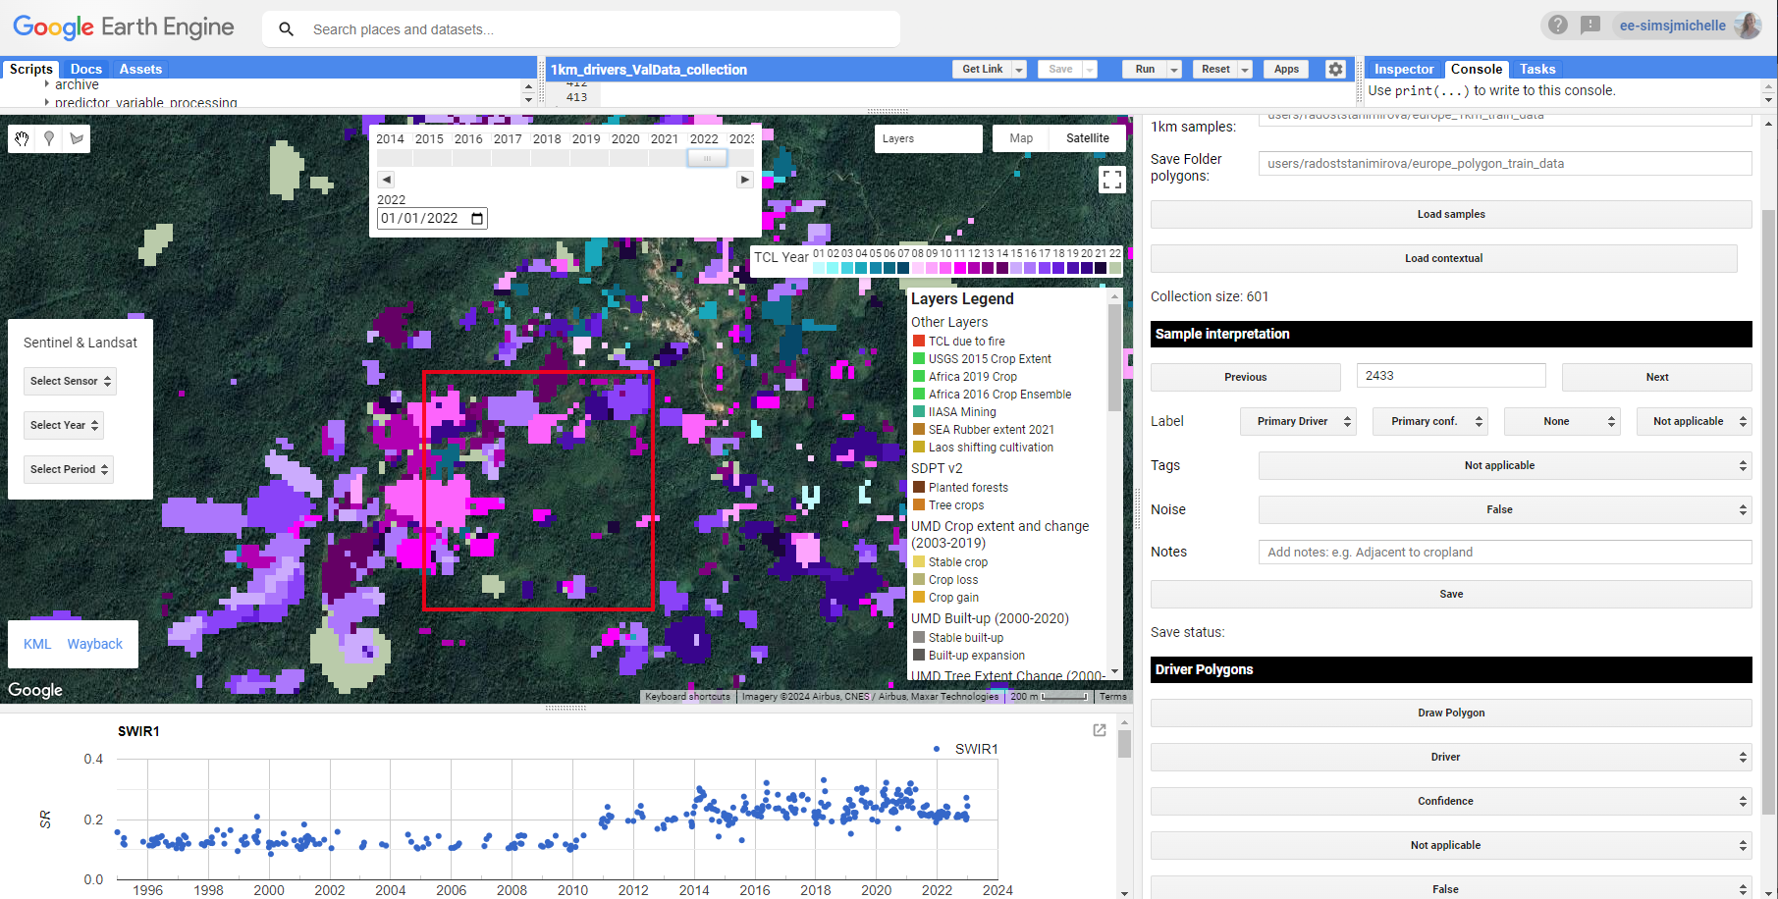
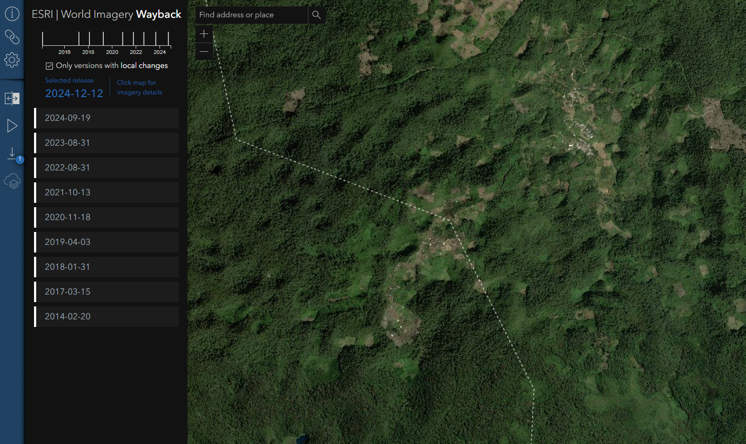
Training data collection
Google Earth Pro historical imagery
Google Earth Engine app to view Landsat and Sentinel-2 images, Planet, Landsat time series (SWIR1 and indices), loss data and other contextual layers, and record interpretation
ESRI Wayback historical imagery
Notes:
For interpretation, we developed an application in Google Earth Engine so that interpreters could load various data, including Landsat, Sentinel, Planet imagery, Landsat time series of SWIR1 and various indices, as well as the loss data and other contextual layers
Used very high resolution imagery from Google Earth Pro and Esri Wayback
Interpreters used the GEE interface to record their labels.
Image analysts recorded the primary, or dominant, driver, secondary driver (where applicable), confidence in assigning their label. Only the primary driver label was used for training. Each plot was reviewed for quality by senior analysts with domain expertise.

Slide 23
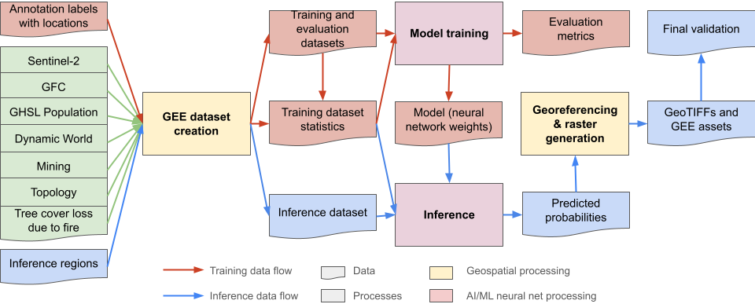
Overall flow of data and model training
Notes:
The diagram depicts the overall data flow or a pipeline that we used to generate and iterate on the model development.
Two main work flows:
Model training / iteration
Inference

Slide 24
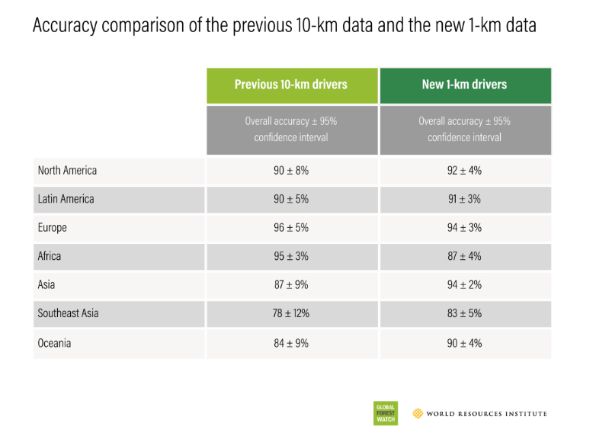
Accuracy improvements
Overall accuracy
89 ± 3%
91 ± 1%
Notes:
This tables shows the accuracy improvements we have been able to achieve with the new dataset. The rows show the different regions around the world, while the bottom shows the overall accuracy. The left hand side column shows the accuracy with the 10 km data while the right column shows the accuracy with the 1 km drivers. You can see that the overall accuracy is higher with the new data, and the regional accuracy is generally higher with the new product except for Africa and Europe.
This demonstrates to you all the quality of this work via an independent assessment.

Slide 25
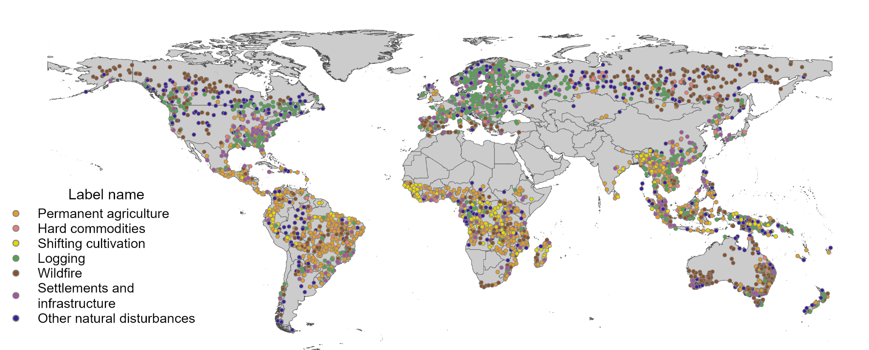
Validation data collection
Independent, probabilistic sample
Stratified random sample of 3,574 plots
49 strata: 7 driver classes and 7 regions
Estimated the proportion of forest loss from 2001-2022 attributed to each driver
Estimate overall, user’s, and producer’s accuracy
Notes:
Independent, probabilistic sample collected separately from training data
Collected a stratified random sample using a preliminary version of the drivers map. To determine optimal sample allocation:
We targeted standard errors from 0.05% to 0.2% for rare and common classes respectively, and 95% confidence interval
minimum sample size of 40 for rare classes and the rest were allocated proportionally
Sample size was a compromise between practical considerations (e.g., resources) and precision
Employed an unbiased estimator (ratio estimator) and calculated an associated uncertainty.
Used to estimate proportion of forest loss from 2001-2022 attributable to each driver globally and by region
1 km plots weighted by forest loss area within each cell
Calculated overall, producer’s and user’s accuracy
Samples collected using a similar workflow as training data collection

Slide 26
