Slide 1
Integrated Assessment of Climate Impacts of Grasslands Management and Afforestation
Modeling Climate Change Damages
G. Cornelis van Kooten
University of Victoria & Trinity Western University
Patrick Withey
St. Francis Xavier University
Xiaoli Fan
University of Alberta

Slide 2
Research Overview
Objective
Key Contributions
Examine the prospective reduction in climate-change damage estimates attributable to:
• Increased crop yields via rising atmospheric CO₂ (fertilization effect)
• Afforestation investments as an additional carbon dioxide removal (CDR) mechanism
• Improved grasslands management to enhance soil organic carbon stocks
Augmented Energy Balance Model (EBM)
Four carbon pools: atmosphere, land, upper & deep ocean
SSP Emission Pathways
Temperature projections 2005–2100 across SSP2, SSP3, SSP5
Dual Damage Functions
Nordhaus (DICE) vs. Weitzman specifications
Land Carbon Sink
CO₂ fertilization effect on GPP and NPP modelled explicitly
van Kooten, Withey & Fan (2026)

Slide 3
1st-stage Scenario-Based Integrated Assessment Models (IAMS):
Shared Socioeconomic Pathways (SSP) & Representative Concentration Pathways (RCP)
REMIND Potsdam Institute for Climate Impact Research, Germany
GISS Goddard Institute for Space Studies (NASA), U.S.
CSIRO Australian Commonwealth Scientific and Research Organization
GFDL Geophysical Fluid Dynamics Laboratory, U.S.
IAP Institute of Atmospheric Physics, China
IPSL Institut Pierre Simon Laplace, France
MPI Max-Planck Institute for Meteorology, Germany
GCAM Joint Global Change Research Institute, U.S.
AIM Asian Pacific Integrated Model, Japan
IMAGE Integrated Model to Assess the Greenhouse Effect, Netherlands
MARIA Multiregional Approach for Resource and Industry Allocation, Japan
MESSAGE Model for Energy Supply Strategy Alternatives & General Environmental Impact, IIASA, Austria
2nd-stage Global Climate Models (GCM)
3rd-stage Economic-Optimization IAMS

Slide 4
Stage I: Integrated Assessment Models (IAM)

Slide 5
GDP
POPULATION
TECHNOLOGY
NATURAL RESOURCE BASE
THE ECONOMY
Energy
Land use
Supply
– fossil fuel
– nuclear
– biomass
– wind & solar
– other
Demand
– transportation
– space heating
– electricity
– other
Supply
– cropland
– pasture
– forest
– biomass
– non-market
– other
Demand
– food
– fuel
– forest products
– ecosystem services
– other
Industrial/Commercial
Supply
– goods & services
Demand
– goods & services
POTENTIAL FEEDBACKS
Trade
General Structure of an Integrated Assessment Model used to Model Shared Socioeconomic Pathways and Representative Concentration Pathways
GREENHOUSE GAS EMISSIONS
CLIMATE MODEL

Slide 6
Five Most Prominent Integrated Assessment Models
IAM Name | Institution | Country
IMAGE | PBL Netherlands Environmental Assessment Agency | Netherlands
GCAM | Joint Global Change Research Institute (PNNL + UMD) | USA
REMIND | Potsdam Institute for Climate Impact Research (PIK) | Germany
MESSAGE-GLOBIOM | International Institute for Applied Systems Analysis (IIASA) | Austria
AIM | National Institute for Environmental Studies (NIES) | Japan

Slide 7
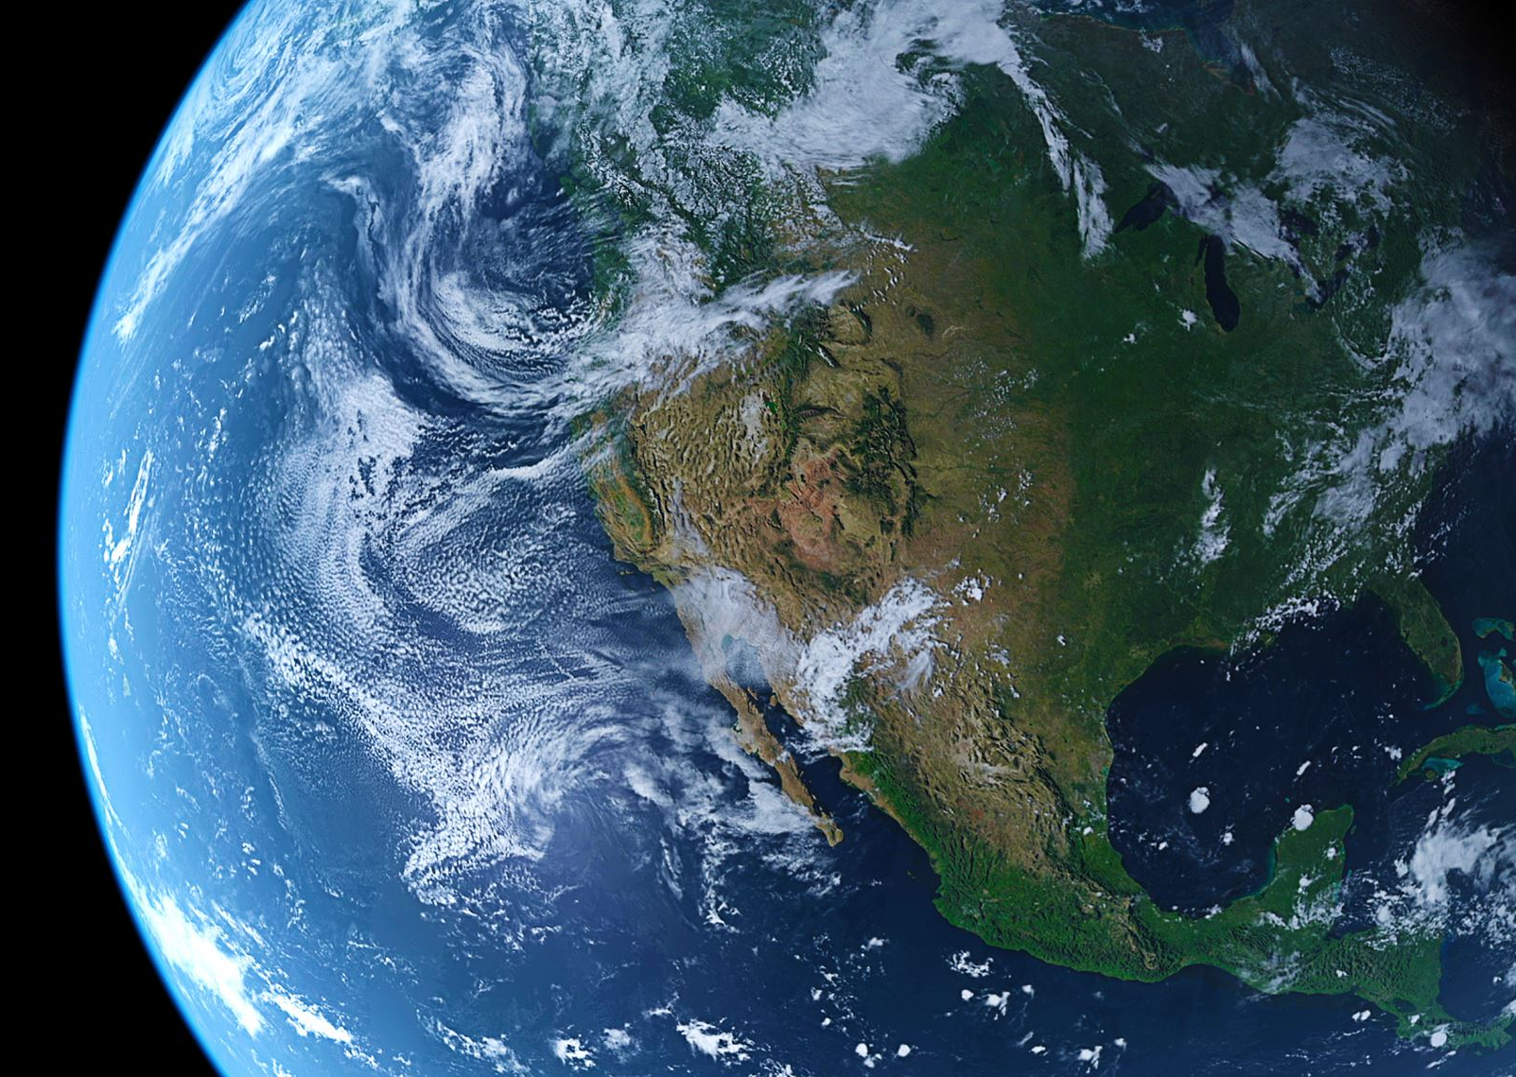
Five Main Shared Socioeconomic Pathways (SSP)
SSP1 (Sustainability): A world focused on sustainability and inclusive development.
SSP2 (Middle of the Road): A world following historical trends without major changes.
SSP3 (Regional Rivalry): A fragmented world with regional conflicts and slow economic growth.
SSP4 (Inequality): A world with high inequality and uneven development.
SSP5 (Fossil-fueled Development): A world with rapid economic growth driven by fossil fuels

Slide 8
Climate models use SSPs to calculate radiative forcing levels that align with the RCP as follows:
Socioeconomic assumptions: Each SSP outlines specific assumptions about population growth, economic development, energy use, and policy implementation.
Emission scenarios: Based on these assumptions, emission scenarios are developed. These scenarios consider how socioeconomic factors influence greenhouse gas emissions.
Climate modeling: The emission scenarios are fed into climate models to project future concentrations of greenhouse gases.
Radiative forcing calculation: The models calculate the resulting radiative forcing, which aligns with one of the RCPs.

Slide 9
Representative Concentration Pathways (RCP)
RCP2.6: A pathway aiming to keep radiative forcing below 3 W/m² (approx. current level), peaking around 2020, and then declining.
RCP4.5: A stabilization scenario where radiative forcing stabilizes at 4.5 W/m² after 2100.
RCP6.0: A stabilization scenario where radiative forcing stabilizes at 6.0 W/m² after 2100.
RCP8.5: A high-emission scenario with radiative forcing reaching 8.5 W/m² by 2100

Slide 10
4.43⁰C

Slide 11
Stage II: Climate Models
CMIP = Coupled Model Intercomparison Project
“Coupled” → models link atmosphere, oceans, land, and ice systems
“Intercomparison” → many research groups run standardized experiments so results can be compared
Purpose → improve climate models and assess climate change projections
In CMIP6 (used for IPCC AR6)
About 100+ models (depending on counting method)
~50 distinct modeling centers
Thousands of simulations (ensembles)--many more experiments than CMIP5
CMIP5 used e.g.: RCP2.6, RCP4.5, RCP8.5
CMIP6 used e.g.: SSP1-2.6, SSP2-4.5, SSP5-8.5

Slide 12
Stage III: Policy Optimization Models
Models employ their own climate modules
Dynamic Integrated Climate and Economy (DICE) model (Nordhaus)
Mathematical programming IAM written in GAMS
Main result: social cost of carbon
Climate Framework for Uncertainty, Negotiation and Distribution (FUND) (Tol)
Detailed simulation model originally written in C++; later Matlab
  For economic optimization, GAMS version is available but custom adaptations
Provides social cost of carbon and regional details (great deal of disaggregation)
Policy Analysis of the Greenhouse Effect (PAGE) (Chris Hope)
Employs Monte-Carlo simulation and less aggregated than FUND
Incorporates risk of catastrophic outcome (“fat tails”): focus on risk and uncertainty
Written in Excel using VBA for Monte-Carlo simulation, but proprietary

Slide 13
The Energy Balance
Climate Model (our study)
Four carbon pools, two temperature layers, SSP pathways

Slide 14
Augmented Energy Balance Carbon-Climate (EBCC) Model
Atmosphere
(CO₂)
Surface &
Deep Ocean
Temperature
(2-Layer EBM)
Economic
Damage D(T)
(% of GDP)
Land Carbon
(forests + grasslands)
→
→
Upper Ocean
↑
↑
SSP2 / SSP3 / SSP5
Emission Pathways
ECS: 0.75°C – 5°C+
(Equilibrium Climate Sensitivity)
Deep Ocean
Key inputs: CO₂ fertilization effect on land carbon pool · Afforestation area scenarios · SSP GDP projections (2005–2100)
van Kooten, Withey & Fan (2026) — adapted from van Kooten et al. (2021)

Slide 15
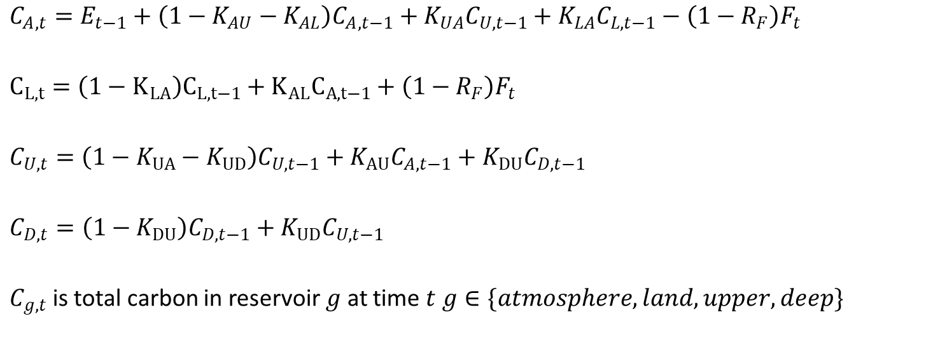
Four carbon pools & carbon fluxes (difference equations)
Land carbon pool was missing in DIC models
$C_{A,t}=E_{t−1}+\left(1−K_{AU}−K_{AL}\right)C_{A,t−1}+K_{UA}C_{U,t−1}+K_{LA}C_{L,t−1}−{\left(1−R_{F}\right)F}_{t}$
$C_{L,t}=\left(1−K_{LA}\right)C_{L,t−1}+K_{AL}C_{A,t−1}+{\left(1−R_{F}\right)F}_{t}$
$C_{U,t}=\left(1−K_{UA}−K_{UD}\right)C_{U,t−1}+K_{AU}C_{A,t−1}+K_{DU}C_{D,t−1}$
$C_{D,t}=\left(1−K_{DU}\right)C_{D,t−1}+K_{UD}C_{U,t−1}$
$C_{g,t}$ is total carbon in reservoir $g$ at time $t$ $g∈\{atmosphere, land, upper, deep\}$

Slide 16
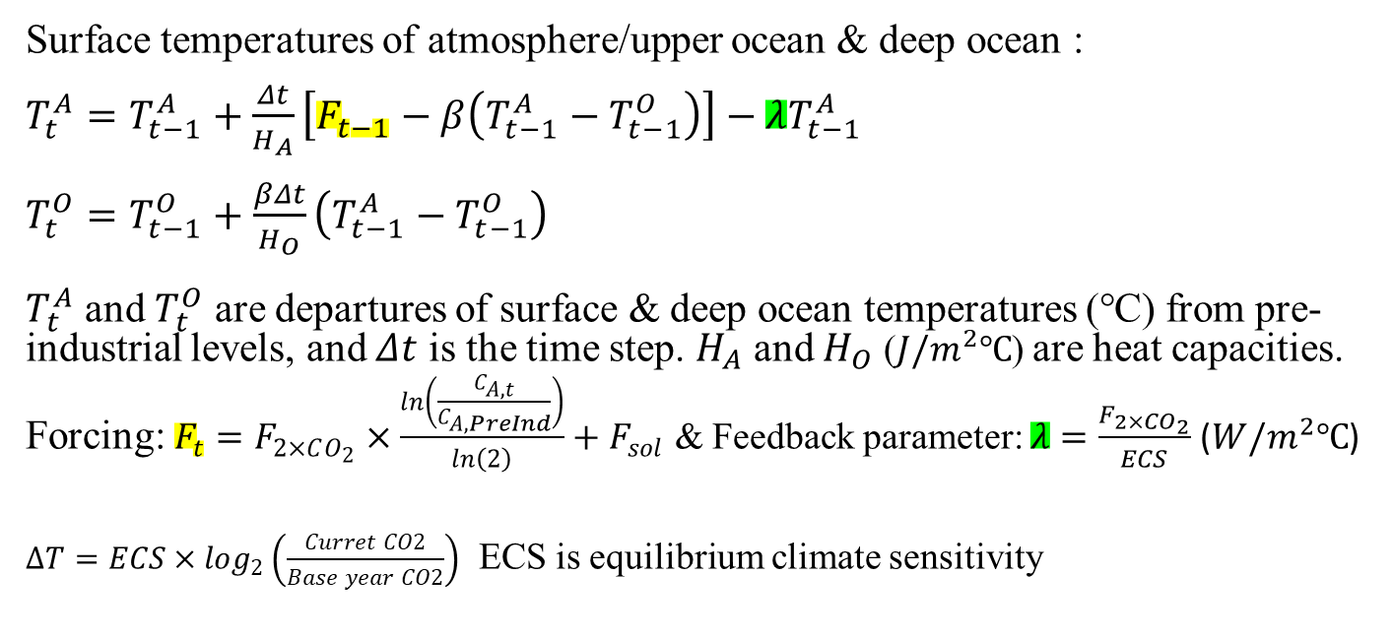
Climate model equations
Surface temperatures of atmosphere/upper ocean & deep ocean :
$T_{t}^{A}=T_{t−1}^{A}+\frac{Δt}{H_{A}}\left[F_{t−1}−β\left(T_{t−1}^{A}−T_{t−1}^{O}\right)\right]−λT_{t−1}^{A}$
$T_{t}^{O}=T_{t−1}^{O}+\frac{βΔt}{H_{O}}\left(T_{t−1}^{A}−T_{t−1}^{O}\right)$
$T_{t}^{A}$ and $T_{t}^{O}$ are departures of surface & deep ocean temperatures (℃) from pre-industrial levels, and $Δt$ is the time step. $H_{A}$ and $H_{O}$ ($J/m^{2}℃$) are heat capacities.
Forcing: $F_{t}=F_{2×CO_{2}}×\frac{ln\left(\frac{C_{A,t}}{C_{A,PreInd}}\right)}{ln\left(2\right)}+F_{sol}$ & Feedback parameter: $λ=\frac{F_{2×CO_{2}}}{ECS}$ ($W/m^{2}℃$)
$∆T=ECS×\log_{2}\left(\frac{Curret CO2}{Base year CO2}\right)$ ECS is equilibrium climate sensitivity

Slide 18
Comparison of EBM and CMIP5 Projected Temperature Pathways

Slide 19
Economic Damage
Functions
Nordhaus vs. Weitzman — divergent assumptions, divergent outcomes

Slide 20


Nordhaus vs. Weitzman Damage Functions
Nordhaus (DICE)
Weitzman (2010): thick tail specification
$$1−D\left(T\right)=\frac{1}{1+0.00236T^{2}}$$
$$1−D\left(T\right)=\frac{1}{1+{\left(\frac{T}{20.2}\right)}^{2}+{\left(\frac{T}{6.08}\right)}^{6.76}}$$
• Damages = 50% of GDP at +6°C warming
• Damages = 99% of GDP at +12°C warming
• Emphasises catastrophic tail risks neglected by Nordhaus
• Produces higher damage estimates at elevated temperatures
• Implies greater policy value for land-based CDR strategies
• Quadratic damage scaling with temperature
• D(T) represents share of GDP lost to climate change
• Moderate damages even at high temperatures
• Widely used in integrated assessment models (IAMs)
• Does not account for catastrophic tail risks
Nordhaus (2018); Weitzman (2010); Russell et al. (2022)

Slide 21
CO₂ Fertilization and Grasslands Management Effects
Carbon uptake by land biomass enhances the land-carbon sink by reducing CO₂ in the atmosphere. This lowers temperatures and thereby damages as proportion of GDP. Given GDP pathways for various SSP scenarios, we can calculate damages avoided.

Slide 22
CO₂ Fertilization & the Land Carbon Sink
56.4 GtC/yr
~120 GtC/yr
+31%
Global Terrestrial NPP (2020)
Estimated Global GPP
Rise in Global GPP since 1900
vs. 48.5 GtC/yr for oceans
NPP ≈ 47% of GPP
primarily CO₂ fertilization
(Haverd et al. 2020)
Mechanism: Elevated atmospheric CO₂ enhances photosynthetic carbon uptake (GPP) and improves water-use efficiency, increasing net primary production (NPP).
Historical Trend: GPP increased ~10–15% from 1980 to 2020 (~0.25–0.35%/yr), largely attributed to CO₂ fertilization.
IPCC Gap: The CO₂ fertilization effect on crop yields has been neglected in standard damage estimates, even though it was critical to the green revolution.
van Kooten, Withey & Fan (2026)

Slide 23
CO₂ Fertilization: Regional & Biome Variation in NPP
Estimated increase in NPP per 100-ppm rise in atmospheric CO₂ (pre-industrial to early 21st century)
Source: McGrath & Lobell (2013); Pan et al. (2014) — A2 scenario

Slide 24
Afforestation: Potential & Constraints
Sequestration Estimates
Key Considerations
Source | Area (Mha) | CDR (GtCO₂)
Sathaye et al. (2006) | 231 | 176
Humpenöder et al. (2014) | 2,800 | 700
Bastin et al. (2019) | 842.6 | —
Zanello & van Kooten (2024) weighted MAI: 2.31 m³/ha
Scale vs. Anthropogenic Emissions
Afforestation CDR is small relative to industrial CO₂ sources — limiting its standalone climate impact.
Carbon Flux Offset Effect
Increased land carbon sink stimulates fluxes to atmosphere and ocean, partially offsetting gains.
Ecosystem Co-Benefits
Biodiversity, water regulation, and local climate benefits remain substantial — even where global CDR impact is modest.
Regional Value
Afforestation may support specific regions in meeting locally-set emission-reduction targets.
Tropical regions hold the largest afforestation potential, with high growth rates.
(Doelman et al. 2020)
van Kooten, Withey & Fan (2026)

Slide 25
Grassland Carbon Stocks
Total Carbon
Grasslands store 650–810 GtC across all pools (White 2000; Liu et al. 2023)
Dominant Pool
71.5–89% is Soil Organic Carbon (SOC), mostly mineral-associated organic matter (MAOM)
vs. Forests
Unlike forests (where aboveground woody biomass dominates), grasslands hold carbon mainly belowground
Global Share
Grasslands store approximately one-third of all terrestrial carbon stocks
Source: White (2000); Bai & Cotrufo (2022); Liu et al. (2023)

Slide 26
Grassland Carbon Mitigation Potential
⚠ Large uncertainty ranges exist across all estimates. Carbon saturation limits long-run sequestration rates. (Georgiou et al. 2025)
Source: IPCC AR6 (2023); Bai & Cotrufo (2022)

Slide 27
Some Results
Carbon stocks, mitigation potential, and sequestration pathways

Slide 28
Afforestation Results, 850 million ha available for afforestation
 |  | Before Afforestation |  |  | Realistic Afforestationª |  |  | Optimistic Afforestation^{b}
Scenario | Total GDP | Nordhaus | Weitzman |  | Nordhaus | Weitzman |  | Nordhaus | Weitzman
SSP2 | 6,561,423 | 25,774.83 | 27,064.40 |  | 25,731.75 | 27,017.25 |  | 25,415.89 | 26,679.29
 |  | 0.39% | 0.41% |  | 0.39% | 0.41% |  | 0.39% | 0.41%
SSP3 | 5,089,831 | 41,190.09 | 46,036.75 |  | 41,135.05 | 45,955.84 |  | 40,610.41 | 45,299.38
 |  | 0.81% | 0.90% |  | 0.81% | 0.90% |  | 0.80% | 0.89%
SSP4 | 6,057,761 | 64,784.68 | 75,978.98 |  | 64,688.23 | 75,811.93 |  | 63,813.95 | 74,565.08
 |  | 1.07% | 1.25% |  | 1.07% | 1.25% |  | 1.05% | 1.23%
SSP5 | 9,996,684 | 257,181.93 | 605,165.37 |  | 256,822.83 | 602,884.78 |  | 254,214.94 | 591,960.10
 |  | 2.57% | 6.05% |  | 2.57% | 6.03% |  | 2.54% | 5.92%
ª Half of 850 Mha planted in about 25 years, with any afforested land subsequently experiencing a MAI of 5 m³/ha in perpetuity.
^{b} The 850 Mha that is available for afforestation is planted immediately with mean annual increment of 10 m³/ha in perpetuity.

Slide 29
Key Findings & Conclusions
Limited Global CDR Impact
Damage Function Matters
01
Afforestation and grasslands management produce only a modest reduction in global atmospheric CO₂ under SSP2–SSP5 scenarios. Increased carbon flux offsets (release from land to other sinks) partially negate sequestration benefits.
03
Weitzman's specification amplifies the value of land management compared to Nordhaus, due to heavier tail risk weighting — important for policy design under deep uncertainty.
CO₂ Fertilization Neglected
Regional & Ecosystem Co-Benefits
02
Standard damage functions overlook CO₂ fertilization effects on crop yields — a critical omission given the ~31% rise in global GPP since 1900 and the green revolution's dependence on this effect.
04
Even where global warming mitigation is minimal, afforestation and grasslands management deliver substantial biodiversity, water, and local climate co-benefits that justify investment.
van Kooten, Withey & Fan (2026)

Slide 30
Thank You
Questions & Discussion
G. Cornelis van Kooten
Department of Economics, University of Victoria
School of Business, Trinity Western University
Patrick Withey · Xiaoli Fan
Working paper — February 2026
Afforestation, Improved Grasslands Management & CO₂ Fertilization on Climate Change Damage Estimates

Slide 31
Zoom link: https://dorisduke-org.zoom.us/s/95863181321
Meeting ID: 958 6318 1321
Passcode: 832009

